Slide 1
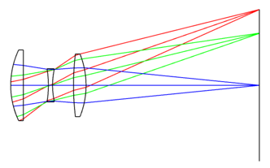
Triplet Lens Design: Reducing Aberrations with Ansys Zemax OpticStudio®
Developed and curated by the Ansys Academic Development Team
Harriet Parnell
education@ansys.com
This lecture unit is based on an example taught by Dr. F. Bociort in the course AP3391 Geometrical Optics at Delft University of Technology

Slide 2
Learning objectives
This tutorial uses the Cooke triplet as an example to guide you through the basic process of designing a lens. You’ll start with a single lens, analyze its performance, and observe its limitations. The tutorial then demonstrates how adding more components can enhance the system’s performance. Finally, you'll learn how to optimize the design to improve overall image quality, reducing aberrations and achieving better results.
Software used: Ansys Zemax OpticStudio®, optical system design and analysis software.
By the end of this tutorial, you should be able to:
Learn how to setup an optical system in the Sequential Mode of OpticStudio software.
Evaluate the system performance using available analysis tools.
Understand basic concepts of optimization including setting variables and using the Merit Function Editor.
Notes:
Here are the learning objectives for this tutorial.

Slide 3
How to use this tutorial
Content: Follow the step-by-step process outlined in the slides, using the screenshots from OpticStudio software for guidance.
Notes: This section provides additional context to support educators in teaching this material.
Notes:
What to expect as you work through this tutorial.

Slide 4
Specifications
In this tutorial, we will design and optimize an optical system, beginning with an F/5 singlet lens made of SK16 glass, intended for use as a photographic objective.
The final design solution shall meet the following specifications and constraints:
Specification | Constraint
Focal length | 50 mm
Entrance Pupil Aperture | 10 mm
AFOV | 20 degrees
Wavelength | F, d, C preset
Object location | At infinity
Optimization criteria | RMS Spot Size averaged over AFOV
Notes:
Design Specification Overview

Slide 5
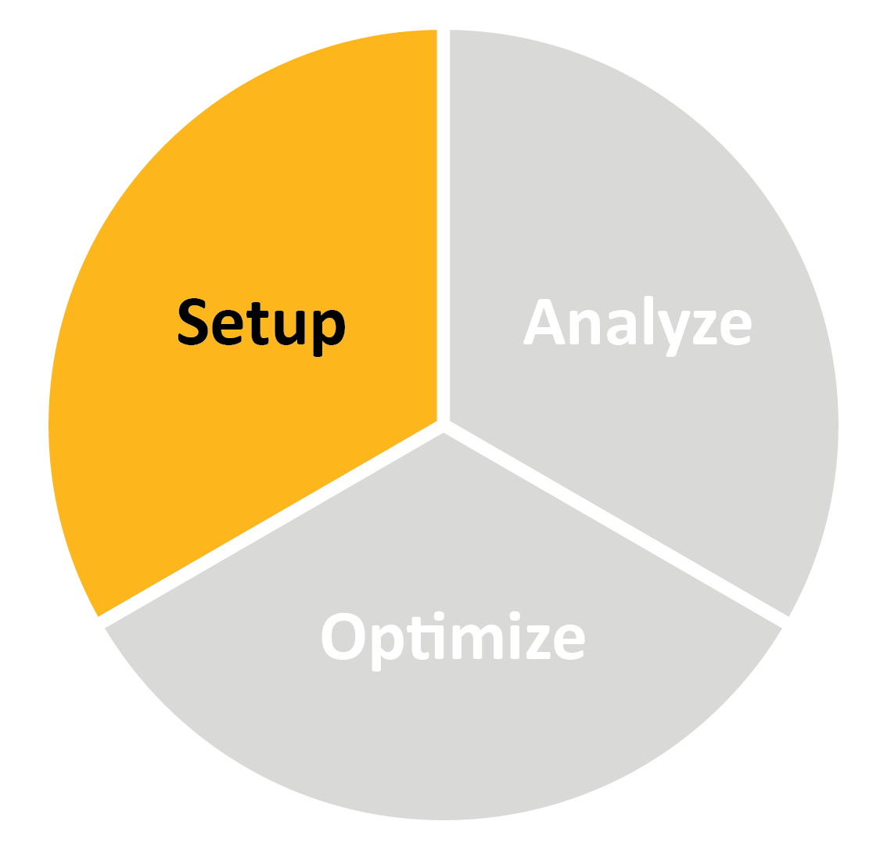
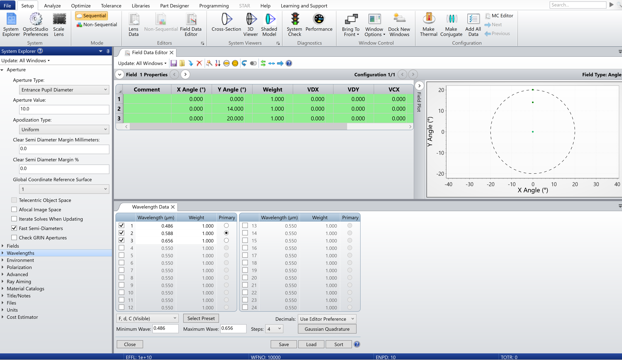
Triplet lens design tutorial
Step 1: initial system parameters
Aperture: 10 mm Entrance Pupil Diameter
Create a 20° half field of view. Choose three points e.g. 0°, 14°, and 20°
Select the F,d,C preset for the wavelengths
a
b
c
Notes:
Step 1:
If it is not already open, go to the System Explorer under the Setup tab.
Expand the Aperture drop down, select ‘Entrance Pupil Diameter’ type and enter 10.00 mm as the aperture value.
Expand Field and select Add Field. Make sure Angle* is selected as the field type. Specify three y-values as 0°, 14°, and 20°. Because the system is rotationally symmetric, we do not need to explicitly specify -0°, -14°, and -20° in the y-field.
Expand Wavelengths in the system explorer and select Settings. Select F, d, C (Visible) from the drop-down menu. Click Select Preset. Three wavelengths of 0.486 μm, 0.588 μm, and 0.656 μm) are now available.
* When ‘Angle’ is selected as the field type, we are specifying the field of view (FOV) that we are adjusting is the angular field of view (AFOV). For example, by specifying the y-value as 20°, we are saying that the AFOV can see 20° above and below the center axis. In this case, the AFOV is specified by the half angle. This option is most useful when at infinite conjugates.

Slide 6
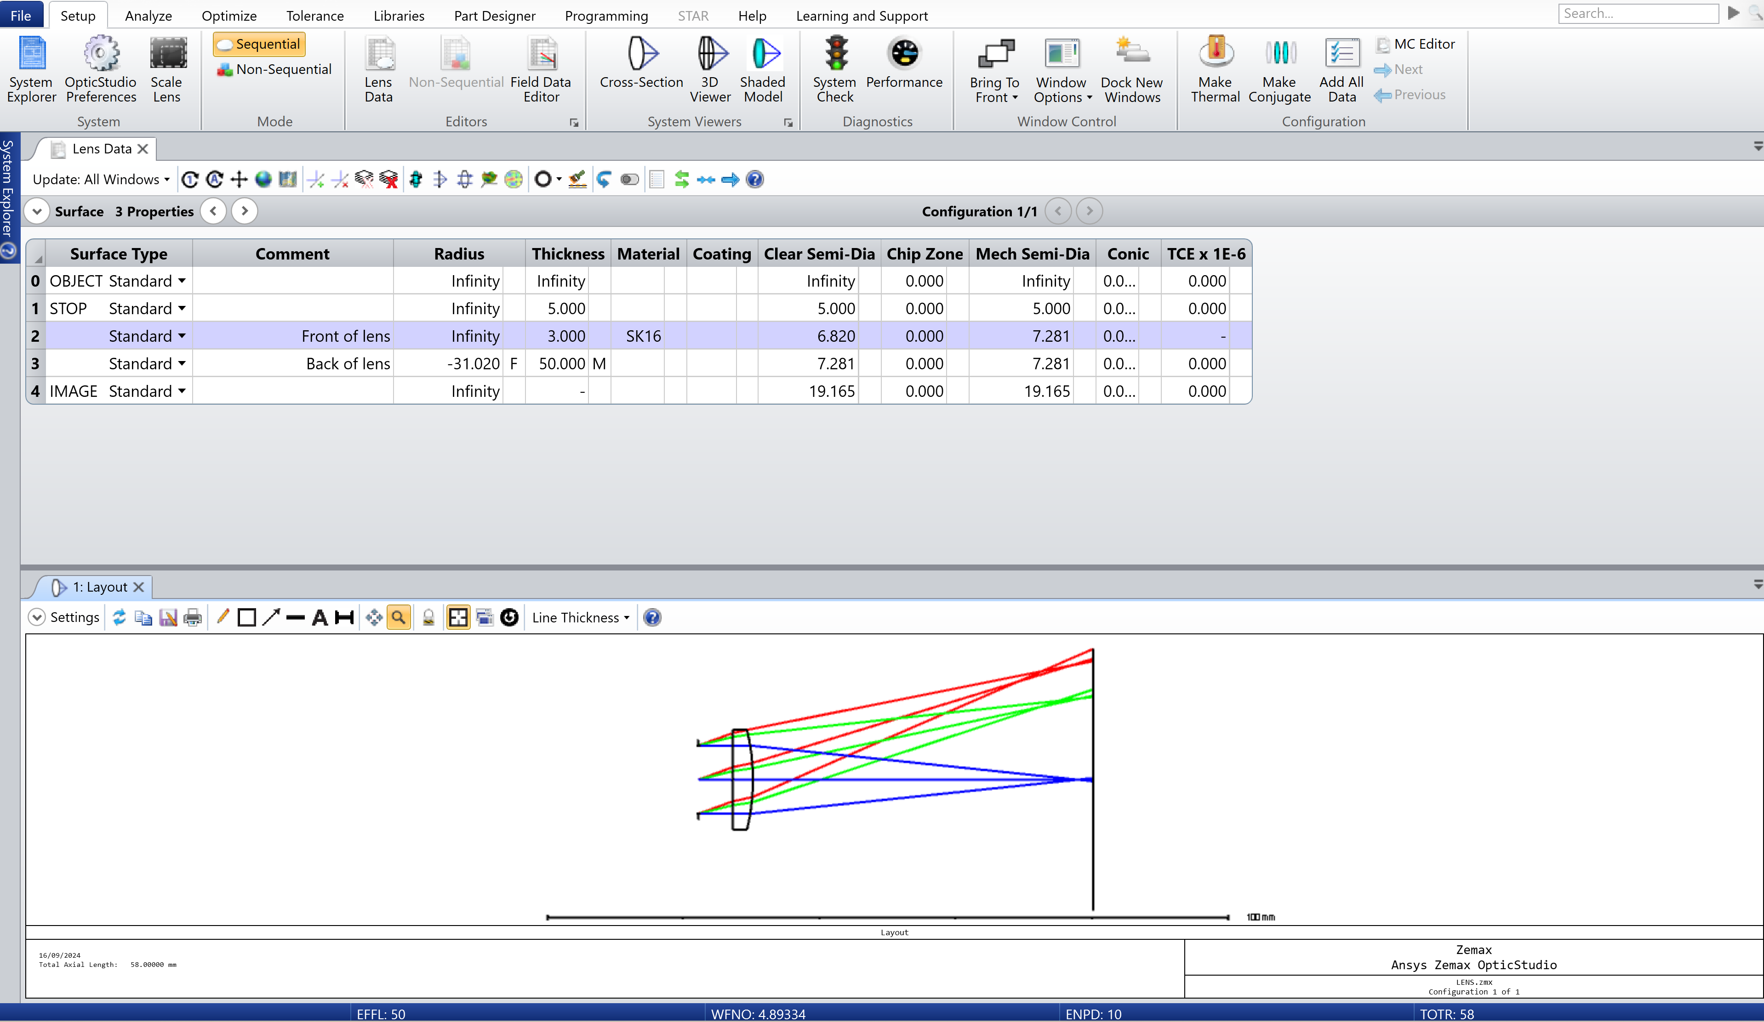
Triplet lens design tutorial
Step 2: Lens Data
To optimize a system, we need a starting point.
Let’s begin with a 3 mm thick single lens, made from SK16 with an f/# = 5.
Geometry and materials data
Q
Visualize system
Further thinking:
1. What kind of material is SK16?
2. What is a Plano-Convex (PCX) Lens?
Notes:
Step 2:
Open Lens Data under the Setup tab and insert two new surfaces after either by right clicking on a surface and selecting ‘insert object’ or by pressing ‘insert’ on your keyboard.
Insert the following data:
For surface 1, add a 5 mm air gap from STOP to the front of lens.
For surface 2, add a 3 mm thick lens, made of SK16 glass.
For surface 3, use F-number solve to adjust the radius of curvature to maintain the system at f/50. Then add a 50 mm air gap from back of lens to image plane, including a Marginal Ray Height solve on the thickness, keeping default values of height and pupil zone at 0.
Open the Cross-Section layout under the Setup tag and view the current system.
Q: What kind of material is SK16?
A: SK16' is a type of Schott optical glass with a refractive index of 1.620 at the d-line and an Abbe number of 60.32 at the same wavelength. Its high refractive index allows for compact lens designs by bending light more effectively, while its moderate Abbe number provides a good balance of dispersion to manage chromatic aberrations. These properties make SK16 an effective material for improving optical system performance and reducing spherical aberration. You can find more details about this glass, and others, in the Materials Catalog, found under the Libraries tab.
Q: What is a Plano-Convex (PCX) Lens?
A: A Plano-Convex (PCX) lens has one flat surface and one convex surface. It's commonly used to focus light by converging parallel rays to a single focal point on the convex side. This lens design is effective in minimizing spherical aberrations when the flat side faces the light source, making it useful in applications like imaging systems, laser optics, and beam collimation.

Slide 7
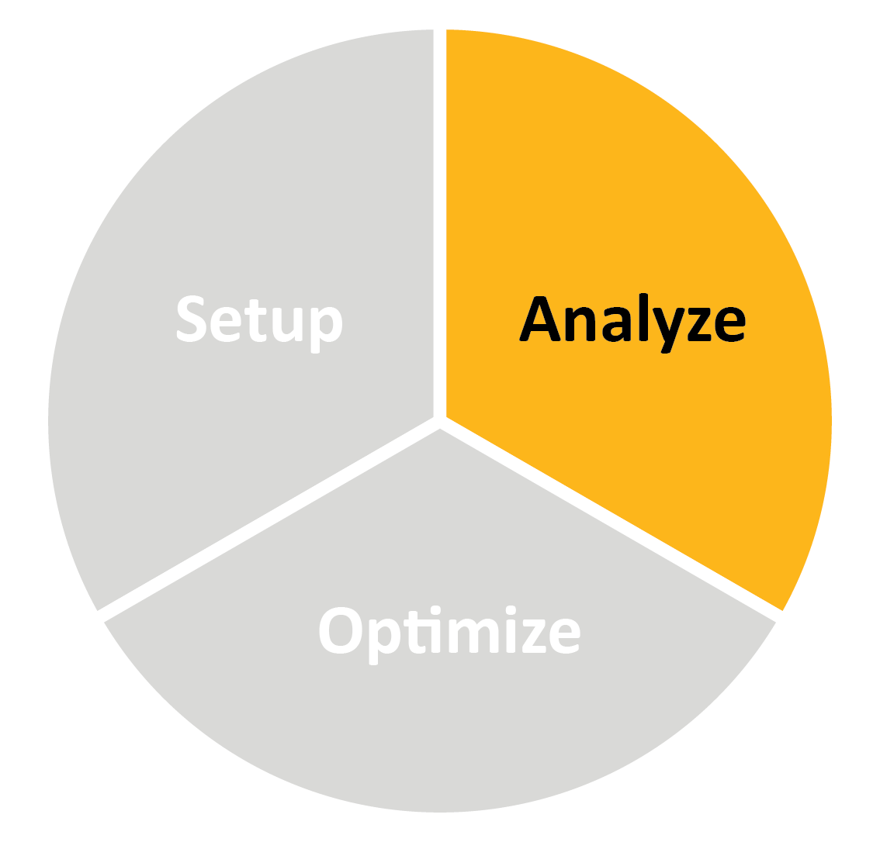
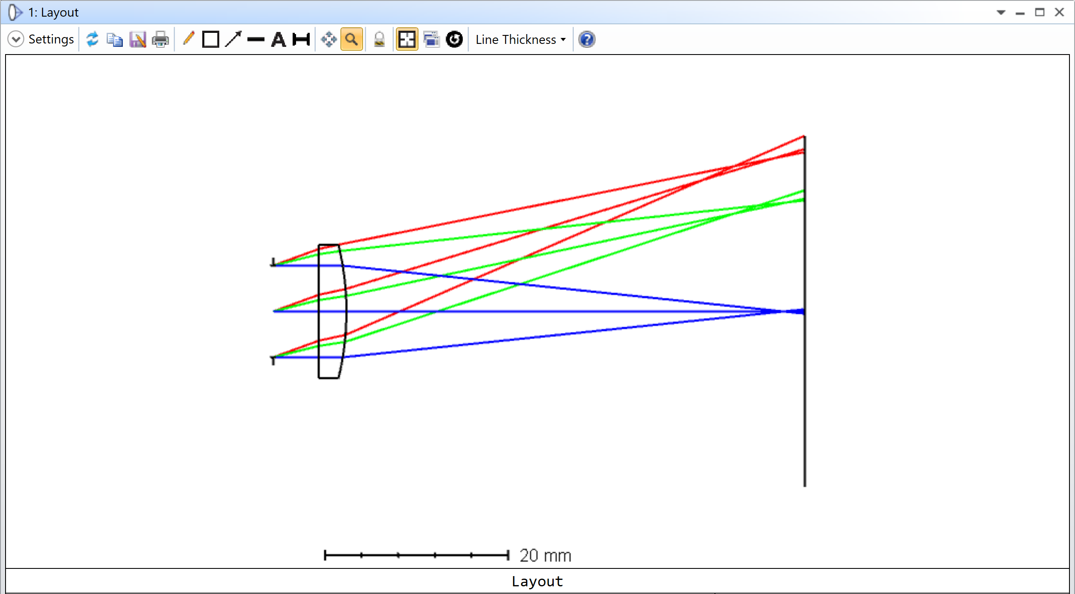
Triplet lens design tutorial
Step 3.1 analyze starting system
Expand the Layout view to observe the starting rays.
Q
What aberration can you identify? Explain the phenomenon.
Notes:
Step 3.1:
Expand Layout window to take a closer look at the rays.
Q: What aberration can you identify?
A: Field curvature.
Explanation: Field curvature is an optical aberration that occurs because lenses inherently focus light onto a curved surface rather than a flat image plane. This happens due to the varying angles at which light rays enter the lens: rays entering near the edges of the lens focus at a different plane than those entering near the center. Consequently, when focusing on the center of the image, the edges may appear out of focus, and if you adjust to focus on the edges, the center may become blurry. This aberration is particularly pronounced in wide-angle lenses and is noticeable when imaging flat subjects, such as documents
How is Field Curvature Corrected?
Several methods can help correct field curvature:
Lens Design: Combining different types of lenses (like convex and concave lenses) in a single system can counteract the curvature effect.
Curved Sensors: Some advanced imaging systems use curved sensors that match the curvature of the image plane, reducing or eliminating the aberration.
Stopping Down: Reducing the aperture size (increasing the f-number) can increase the depth of field, making the curvature less noticeable by bringing more of the image into acceptable focus.

Slide 8
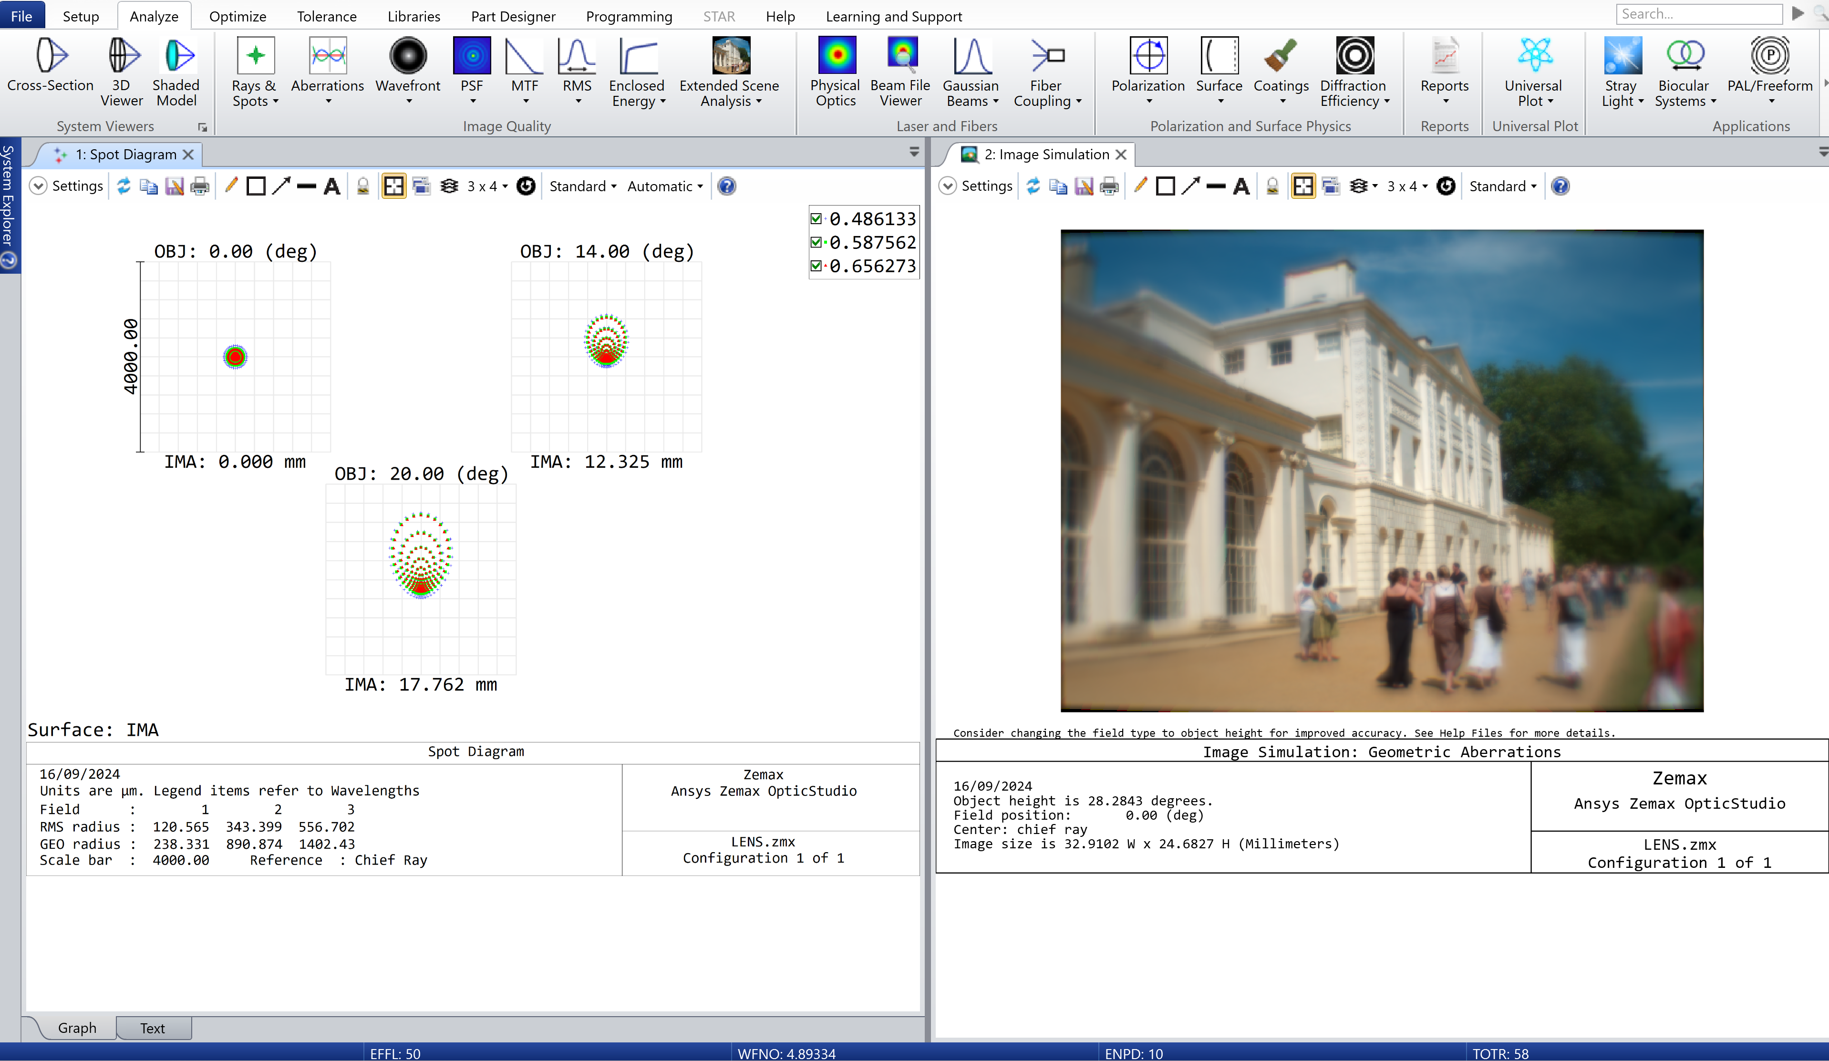
Triplet lens design tutorial
a
b
Step 3.2 analyze starting system
a. Spot Diagram: Traces ray bundles through the system to display their distribution on a specific surface.
Key observation:
Here we have a large spot size which distorts towards the edge of the field.
b. Image Simulation
Simulates the formation of images by convolving a source bitmap file with an array of Point Spread Functions.
A useful visualization tool!
Notes:
Step 3.2:
Under the Analyze tab, open:
Standard spot diagram found under the Rays & Spots drop down.
Image Simulation found under the Extended Scene Analysis. Initially this may show a grids and line image, but it can be changed to a demo picture using the settings.
More information about each analysis tool can be found within the help (?) feature in OpticStudio. Here is a summary:
a. Spot diagram: Traces ray bundles through the system to display their distribution on a specific surface.
Overview:
Spot diagrams in optical systems help visualize how light rays converge, considering various factors like diffraction, aberrations, and distortions. Different ray patterns (hexapolar, square, or dithered) and reference points (chief ray, centroid, etc.) influence the diagram's appearance. Key metrics include the GEO spot radius, which measures the farthest ray from the reference point, and the RMS spot radius, which gives an overall spread of rays.
The Airy disk represents the smallest spot size due to diffraction, and if the rays fit within it, the system is "diffraction limited." The spot diagram can show the Airy disk for scale, though it's only an approximation in non-uniformly illuminated or vignetted systems. Ray grids are generated based on wavelength weighting and apodization, with the RMS spot radius reflecting these factors but providing only an estimate of spot size accuracy. The spot diagram also displays coordinates of the reference point, aiding in understanding the optical system's performance.
Points for analysis:
Spot Size and Shape:
Small, Round Spot: Indicates good optical performance with minimal aberrations. Ideally, the spot should be small and close to the size of the Airy disk for a diffraction-limited system.
Large or Distorted Spot: Suggests significant aberrations, indicating that the system is not focusing light effectively.
Comparison with Airy Disk:
If the spots fit within the Airy disk, the system is likely diffraction-limited, meaning that the performance is as good as physically possible given diffraction limits.
If the spots are larger than the Airy disk, the system's performance is limited by aberrations rather than diffraction.
Distribution of Rays:
Symmetry: Symmetrical patterns suggest fewer aberrations. Asymmetrical or scattered patterns can indicate issues like coma or astigmatism.
Centering: If the spot is centered around the reference point (chief ray or centroid), the system is likely well-aligned. Off-center spots might indicate misalignment.
GEO and RMS Spot Radii:
GEO Spot Radius: Shows the maximum spread of rays; a large value suggests significant aberrations.
RMS Spot Radius: Provides an overall measure of how spread out the rays are, giving a sense of the average performance across the field.
Field Dependence:
Variation Across the Field: Check how the spot size and shape change across different field points. Consistency indicates uniform performance, while variation might point to issues like field curvature or astigmatism.
Color (Chromatic) Aberrations:
If using multiple wavelengths, examine if different colors focus at different points, which would indicate chromatic aberration.
Observation for this singlet lens: the optical system has significant aberrations, particularly at the edges of the field. The "large spot size" indicates that the rays are not converging well, leading to a blurry image. The fact that the spot "distorts towards the edge of the field" suggests that off-axis aberrations like coma or astigmatism are present, causing the spot to stretch or skew as you move away from the center of the field.
b. Image Simulation:
The algorithm simulates the appearance of an image after passing through an optical system by accounting for optical aberrations, diffraction, geometric distortions, and other effects. It computes a grid of PSFs, which are interpolated for each pixel, and then convolves this with the source image to produce the final simulated image. This process is crucial for accurately modeling how an image would look when viewed through different optical systems, considering various physical effects like diffraction, aberrations, and polarization.
For students, or industry professionals, who are not familiar with optical aberrations, this makes for a useful visual aid.

Slide 9
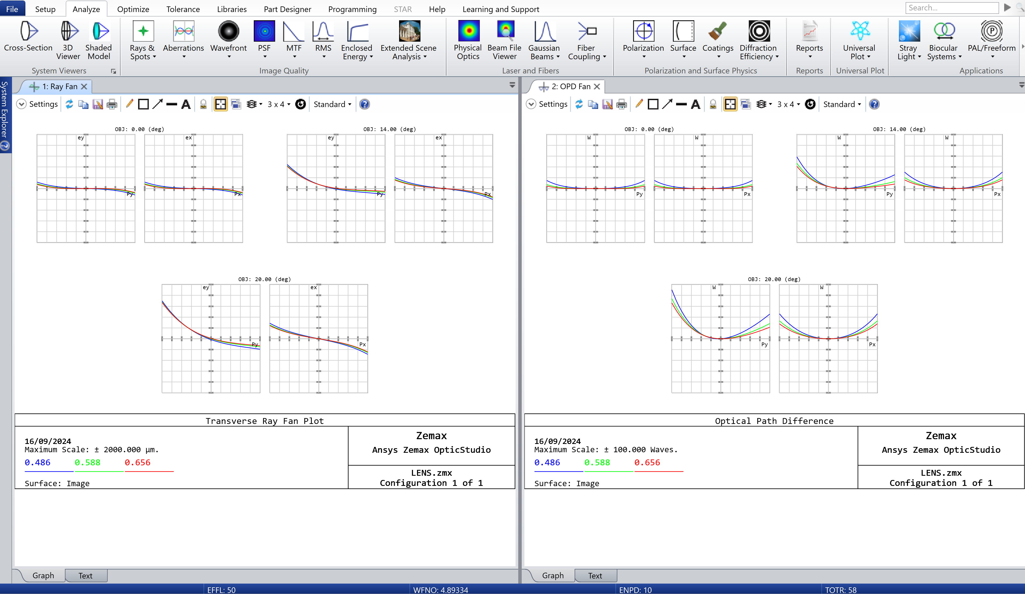
Triplet lens design tutorial
Step 3.3 analyze starting system
c. Ray Fan: Shows ray aberrations as a function of pupil coordinate
Key observation:
Asymmetry in ray fan plots, especially worsening towards the edge of the pupil, is typical of field curvature and spherical aberrations. The difference between x and y also indicates astigmatism.
d. OPD Fan: Shows optical path difference as a function of pupil coordinate.
Key observation:
A large trough in the OPD plot, worsening towards the pupil's edge, typically indicates spherical aberration. Asymmetry in the plot may also suggest the presence of coma. The difference between x and y also indicates astigmatism.
Notes:
Step 3.3:
Under the Analyze tab, open:
Ray Aberration and Optical Path found under the Aberrations drop down
More information about each analysis tool can be found within the help (?) feature in OpticStudio. Here is a summary:
c. Ray Fans: Shows ray aberrations as a function of pupil coordinate.
Tangential Ray Fans show how light rays deviate in the vertical direction (y-axis) as they pass through the lens. The graph plots the difference between where a ray hits and where the central (chief) ray hits, helping us identify vertical aberrations. The horizontal scale on the graph represents the position of the ray in the lens, while the vertical scale shows the difference from the ideal focus.
Sagittal Ray Fans do the same thing but focus on the horizontal direction (x-axis). This helps identify horizontal aberrations.
Labels and Components: When the plot shows vertical deviations, it’s labeled EY. For horizontal deviations, it’s labeled EX. These graphs help us understand how well the lens focuses light but don’t fully describe the lens's performance because they only look at two directions (vertical and horizontal).
Wavelength Considerations: If the graph shows data for multiple wavelengths, the main wavelength’s central ray is used as a reference. When switching between single (monochromatic) and multiple wavelengths, the data might change, so it's important to know what wavelength you're focusing on.
Limitations: These plots are great for spotting specific types of lens distortions, but they don’t tell the whole story, especially for complex lenses that aren’t perfectly symmetrical.
d. Optical Path:
The options are identical to those for ray aberration fans, except the only option for "Tangential" and "Sagittal" is Optical Path Difference (OPD), since OPD is a scalar quantity.
OPD measures how much the optical path length of a ray deviates from that of the chief ray (the central ray) as it travels through the optical system. It shows the difference between the actual path of light and the ideal path.
Graph Details:
Vertical Axis: Shows the OPD values, which represent deviations in the optical path length. These values are often expressed in terms of wavelengths, indicating how much the path differs relative to the wavelength of light.
Horizontal Axis: Represents positions across the entrance pupil, normalized to show where these deviations occur in the system.
Reference Points:
When plotting for multiple wavelengths, the OPD is referenced to the primary wavelength's reference sphere and chief ray, but values are shown in terms of each wavelength’s own scale.
For monochromatic (single wavelength) analysis, the OPD values are referenced to the sphere and chief ray of that specific wavelength.
Infinite Conjugates:
For systems with infinite conjugates (where objects are far away), a reference plane is defined at the intercept of the chief ray with the first surface. This reference is oriented perpendicular to the chief ray, and the OPD calculation starts from this plane, assuming the wavefront is initially a plane wave.

Slide 10
Identifying aberrations (1)
OpticStudio software offers numerous analysis features to evaluate your system's performance. This table (continued on the next slide) summarizes key indicators for Focus, Distortion, Astigmatism, Coma, Spherical Aberrations, and Field Curvature.
Notes:
There is more support to help you identify which aberrations are present in your optical system.

Slide 11
Identifying aberrations (2)
Notes:
There is more support to help you identify which aberrations are present in your optical system.

Slide 12
Optimization
Heuristic approach to system refinement:
Introducing more parameters for greater degrees of freedom.
Design requirements:
Constant effective focal length of 50 mm
Correct seven primary aberrations
Total: 8 parameters needed
Calculating degrees of freedom:
One lens: provides two degrees of freedom (2 surface curvatures).
Two lenses: provides four degrees of freedom (4 curvatures).
Three lenses: provides six degrees of freedom (6 curvatures)
Three lenses + two air gaps: provides eight degrees of freedom
For a simpler example, see this tutorial on singlet lens optimization.
Notes:
So far, we've created a system with a singlet lens and identified significant aberrations. While there are several ways to improve this system, this tutorial will focus on a heuristic approach—adding more lenses to increase the degrees of freedom.
For a simpler example, follow the link to explore optimization of a singlet lens.

Slide 13
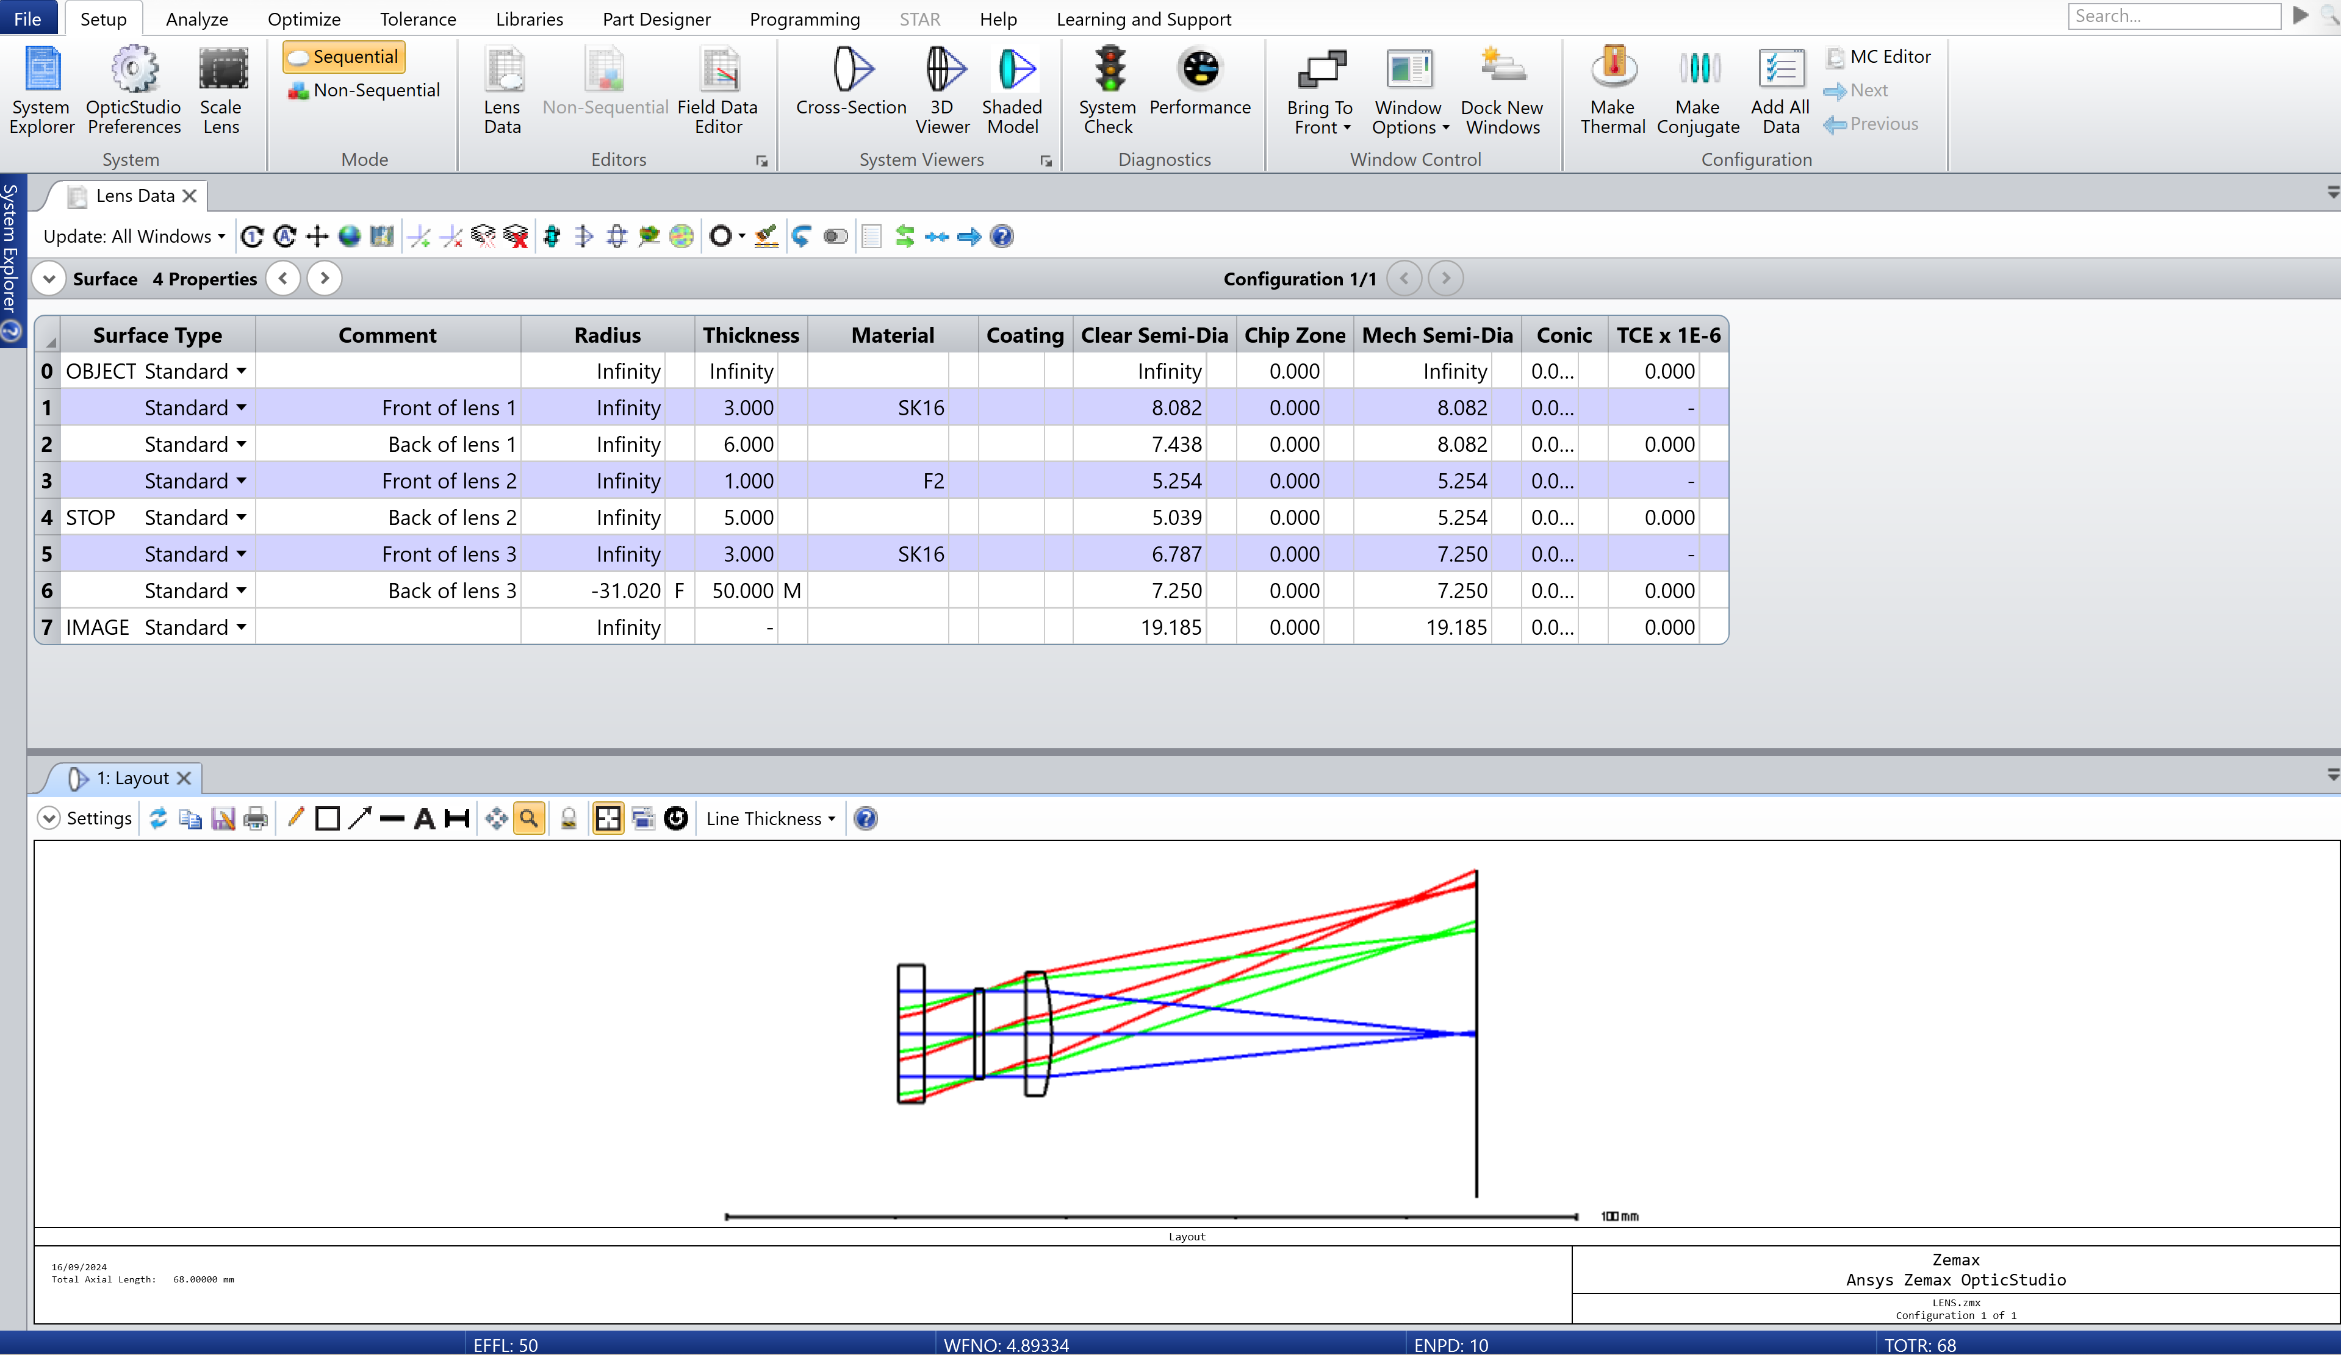
Triplet lens design tutorial
Step 4: update lens data
a
b
Add two parallel plate lenses before the STOP:
The first a 3 mm thick SK16 lens, followed by a 6 mm air gap
The second a 1 mm thick F2 lens, followed by a 5 mm air gap
Notes:
Step 4:
Return to the Lens Data under the Setup tab.
Add two new parallel plate lenses before the STOP, as described on the slide.
The first a 3 mm thick SK16 lens, followed by a 6 mm air gap
The second a 1 mm thick F2 lens, followed by a 5 mm air gap
At this point, it is helpful to add comments to help identify each surface.
Now you can see three lenses in our optical system layout.

Slide 14
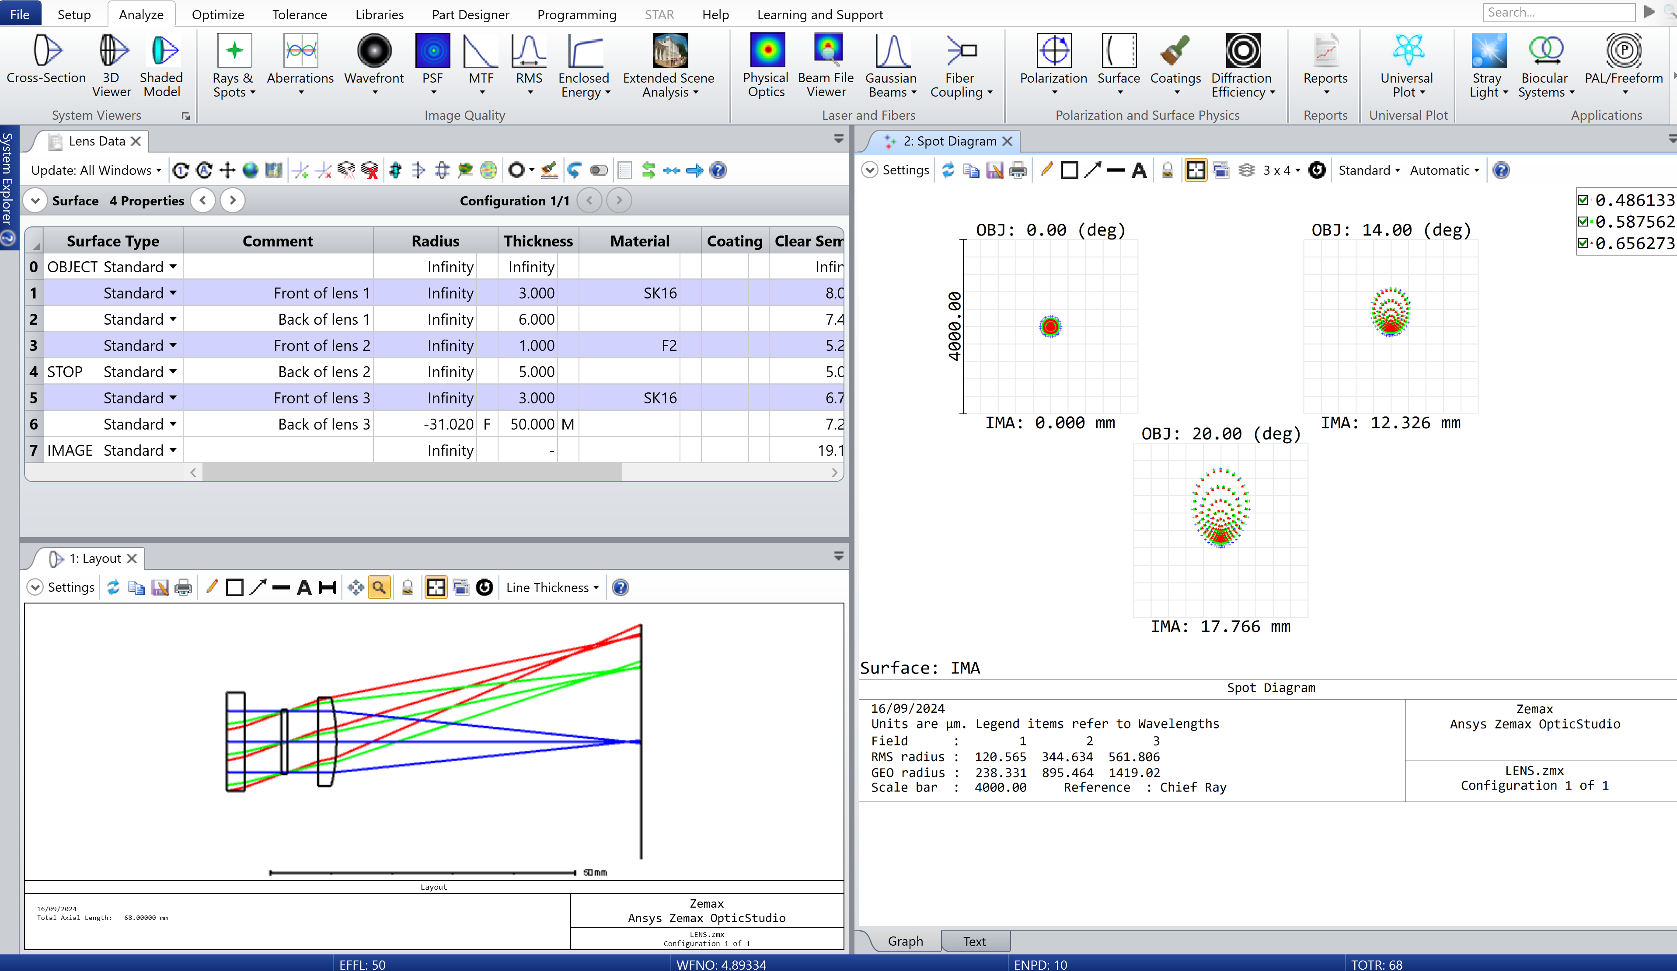
Triplet lens design tutorial
Prior to optimization, make note of the starting spot sizes:
At 0° RMS radius: 120.565 μm
At 14° RMS radius: 344.634 μm
At 20° RMS radius: 561.806 μm
Notes:
At this stage there will be no improvements to the system.
Throughout this example, we will focus on the spot diagram to observe improvements as we gradually optimize the system. Therefore, it is helpful, to make note of the starting values, highlighted here.
At 0° RMS radius: 120.565 μm
At 14° RMS radius: 344.634 μm
At 20° RMS radius: 561.806 μm
The scale bar also reads 4000 μm.

Slide 15
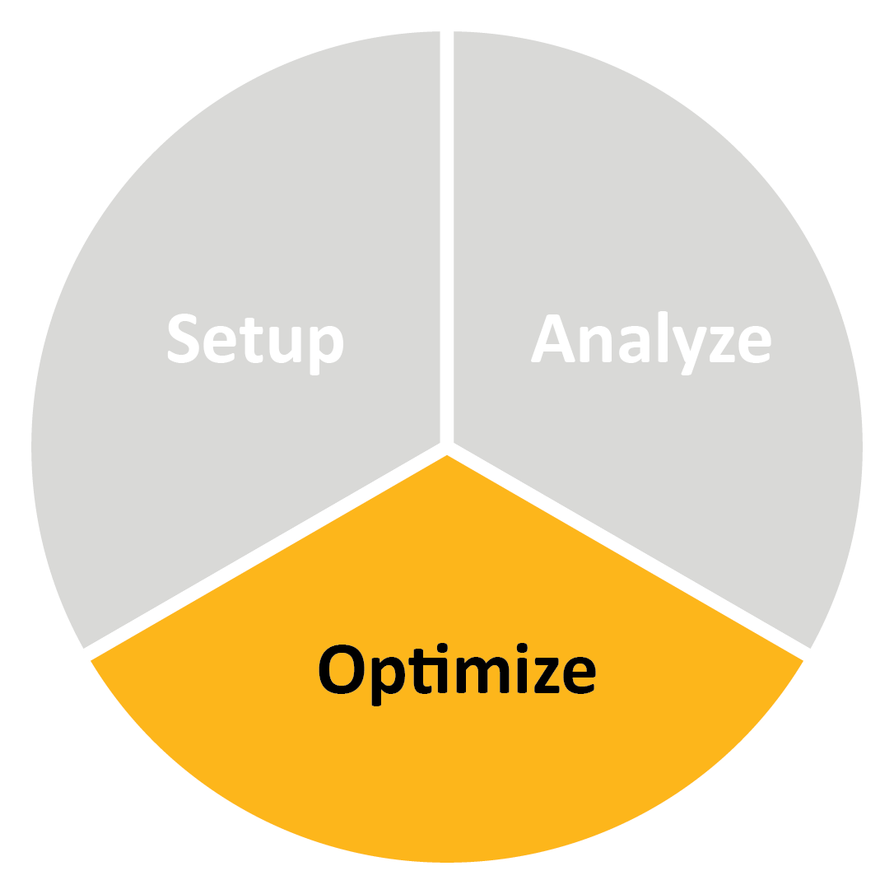
Optical system: optimization
To optimize a system, you need four things:
Starting configuration: The initial design setup used as a baseline.
Status: Completed
Variables: Adjustable parameters in the system (e.g. lens curvature).
Assignment: Radius of each lens (except the back of lens 3)
Optimization merit function: A function that measures how well the system meets design.
Details: Explored on the next slide
Constraints: Limits or conditions that the design must satisfy.
Conditions: Back of lens 3, F# = 5. Marginal Ray Height on surface 6. All lens thicknesses and air spaces kept constant.
Notes:
Optimization, in optical system design, is the process of refining a system's parameters to achieve the best possible performance according to specific goals.
In this process, we have four key parameters:
Starting Configuration: This is the initial design or setup of your optical system, including lens positions, shapes, and materials, which serves as the baseline for optimization.
Variables: These are the adjustable parameters, like lens curvature, spacing, or material, that can be changed to improve the system's performance.
Optimization Merit Function: This is a mathematical function that quantifies the performance of the system, guiding the optimization process by showing how close the design is to the desired outcome.
Constraints: These are the limits or conditions that must be met during optimization, such as physical size, material properties, or specific performance criteria that the system must adhere to.

Slide 16
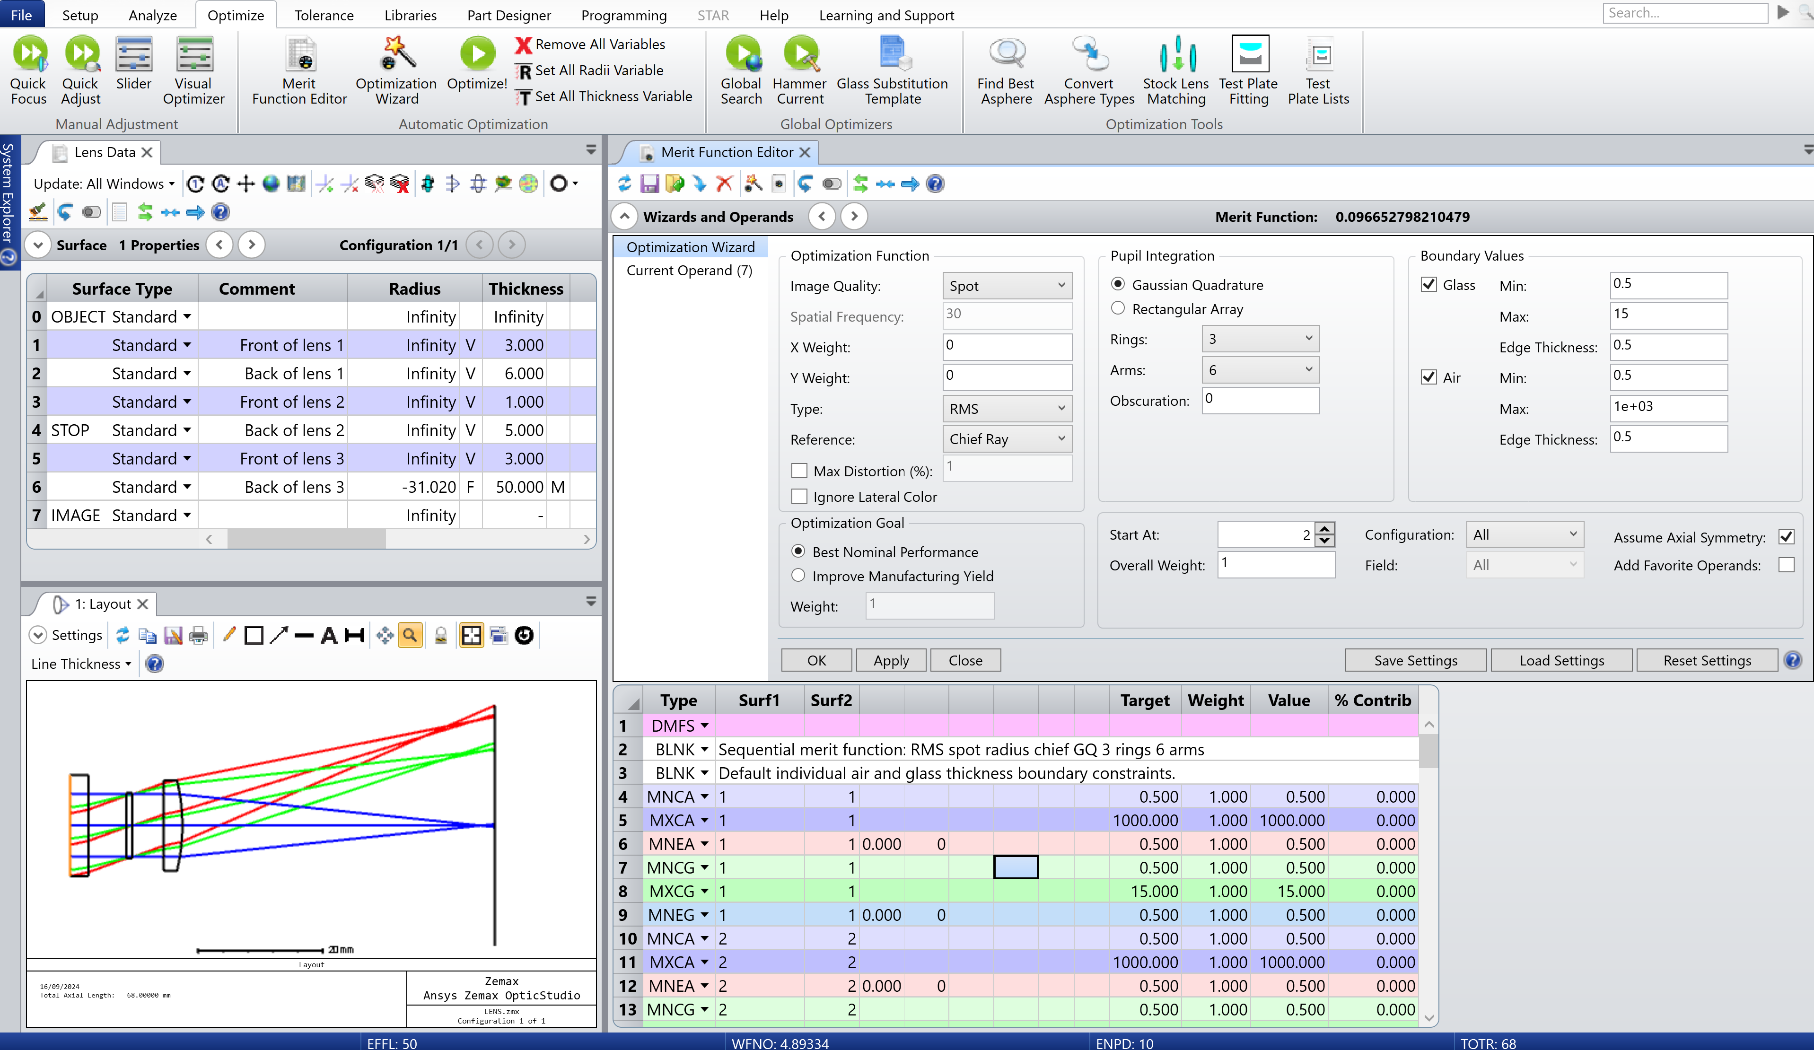
Triplet lens design tutorial
Step 5: Assign variables
Assign variables to all radii, except surface 6.
5
6
Step 6: Merit Function Editor
Within the Optimization Wizard, choose default merit function, ensuring:
[Image quality] Spot
[X and Y weight] 0
[Type] RMS
[Reference] Chief ray
[Boundary Values] as shown in the screenshot
Notes:
Step 5: Assign variables
Return to the Lens Data window.
A radius of ‘Infinity’ is currently assigned to surfaces 1 to 5. Click on the box next to each of these and choose ‘variable’ from the dropdown menu. Alternatively, Ctrl + Z will also assign a variable.
Step 6: Merit Function Editor
Open the Merit Function Editor which can be found under the Optimize tab.
Click on the dropdown to find the Optimization Wizard.
Keep the default values, but change:
Image Quality → Spot
X weight → 0
Y weight → 0
Type → RMS
Reference → Chief Ray
Boundary values* → Glass (min: 0.5, max: 15, edge thickness: 0.5); Air (min: 0.5, max: 1e+03, edge thickness: 0.5)
The optimization operands are then automatically inserted into the Merit Function Editor.#
*Boundary constraints also need to be set to prevent the lens from having impractical values.

Slide 17
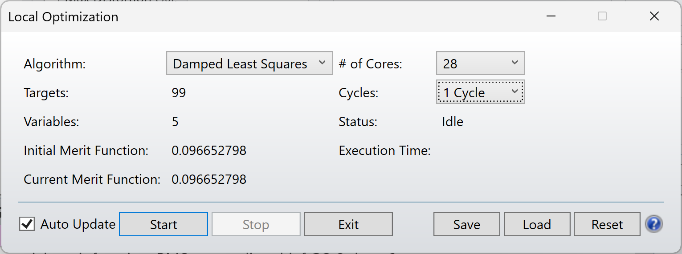
Triplet lens design tutorial
Step 7: Optimize (1 Cycle)
Make note of the initial merit function: 0.096652798
Now complete four cycles of optimization, noting the ‘current merit functions’ as you go. Results are shown on the next slide.
Notes:
Step 7: Optimize (incremental steps)
Click on Optimize! found within the Optimize tab.
Change the number of cycles from ‘Automatic’ to ‘1 Cycle’ so we can closely investigate the initial improvements.
Note: during optimization, OpticStudio attempts to lower this Merit Function value, which means the design is closer to the goal described in the Merit Function Editor.

Slide 18
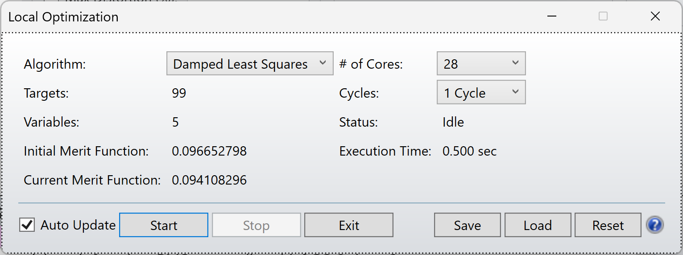
Triplet lens design tutorial
Cycle 1
Cycle 2
Cycle 3
Cycle 4
Notes:
Observation: with each cycle of optimization, you can see an improvement in the merit function.

Slide 19
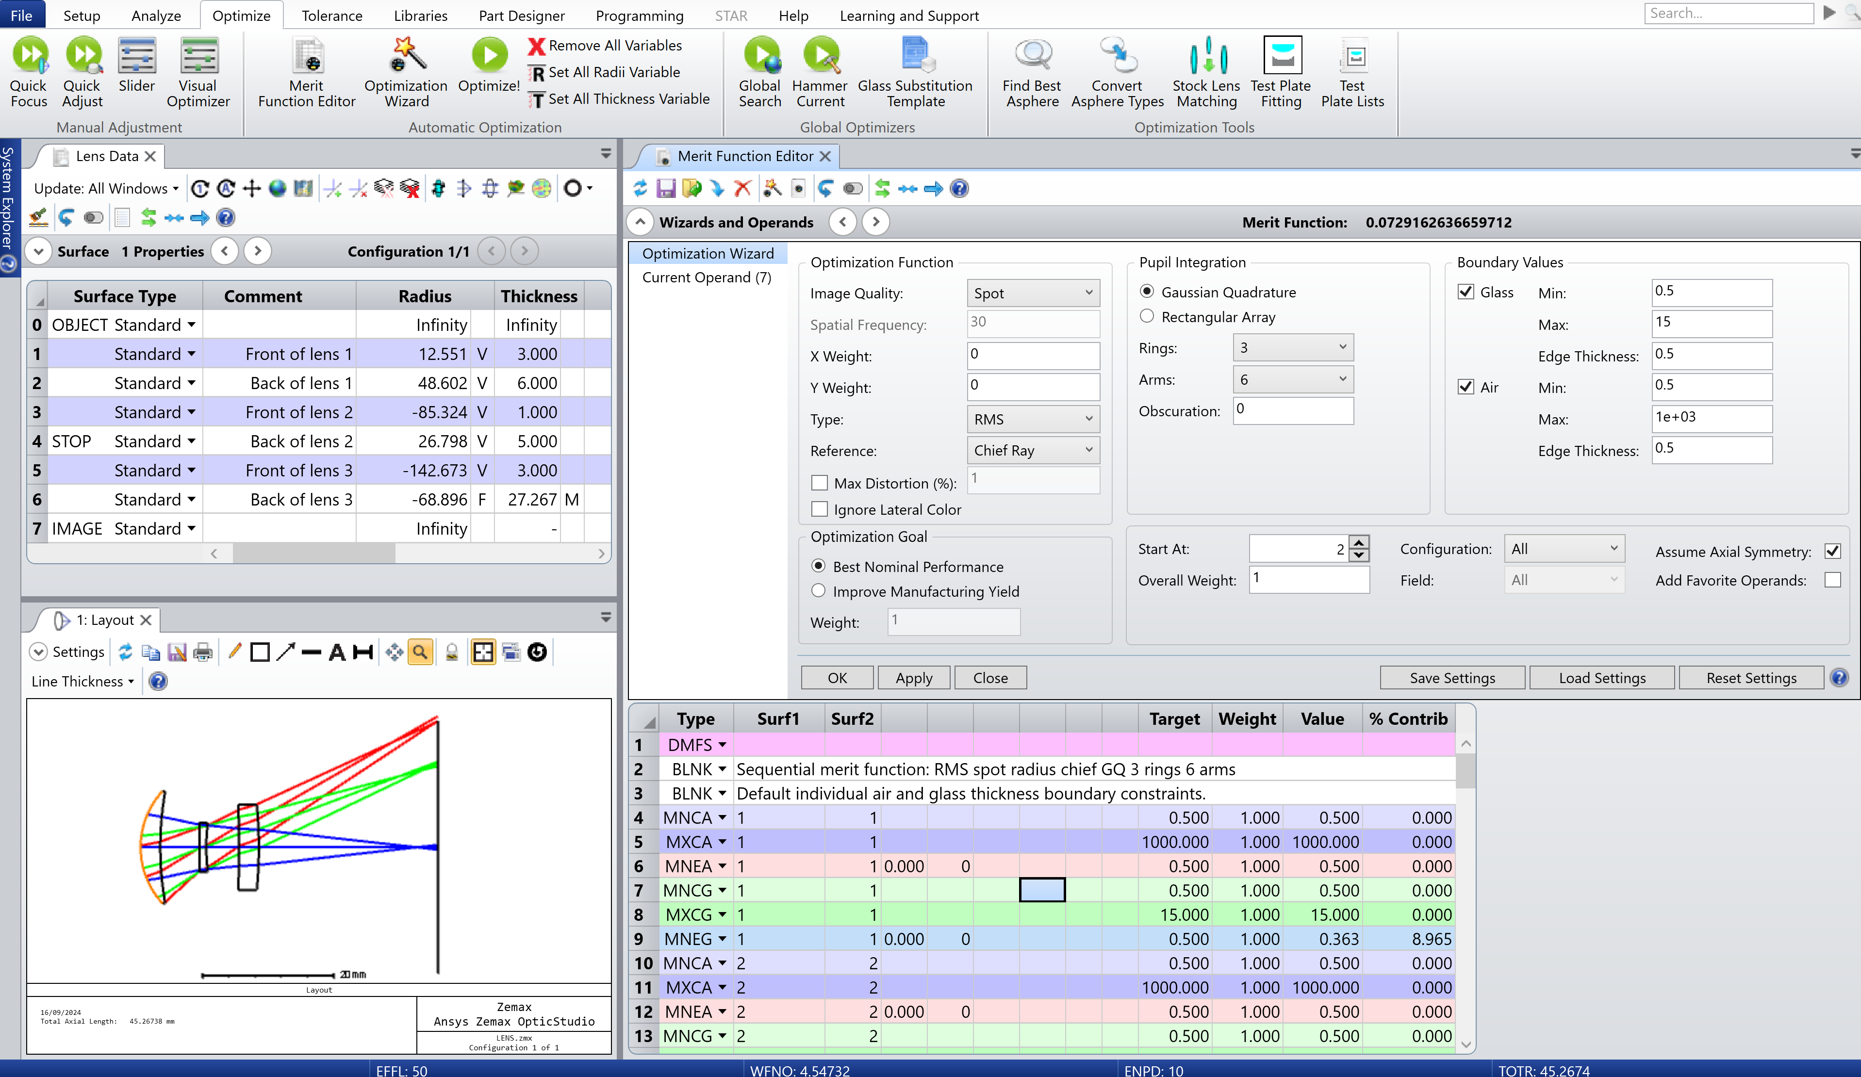
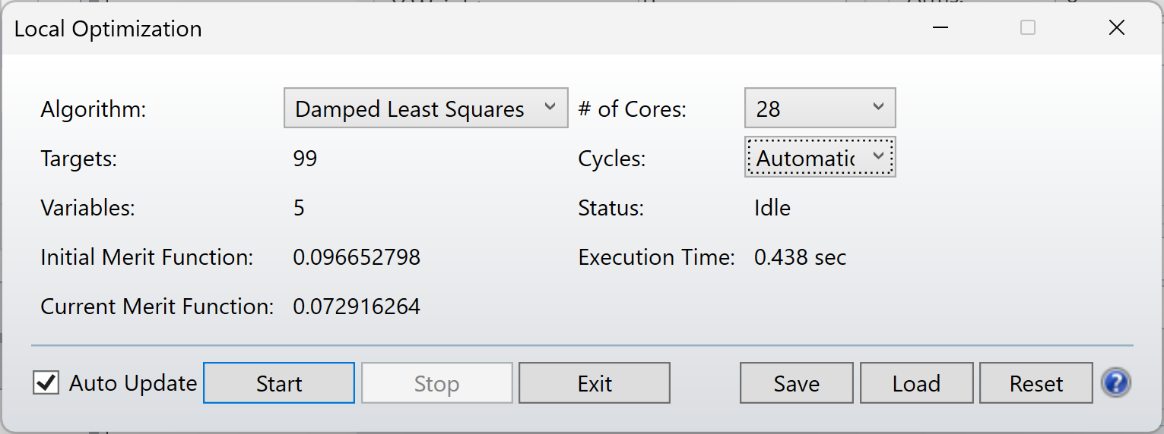
Triplet lens design tutorial
Step 8: Optimize (Automatic)
Now, complete this optimization step by selecting ‘automatic’ in the number of cycles.
Optimized Merit Function: 0.003552349
Notes:
Step 8: Optimize (automatic)
Select ‘automatic’ from the dropdown next to cycles.
Start optimization.
Selecting this option enables the software to automatically optimize the optical system according to user-defined parameters, including constraints, variable settings, and boundary conditions on operands.
Upon full optimization, the merit function value decreased from 0.096652798 to 0.003552349, indicating a significant improvement in system performance.

Slide 20
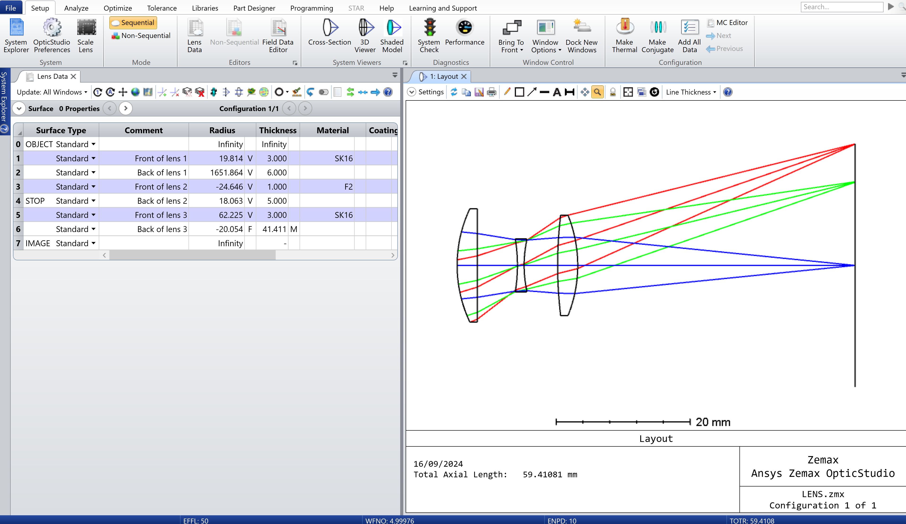
Triplet lens design tutorial
Step 9.1: Analyze optimized system
The optimized system now consists of two positive lenses positioned on either side of a negative lens, forming a configuration similar to the Cooke triplet.
Notes:
Step 9.1: Analyze the optimized system
Expand the Layout view.
Observation: The optimized system now consists of two positive lenses positioned on either side of a negative lens, forming a configuration like the Cooke triplet.
The Cooke triplet, invented in 1893, is a widely used lens design in optical systems due to its ability to correct for common aberrations like spherical aberration, coma, and chromatic aberration. This classic design is still relevant today, and its presence in this system highlights its enduring effectiveness in creating sharp, high-quality images across a wide field of view.
Let’s explore what improvements have been made to the system using the analysis tools on the following slides.

Slide 21
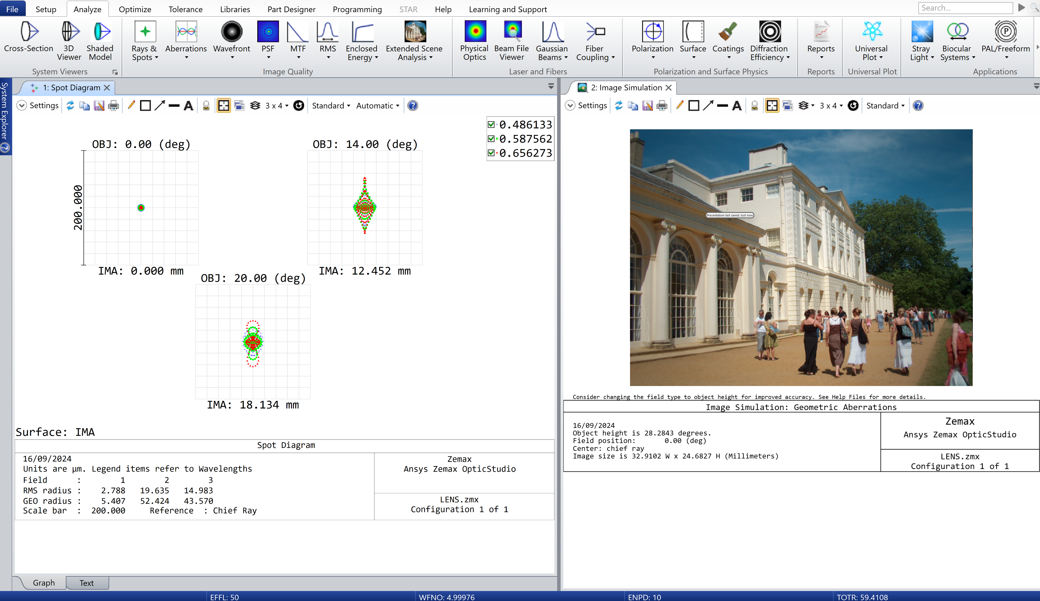
Triplet lens design tutorial
a
b
Step 9.2: analyze optimized system
Spot Diagram: spot size has been significantly reduced across the field of view.
At 0° RMS radius: 2.788 μm
At 14° RMS radius: 19.635 μm
At 20° RMS radius: 14.983 μm
b. Image Simulation: sharper details, reduced aberrations, and improved overall image clarity.
Notes:
Step 9.2: Analyze the optimized system
Return to view the Spot Diagram and Image Simulation which can be found under the Analyze tab.
Observations:
Following optimization, the system’s spot size has drastically decreased, with significant reduction in field curvature. Initially, the RMS spot size increased from 120.565 μm at 0° to 561.806 μm at 20°, but after optimization, it now remains tightly controlled, with an RMS radius of just 2.788 μm at 0°, 19.635 μm at 14°, and 14.983 μm at 20°. This results in far superior focus uniformity across the field of view.
After optimization, the demo picture shows a marked improvement in image quality, with significantly reduced optical aberrations. Although not perfect, the correction of spherical aberration, coma, and astigmatism has resulted in sharper image details, improved contrast, and a more uniform focus across the field of view. The optimized system now produces a clearer, more accurate representation of the object, with minimal distortion and enhanced clarity, reflecting the system's improved performance.

Slide 22
Triplet lens design tutorial
Step 9.3: analyze optimized system
c. Ray Fan: scale of ray fan aberrations reduced from ±2000 μm to ±100 μm.
d. OPD Fan: optical path difference reduced from ±100 waves to ±5 waves.
Results suggest better optical alignment and significant improvements in image quality.
Notes:
Step 9.3: Analyze the optimized system
Return to view the Ray Fan and Optical Path Difference (OPD) Fan which can be found under the Analyze tab.
Observation:
c. Before optimization, the ray fan plots showed noticeable aberrations, with significant asymmetry and increasing distortion toward the edges of the pupil. This pattern is characteristic of field curvature and spherical aberrations, and the difference between the x and y directions highlighted the presence of astigmatism. The scale bar was set at 2000 μm, indicating large deviations. After optimization, while some aberrations remain, their scale has been reduced to 100 μm. This means that the distortions are now much smaller and more controlled, leading to a more uniform and improved performance across the field of view. The reduced scale of aberrations demonstrates a significant enhancement in the system's overall optical quality.
d. After optimizing the optical system, the optical path difference has been reduced from ±100 waves to just ±5 waves. This improvement suggests the system now delivers much better focus and fewer distortions, resulting in a clearer and more accurate image.

Slide 23
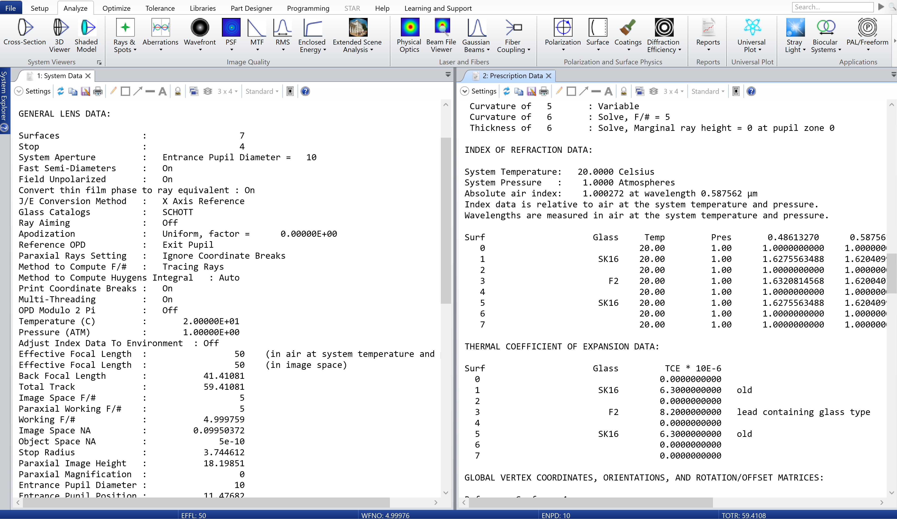
Triplet lens design tutorial
Step 10: Reports
Useful documentation
System Data Report: Offers a broad overview of the system's global settings and configurations.
Prescription Data Report: Details the specifications and characteristics of individual optical elements in the system.
Notes:
Step 10: Reports
Under the Analyze tab, click on the Reports drop-down menu and select System Data/Prescription Data.
System Data Report:
Purpose: This report provides a high-level overview of the optical system's overall configuration and settings. It includes general system parameters such as aperture size, field of view, wavelength settings, and the environmental conditions (e.g., temperature, pressure) in which the system operates.
Use: It’s useful when you want to verify or document the global system configuration, especially when reviewing design tolerances or comparing different optical setups. It helps ensure that all the foundational settings align with the design goals and constraints.
Prescription Data Report:
Purpose: This report lists all the critical details of the individual optical elements (lenses, mirrors, prisms, etc.) in the system. It includes surface-by-surface data such as radii of curvature, thicknesses, material properties, and positions of each component in the optical train.
Use: The prescription data report is particularly useful for ensuring the optical elements are correctly specified and arranged. It allows you to check lens curvatures, thicknesses, material properties (e.g., refractive indices), and spacings, all of which directly impact optical performance. This report is vital for both designing and manufacturing the system.

Slide 24
Summary
We explored the optimization of a triplet lens system, aiming to improve image quality through aberration reduction.
The process began with a single lens, where we analyzed its performance and identified limitations.
By adding two additional lenses, we increased the degrees of freedom, refining the system for better performance.
The final design resembles the Cooke triplet, featuring two positive lenses surrounding a negative lens.
Throughout the tutorial, we utilized analysis tools and optimization techniques in OpticStudio software.
These steps demonstrated how design adjustments and optimization can enhance image clarity and overall system performance.

Slide 25
Further support
Ansys Academic | Simulation Software for Educators, Researchers and Students.
Optical Simulation and Design Software | Ansys Optics: Product overview
Ansys Innovation Courses : Free to Access to courses covering a variety of physics and software.
Ansys Education Resources: Specifically developed for Educators.
Ansys Learning Forum: Ask questions to the Ansys Community!
Ansys Learning : Ansys YouTube Channel with dedicated video playlists.

Slide 26
Ansys Education Resources Feedback Survey
Here at Ansys, we rely on your feedback to ensure the educational content we create is up-to-date and fits your teaching needs.
Please click the link below to fill out a short survey (~7 minutes) to help us continue to support academics around the world utilizing Ansys tools in the classroom.
Feedback Survey Link
Notes:
Feedback Survey link for copy-paste method → https://ansys.typeform.com/to/jcattJI5

