Slide 1
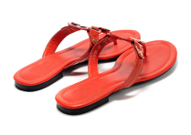
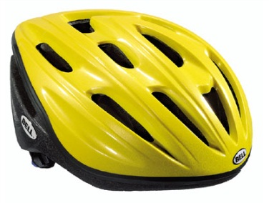
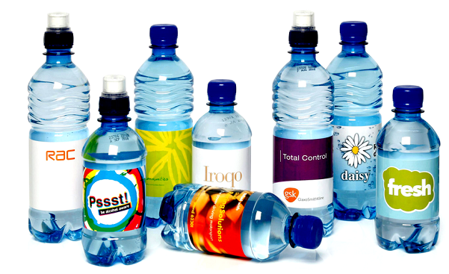
The Polymer Database
Mike Ashby
Department of Engineering,
University of Cambridge
Notes:
The PowerPoint Lecture Units For 2024
The Lecture Units developed for teaching in connection with Granta EduPack are listed at the end of this presentation.

Slide 2
Learning objectives for this lecture unit
Intended Learning Outcomes
Knowledge and Understanding | Knowledge about relevant polymer materials datasets
Skills and Abilities | Ability to find data for polymer material properties
Values and Attitudes | Appreciation of the variety of polymers available for applications
Resources
Software: Ansys Granta EduPack Polymer Database
A number of Advanced Industrial Case Studies available via the Ansys Education Resources Website
Notes:
Learning Objectives
These Intended Learning Outcomes are based on a taxonomy of knowledge and understanding as the basis, skills and abilities as necessary for the practical use of knowledge and understanding, followed by acquired values and attitudes enabling assessments and responsible use of these abilities.
Combined with a suitable assessment, they should be helpful in the context of accreditations or for the CDIO Syllabus.
The Texts listed are from books authored or co-authored by Mike Ashby but other texts are also referred to in the Science Notes.

Slide 3
Outline of the lecture unit
Why are polymers important?
The Granta EduPack Polymer database
Content and use of the database
Notes:
The polymer edition
This Unit introduces the Granta EduPack Polymers Database.
We will talk briefly about the importance of plastics in today’s world as a motivation for the presentation of the database itself.
We will then present the contents of the database and possible ways of using it.

Slide 4
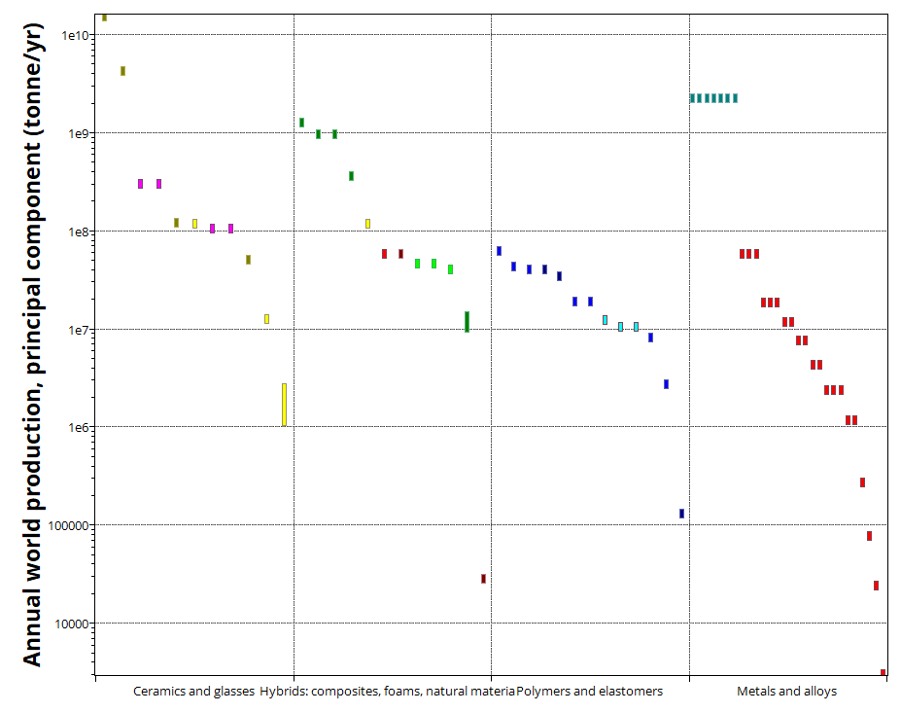
Polymers in today’s world
Annual World Production
Ceramics & Glasses
Hybrid Materials
Polymers & Elastomers
Metals & Alloys
Notes:
Polymers today
Polymers are very important in the world economy.
The plot shows annual world production (in tonnes per year) of several engineering materials. Oil and coal are shown on the left for comparison purposes only.
One can see that polymers come second only to steel, among the metals.
However, polymers are not very dense, so a plot of annual world production in terms of volme would show polymers even more prominently!

Slide 5
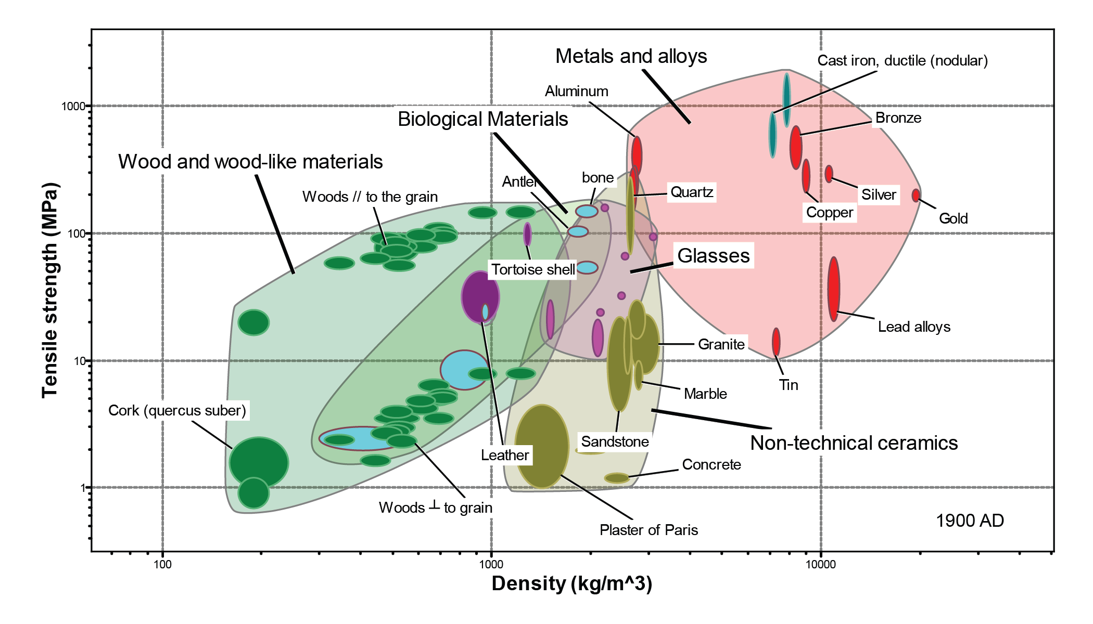
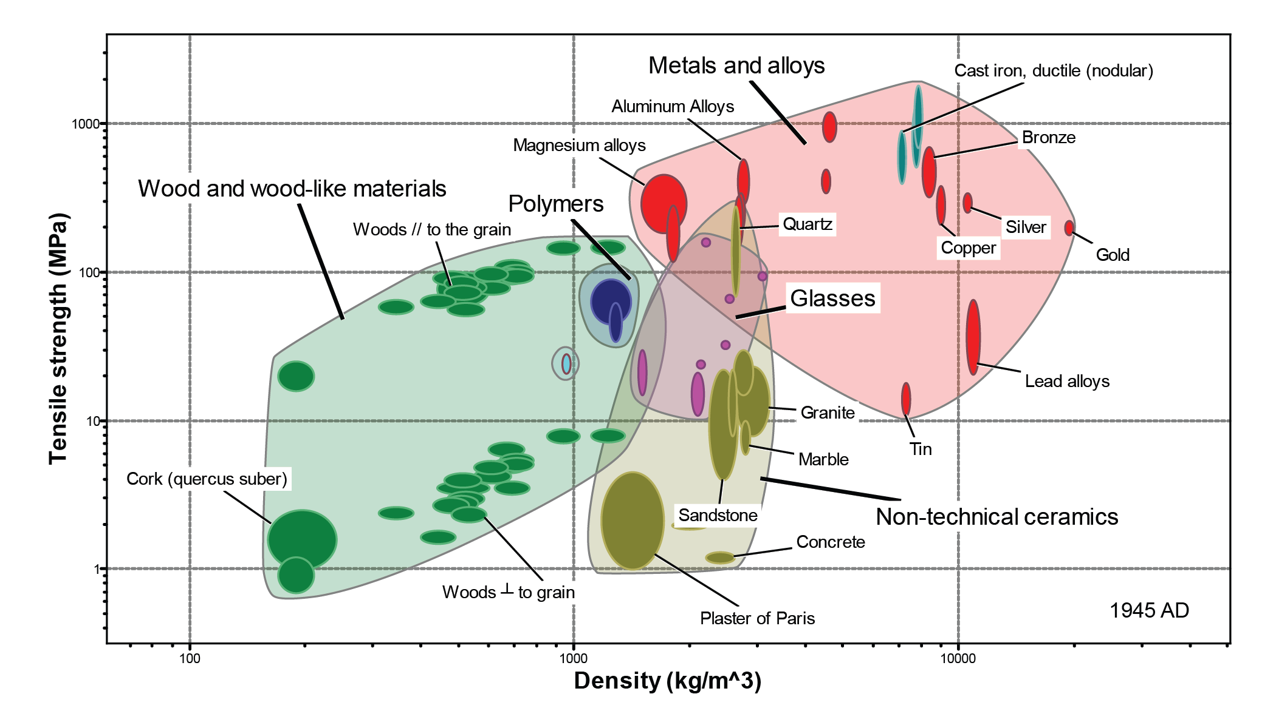
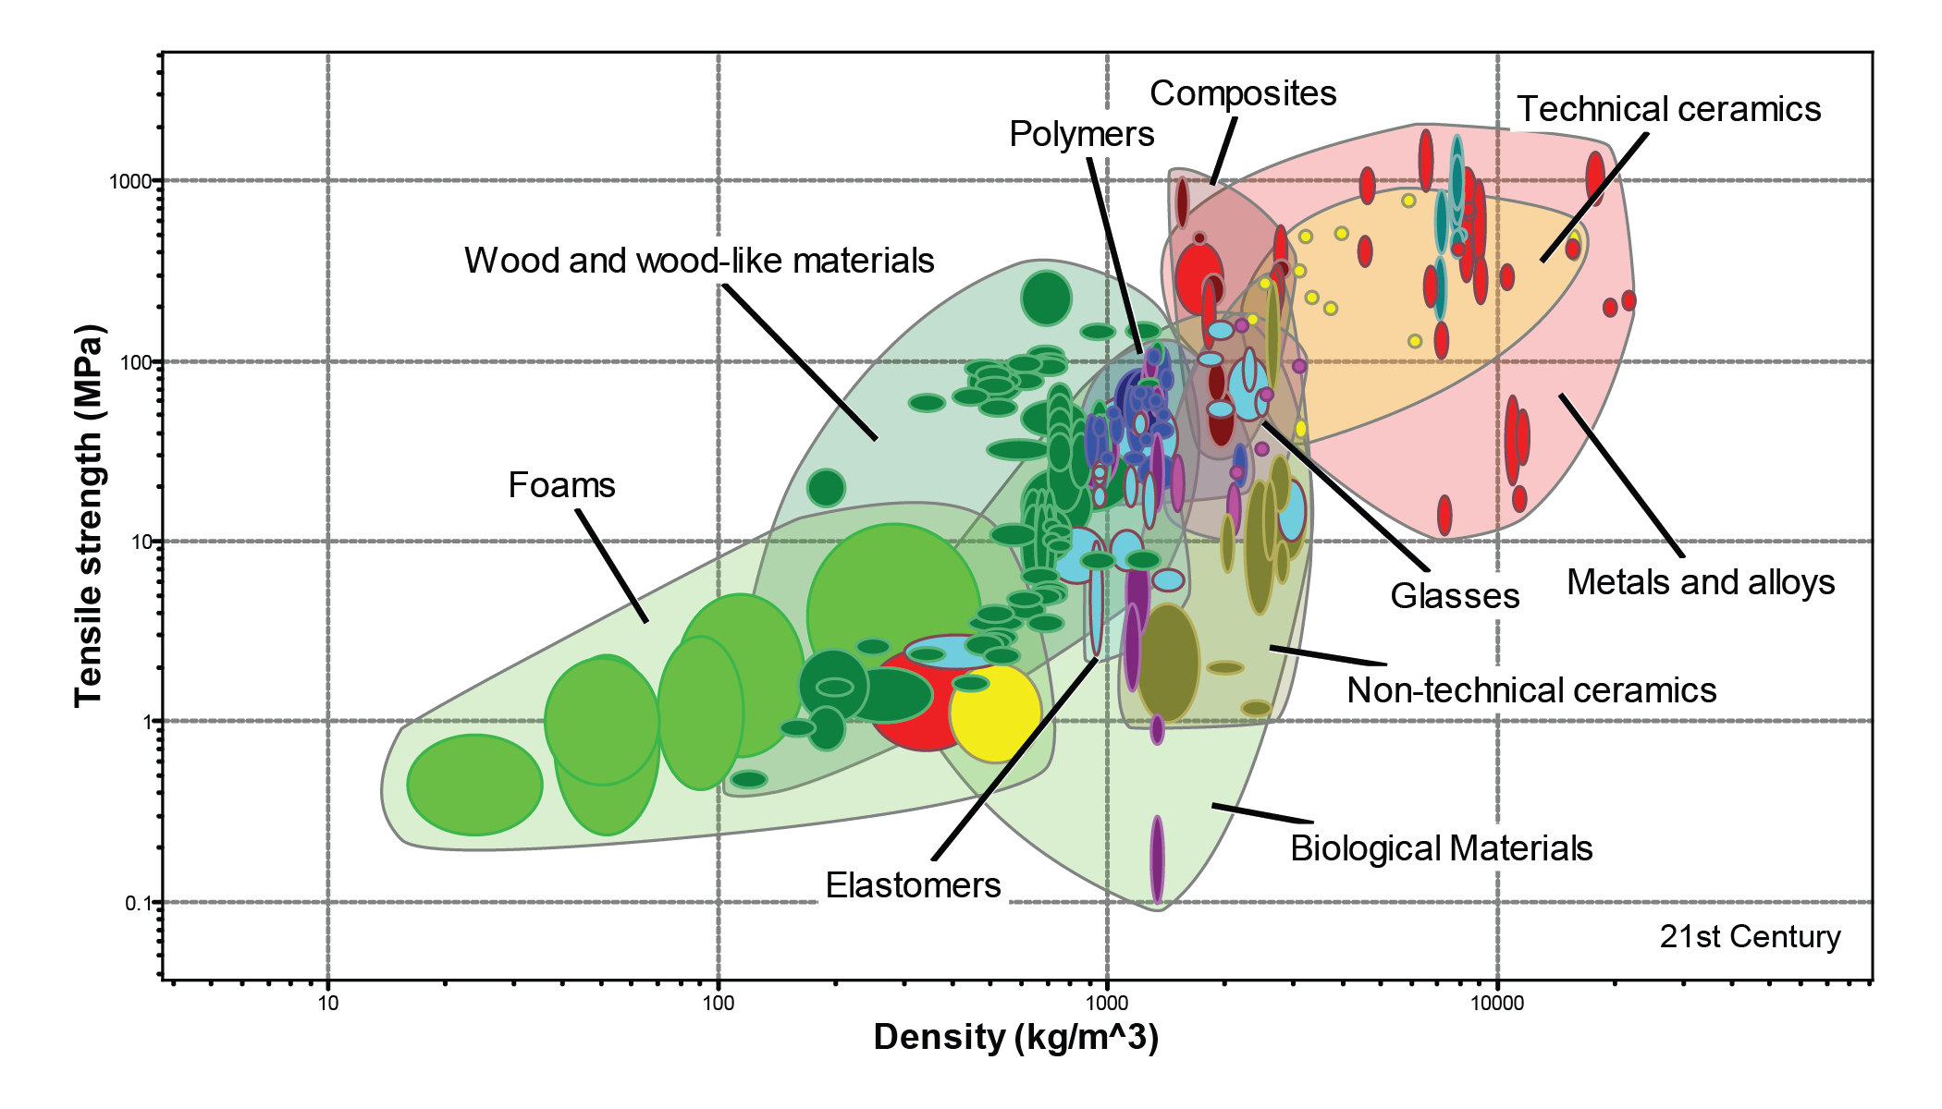
Polymers are fairly recent
Notes:
Polymers are also farily recent materials
The plot shows the materials in use by Man at the beginning of the last century (1900) in a graph of yield strength versus Young’s modulus.
There were some ceramics and glasses, some metals (in red) a few natural materials, but polymers were still not in current use, except for natural rubber and cellulose-based synthetic polymers, the seed for what was to come.
If we jump 100 years into the present, the previous picture changes drastically, thanks mainly to the development of polymers. Elastomers, foams, polymers and composites now cover most of the plot and are present in every aspect of our lives.

Slide 6
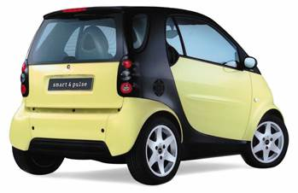
Polymers are important
Polymers have evolved from the materials of throw-away products to serious engineering materials enabling weight-saving structures
200~300kg of cars are now made of polymers
(10-20% of weight on average for a saloon)
Composites rely heavily on polymers
A Boeing 787 has 36 ton of polymer composites
(50% of air-frame weight )
http://en.wikipedia.org/wiki/Boeing_787_Dreamliner#Specifications
Notes:
Polymer facts

Slide 7
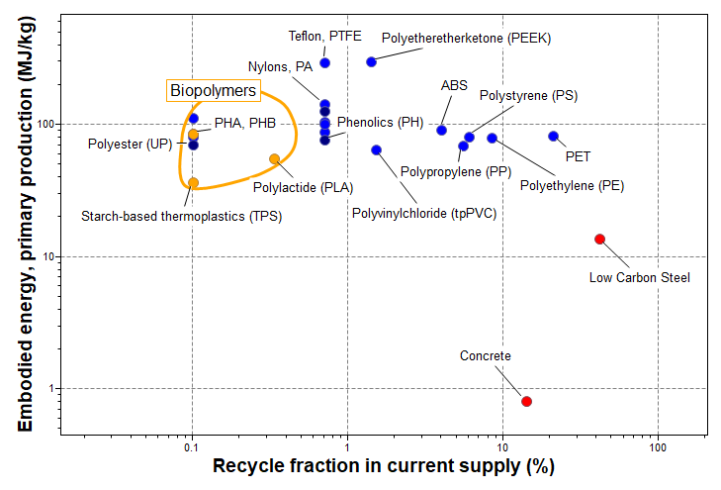
Polymers have an impact on the environment
... just like any other material ...
Notes:
Environmental impact
Because of their pervasive use, they do have an impact on the environment, but this is true for every material.
The plot shows the embodied energy of the most common polymers versus their recyled volume fraction on average today. Low carbon steel and concrete are depicted for comparison purposes.
Good materials should appear near the bottom right of this plot, and sure enough, some polymers do (like PET and PE). Biopolymers appear more to the left because most of them are biodegradable, rendering the question of recylcing somewhat meaningless.
After this brief introduction of polymers, let us now look into Granta EduPack Polymer Database.

Slide 8
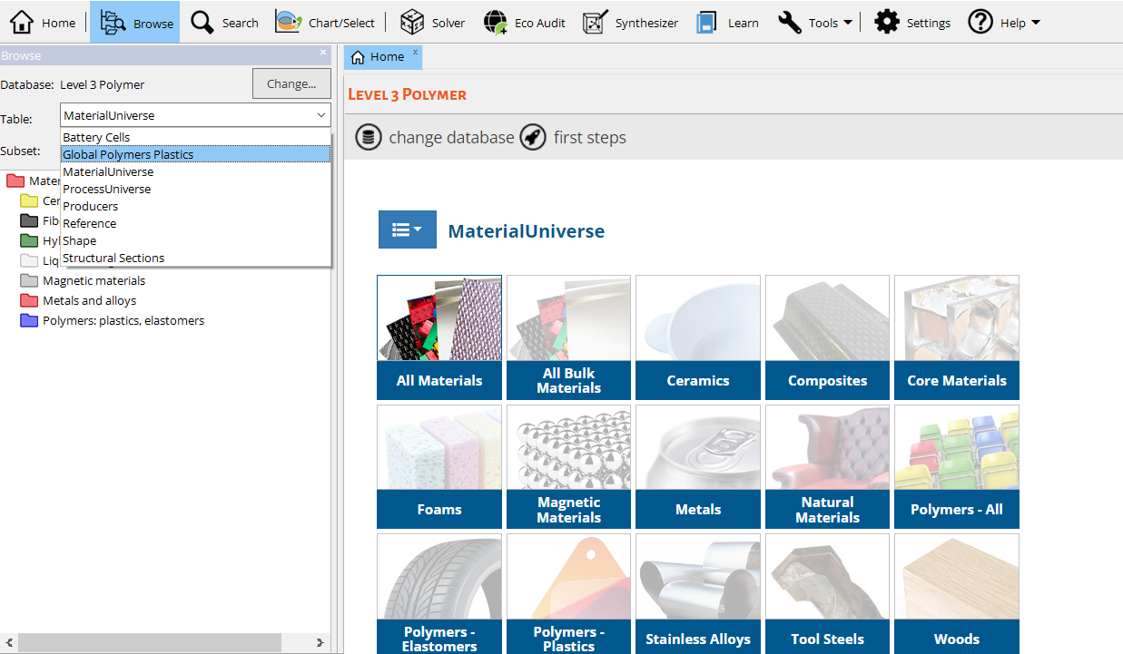
Level 3 Polymer data tables
MaterialUniverse
900+ polymer records Polymer records contain ChemRes data, 180+ additional attributes detailing the relative resistance of each polymer to various chemical environments.
Global Polymers Plastics
105,000+ plastics property datasheets from around 870 suppliers including 68,000+ datasheets listing ASTM standard properties, around 48,000 ISO grade datasheets.
Notes:
Level 3 polymer data tables
The Granta EduPack Polymer Database is a level 3 database, in which a subset of the Material Universe for Polymers has been set, containing over 900 polymer records. For these records, ChemRes data adds around 190 attributes to the Polymer records in the MaterialUniverse table. These attributes detail the relative resistance of each polymer to various chemical environments.
The chemical resistance data in this module is reproduced under license from RAPRA Technology Ltd, Shawbury. It was accumulated by RAPRA from a wide variety of sources over many years of research. It is presented in the form of a compilation of value judgements based, wherever possible, on quantitative data available in the public domain.
The Global Polymers Plastics module is a database of over 105,000 datasheets for specific plastic resin grades from around 870 suppliers worldwide. The database contains around 69 000 ASTM datasheets, around 48 000 ISO grade datasheets.

Slide 9
Granta EduPack Polymer Database structure
The
database
Shape
data-table
References
data-table
Global Polymers Plastics
102,000+ polymers
Materials
data-table
Processes
data-table
Links
Polymer Database
Specific Data
Suppliers
data-table
Structural Sections
data-table
Notes:
Granta EduPack Aerospace Database structure
The structure of the database is very similar to the others of EduPack Level 3, although the wealth of data is sometimes overwhelming.
It relies on the proven MaterialUniverse, ProcessUniverse, Shape and Structural sections data-tables linked together, plus the MMPDS and MILL-HDBK-17 data-tables connected to the Material.

Slide 10
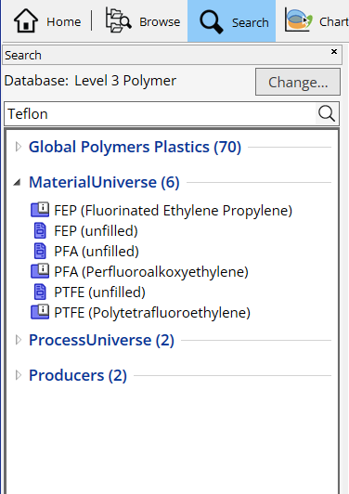
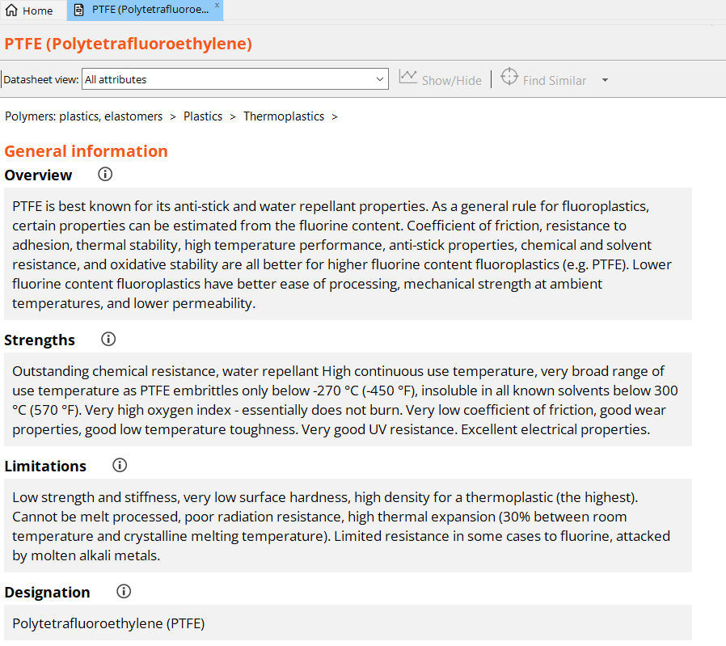
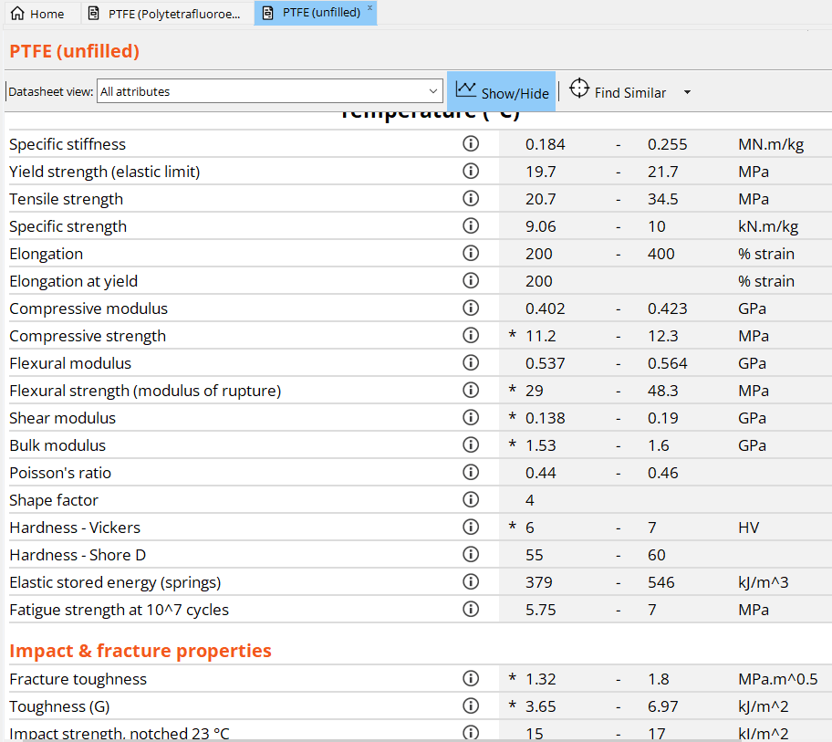
The polymers in MaterialUniverse
Folder-level record for PTFE:
Data record for PTFE (unfilled):
Notes:
Polymers
The Granta EduPack Polymers database has a Browse window that looks like this. Opening the tree-like organization of the material classification allows records to be accessed. Records can also be found by the use of the Search facility. Both Browse and Search are described fully in Lecture Unit 1.
We’ll start with the Polymers subset available from Material Universe. Browsing will show you that there are 927 polymer records available for searching and selecting.
You can Search for polymer names - either their’scientific’ name or their trademark.
Searching for ‘Teflon’, one record will be found – that for PTFE, its basic polymer. Opening this record will show all the information available for PTFE.
. In MaterialUniverse, only the folder-level record contains the word ‘Teflon’ It tells you that it is called PTFE. A PTFE record in the Material Universe looks like this and can be found by searching for ‘PTFE’. It provides further links at the bottom.
It starts with some general properties, composition, mechanical properties, thermal, processing, etc. With durability and some eco-propeties in the end, followed by notes and links to the other datatables: Process Universe and Global Polymers Plastics, for example.
In the record you can also find a lot of information on chemical resistance to specific environments (next slide).

Slide 11
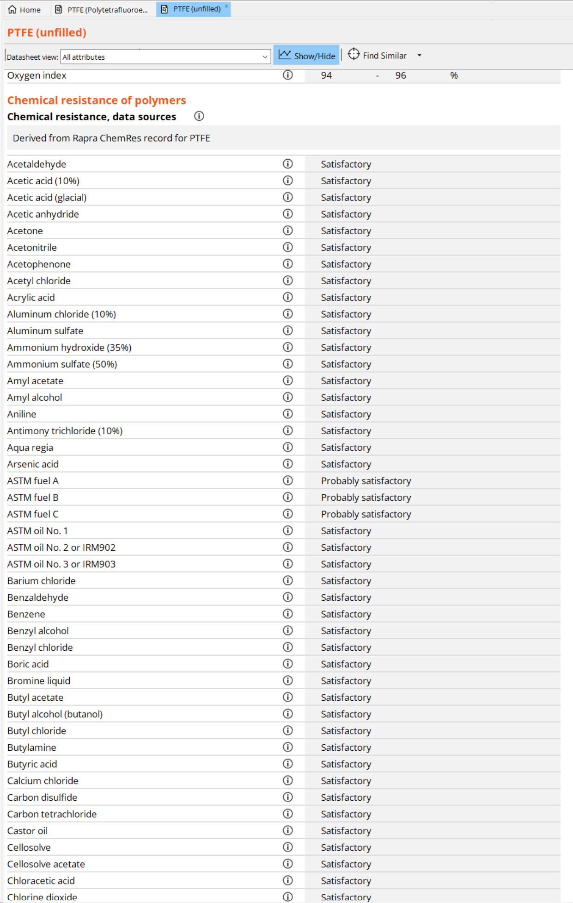
ChemRes data for PTFE
188 additional attributes detailing the relative resistance of each polymer to various chemical environments
Notes:
ChemRes data
The ChemRes data is immense. Here is an Excerpt of properties from A to C.

Slide 12
MaterialUniverse and Global Polymers Plastics compared
 | MaterialUniverse | Global Polymers Plastics
Grade type | Generic | Specific
Number of grades | 974 | 105899
Normalized properties? | YES | NO
Complete datasheets? | YES | NO
Main standards | not applicable | ASTM/ISO
Notes:
Comparing the data
So what are the differences between the different datatables? What can you find in each of them?
A first guidance is given in this slide. As a starting point, a generic datatable like Material Universe can be helpful, moving on to Global Polymers Plastics datatables for further, more specific producer information.
Global Polymers Plastics contains valuable information for the student development a design-build project or the designer looking for a particular grade of polymer for his/her product.

Slide 13
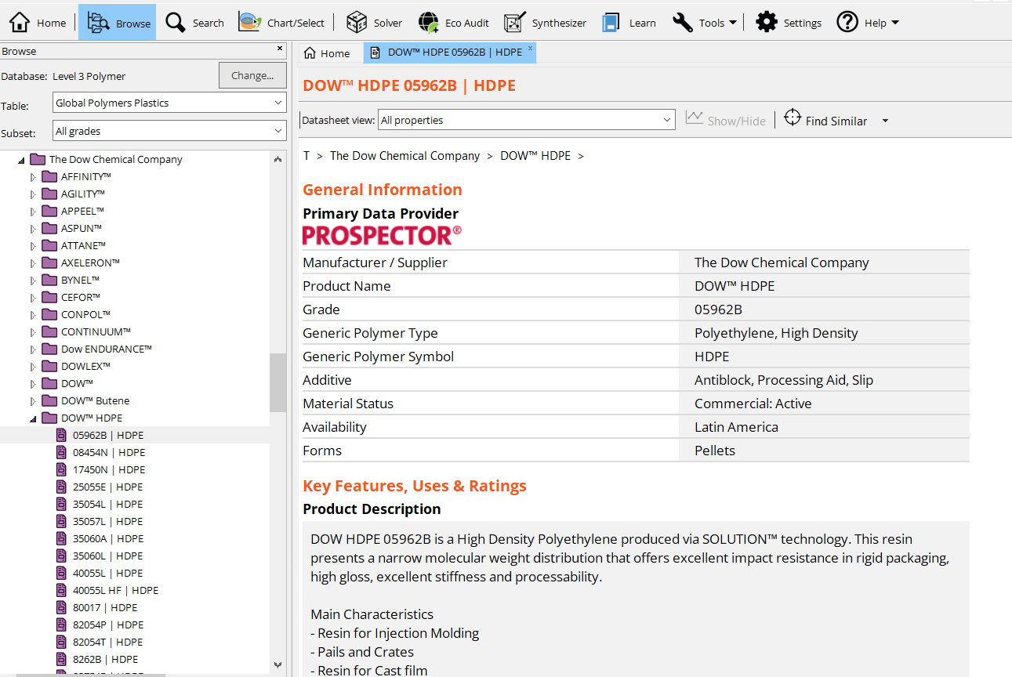
The Global Polymers Plastics datatable
Notes:
Global Polymers Plastics datatable
The Global Polymers Plastics datatable is organized by producer, but the number of producers is so vast that the browse window shows up in alphabetical order, for enhanced browsing. Opening up the folders step by step will eventually let you reach one particular record for a specific polymer, as shown.

Slide 14
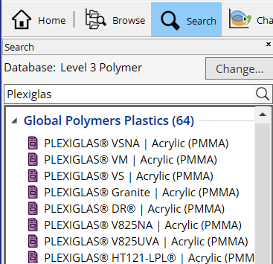
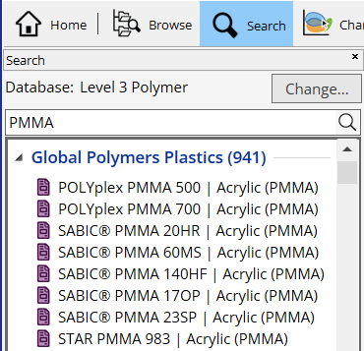
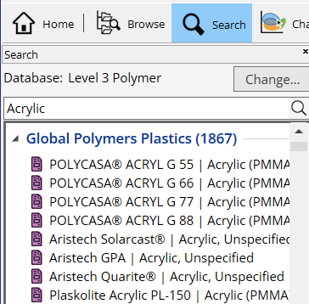
Searching for Plexiglas in Global Polymers Plastics
Tradename search count
Specific compound
General compound
Search term influences number of results!
Notes:
Global Polymers Plastics search: Plexiglas
Searching for a ‘Plexiglas’ in Global Polymers Plastics will yield a total of 69 single polymer records.
But again, noting that ‘Plexiglas’ is a trademark, one should try other keywords like PMMA or Acrylic, to try and find what you want, just like choosing the appropriate keywords in a web search engine.

Slide 15
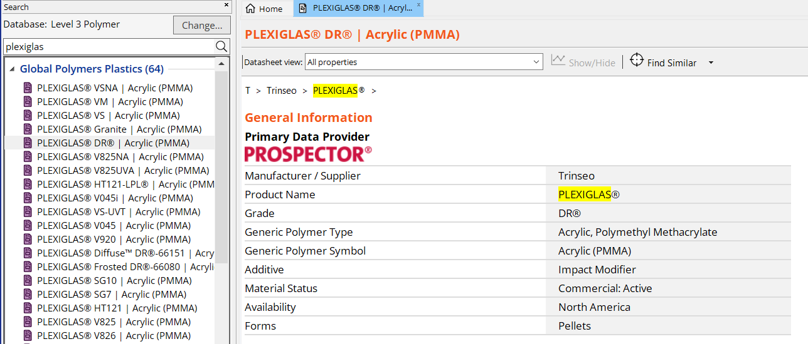
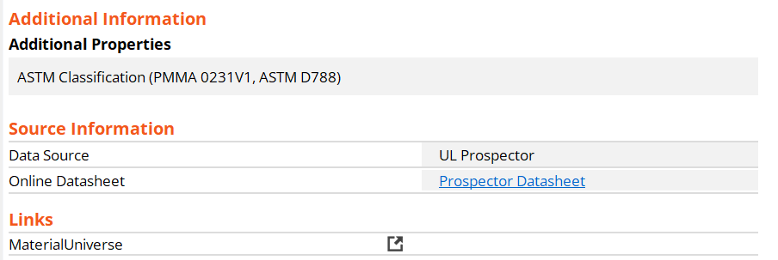
Features of a Global Polymers Plastics record (PMMA)
Requires Prospector account
Notes:
Features
This is what a Global Polymers Plastics record looks like - the one for a particular grade of Plexiglas.
You can see a lot of information, some of which you would also find on a Material Universe record, and some are unique to this record. In this particular record, see for instance the data on “Injection” with numerous details on processing parameters for this Plexiglas. Other records in Global Polymers Plastics will have other features, depending on the producer.
At the end of the record, a link to the PDF version of the Prospector website datasheet for this record can be accessed. In this particular case, all the data follows ASTM standards. In other cases ISO can be accessible through these links.

Slide 16
Using the polymer modules
MaterialUniverse
Designed for primary, broad materials selection. Enables generic candidates (resin and filler type) to be easily identified.
Global Polymers Plastics
Once the resin and filler type are known these can be used to find specific commercial grades and possible vendors.
STAGE 1
STAGE 2
Identify
Resin/Filler
Options
Identify
Commercial
Grades
Design Requirements
Contact Suppliers
Granta MaterialUniverse
RAPRA ChemRes
Global Polymers Plastics
Notes:
So how can we use this database?
The MaterialUniverse data table is designed for primary materials selection exercises. Use the Global Polymers Plastics data-tables for finding specific grades and for selection of possible vendors.
The strength of the MaterialUniverse database is for materials selection at the resin-filler level. Only one generic grade exists for each common resin-filler combination. Every material can be compared with every other material because there are no holes in the data – the datasheets are complete – and all the data are reported on the same scale.
The strength of Global Polymers Plastics is the breadth of coverage – Over 870 suppliers list materials in Global Polymers Plastics. Global Polymers Plastics is excellent for North American usage, where ASTM standards pre-dominate. However, comparability between Global Polymers Plastics grades is relatively poor. The Global Polymers Plastics datasheets are not complete, meaning that a rigorous approach to selection is not possible.

Slide 17
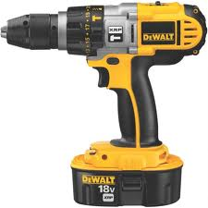
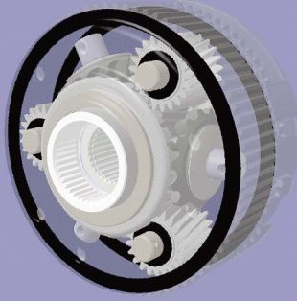
Selection example: polymers for a gear train
The scenario:
Select a polymer for a power-drill gear train
It must be light and cheap
Should have good mechanical properties, resist to moderate temperatures and work with lubricating oil
Some design requirements:
Density < 1500 kg/m3
Price < 5 $/kg
Thermoplastic, semi-crystalline, unfilled
Maximum service temperature < 250ºC
Some resistance to lubricating oil
http://hometools.onsugar.com/Power-Drill-12485056
Granta EduPack
http://www2.dupont.com/Plastics/en_US/Knowledge_Center/engg_design_mag/ed083/ed08305.html
Notes:
Selecting polymers for a gear train
Here is an example of what can be done with the data tables. Here are the objectives and constraints to find polymers for a gear train.

Slide 18
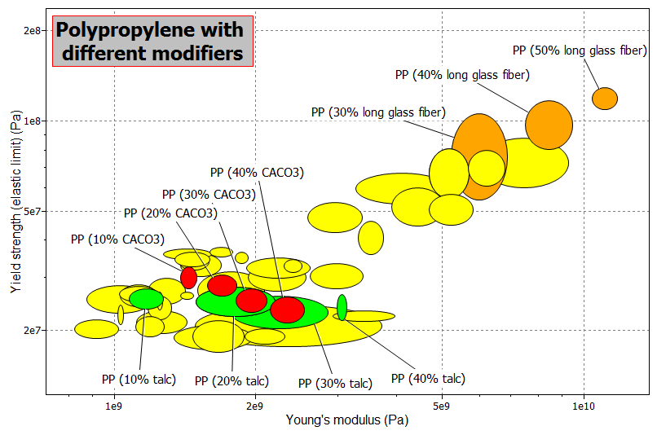
Understanding the influence of fillers
Notes:
The influence of fillers
One other way in which this database can be used is in helping develop a deeper understanding around the facts that the data shows!
One example can be see in the next slide: understanding the influence of fillers in the mechanical behavior of polymers.
What you see in this plot is a number of PP grades with different filler types, of which some particular fillers are coloured differently: in green talc filled grades, in red calcium carbonate filled grades and in orange glass fiber filled grades, in different volume fractions.
You can immediately see that all the fillers increase the stiffness of the blend, while strength shows varying behaviors, depending on the filler. This is a good lead into the microstructure of each of these materials, paving the way for a fruitful discussion on ways to improve mechanical behavior of polymers, or looking at micrographs of broken specimens of each of the materials and analysing what is the influence of the filler, the characteristics of the interface filler-polymer, and so on.
Graphs like these have much more impact than tables filled with numbers, and they remain longer in students’ memory.
But this is not all the database can help with in teaching support.
If the built-in polymer grades and composites aren’t the ones you want, you can build your own virtual materials, using the Hybrid Synthesizer tool.

Slide 19
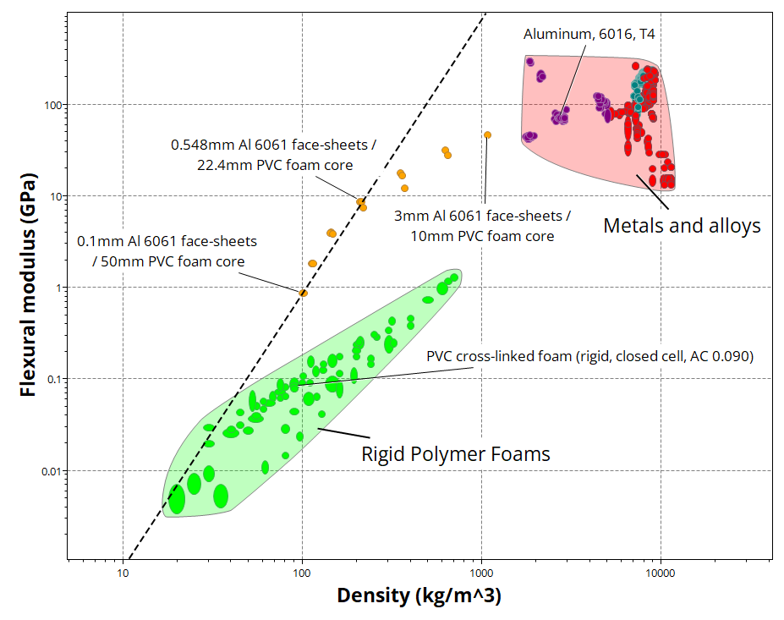
The Synthesizer tool
Enhanced
performance
If you want to model new composites you can use the Hybrid Synthesizer tool included in Granta EduPack Polymer Database
This tool helps you create virtual composites and compare them with those available in the database for a number of physical, mechanical, thermal and electrical properties
Build your own foams, sandwich structures or composite laminates
Further information is available from Lecture Unit Hybrid synthesizer
Optimize
Slope 3
Notes:
Hybrid synthesizer
The Synthesizer tool helps you model new particle - or fiber-reinforced polymers, foams and sandwich structures, and compare their physical, mechanical, thermal and electrical behavior with the existing materials in the database.
Further information is available from Lecture Unit Hybrid Synthesizer of this lecture series, but a very brief summary of what the tool can do is seen in this plot.
Here you can see the modeling (the orange dots) of sandwich panels with Aluminium 6061 T4 face sheets with PVC foam core, on a plot of flexural modulus versus density. If a panel of this material is loaded in bending, its performance surpasses the performance of both face and core materials, effectively bridging the gap between the two materials.

Slide 20
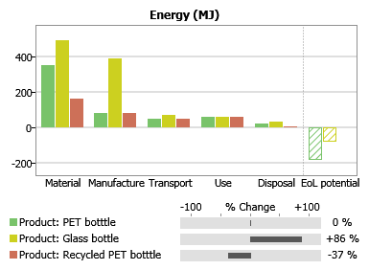
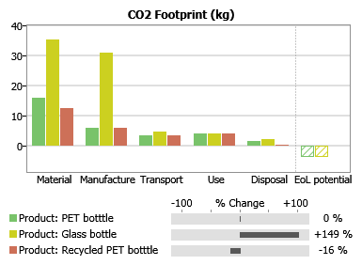
The Eco Audit tool
Can explore:
Material choice
Recycle content
Transport mode
Transport distance
Use pattern
Electric energy mix
End of life choice
You can assess the environmental impact of products with the Eco Audit tool included in Granta EduPack Polymer Database
Compare the influence of using different polymers and manufacturing processes on the various phases of life of a product
Further information is available from Lecture Unit 12 of this series
=
Virgin PET
=
Glass
=
Many projects available as project files.
Recycled PET
Notes:
The Eco Audit tool
Another useful tool is the Eco Audit tool. This tool allows you to assess the environmental impact of products in different phases of life, and compare “what-if” scenarios very quickly, at an early design phase.
Again, further information is available from Lecture Unit 12 of this lecture series, but a very brief summary of what the tool can do is seen in this plot.
Different materials and manufacturing processes, together with different recycled material contents are compared, for a bottle of water. The output is displayed in the form of Energy consumption and CO2 emissions, and useful tips are given to tackle each of the phases of life.
The tool provides the opportunity for in-class discussion of different scenarios and to roughly assess what are the influences of particular design decisions in the entire life cycle of products.
So this brings us to the end of our presentation. Some final remarks can be seen on the coming slide, with some take-away ideas.

Slide 21
Summary
Polymers account for a significant share of the materials in use today
Producers are constantly developing new formulae and new blends
The amount of polymers available is growing rapidly
Global Polymers Plastics data-table provides up-to-date producers information on over 101 000 individual polymer grades
Granta EduPack Polymer Database offers a structured database with very detailed information from producers
The data can be used for browsing, searching or systematic selection, but also to trigger understanding
Notes:
Summary

Slide 22
Lecture unit series
PowerPoint lecture units, as well as many other types of resources, can be found in the Ansys Education Resources webpage.
Finding and Displaying Information
Unit 1 | The materials of engineering
Unit 2 | Material property charts: mapping materials
Unit 3 | The Elements database: properties, relationships and resources
Material Properties
Unit 4 | Manipulating properties: composition, microstructure, architecture
Unit 5 | Designing new materials: filling the materials-property space
Unit 6 | Materials Science and Engineering
Selection
Unit 7 | Material selection: translation, screening, ranking, documentation
Unit 8 | Objectives in conflict: trade off methods and penalty functions
Unit 9 | Material and shape: materials for efficient structures
Unit 10 | Manufacturing processes and cost modeling
Unit 11 | Eco-informed material selection
Unit 12 | Eco design and the Eco Audit tool
Sustainability
What is a sustainable development? A materials perspective
Exploring Critical Materials using Ansys Granta EduPack
Special Topics
The Built Environment: materials for construction
Structural sections: shape in action
Materials in industrial design: Why do consumers buy products?
The Design database for Products
The Medical Devices database
The Battery Designer tool
Advanced Teaching and Research
Advanced databases: a lightning tour
The Aerospace edition
The Polymer edition
The Synthesizer tool: hybrids and other models
Materials for Bioengineering
www.ansys.com/education-resources
Notes:
Lecture Units Series
This is a list of the Lecture Units available for teaching with the Ansys Granta EduPack. These PowerPoint presentations and more information can be found on the Ansys Education Resources webpage:
www.ansys.com/education-resources.

