Slide 1
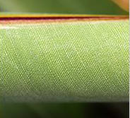
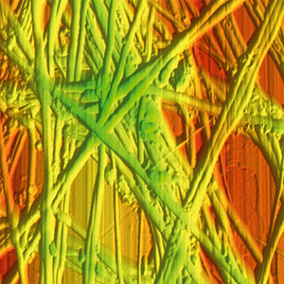
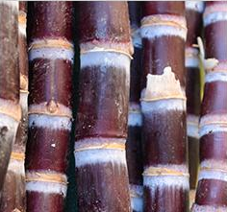
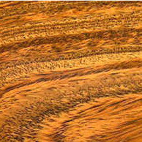
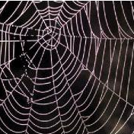
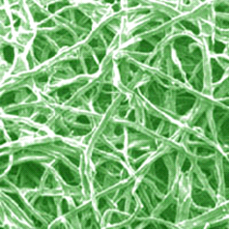
Materials for Bioengineering
Mike Ashby
Department of Engineering,
University of Cambridge
Notes:
PowerPoint Lecture Units For 2024
The Lecture Units developed for teaching in connection with Granta EduPack are listed at the end of this presentation.

Slide 2
Learning objectives for this lecture unit
Intended Learning Outcomes
Knowledge and Understanding | Broad knowledge of the different areas of Bioengineering
Skills and Abilities | Ability to select materials for Bioengineering applications
Values and Attitudes | Awareness of how biomaterials compare with engineering ones
Resources
White Paper: “Bioengineering Database > Part 1: Introduction to Biological and Bio-medical materials”
White Paper: “Bioengineering Database > Part 2: Bio-derived materials and example applications”
White Paper: “Medical Devices- biomedical applications of materials”
Poster: Wall chart of property maps for the materials of nature (download all three from www.ansys.com/education-resources)
Text: “Materials Selection in Mechanical Design”, 5th edition, by M.F. Ashby, Butterworth Heinemann, Oxford, 2016.
Notes:
Learning Objectives
These Intended Learning Outcomes are based on a taxonomy of knowledge and understanding as the basis, skills and abilities as necessary for the practical use of knowledge and understanding, followed by acquired values and attitudes enabling assessments and responsible use of these abilities.
Combined with a suitable assessment, they should be helpful in the context of accreditations or for the CDIO Syllabus.
The Texts listed are from books authored or co-authored by Prof. Mike Ashby but other texts are also referred to in the Science Notes.

Slide 3
Outline
What is bioengineering?
Ansys Granta EduPack databases
  Level 2 Bioengineering
  Level 3 Bioengineering
Materials selection for biomedical applications
  Porous Scaffolds for Bone Tissue Engineering
  Suture Anchor Implant
  Biomaterials Selection for a Joint Replacement
  Biomedical Waste: Health vs Environment
Notes:
Outline
Outline as described above

Slide 4




What is bioengineering?
“A discipline that advances knowledge in engineering, biology and medicine, and improves human health through cross-disciplinary activities that integrate the engineering sciences with the biomedical sciences and clinical practice.” - Whitaker Foundation
Engineering
Life Sciences
Bioengineering
Application of “biological systems knowledge” to engineering issues e.g., bio-inspired wind turbine blades
Application of “engineering principles” to challenges in biology and medicine e.g., pacemakers
Notes:
What is bioengineering?
Bioengineering, or Biomedical Engineering, is a relatively new branch of applied science, which first appeared as an educational program during the 1950s. Combining two main schools of thought, engineering and the life sciences, the Whitaker Foundation defines it above.
The application of concepts and methods from each of the combined fields can be used to develop new technologies, which promote human health, as well as provide inspiration from the natural world (e.g. biomimetics). An example of a nature-inspired turbine blade can be found here: https://royalsocietypublishing.org/doi/10.1098/rspa.2016.0726

Slide 5


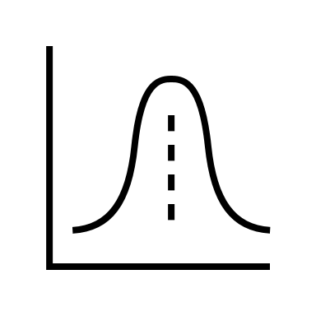



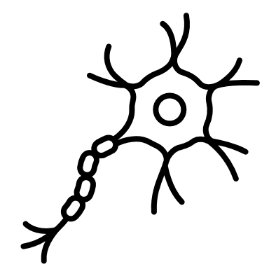
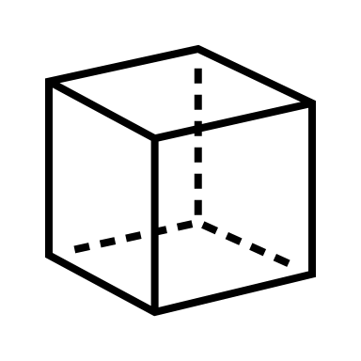

Specialist areas
Bioengineering
Electrical Engineering
Computer Science & Engineering
Math & Statistics
Chemical Engineering
Physics
Chemistry & Biochemistry
Biology & Neurobiology
Materials Science & Engineering
Mechanical Engineering
Notes:
Specialist areas within bioengineering
Bioengineering is a rapidly evolving, interdisciplinary field with specialist areas that include:
Electrical Engineering in the form of robotics, devices, photonics and signal and image processing
Computer Science and Engineering in the form of computation biology, AI and robotics
Mathematics and Statistics in the form of Data manipulation, virtual reality, statistics, simulations and optimisation
Chemical Engineering in the form of biotechnology, nanoparticles, interfaces and polymers
Physics in the form of Biophysics and Photonics
Chemistry and Biochemistry in the form of Nanotechnology, Biophysical and Material Chemistry along with surface science
Biology and Neurobiology in the form of Computational, molecular and cellular biology and Physiology
Materials Science and Engineering in the form of Biomimetics, Biomaterials, Materials characterisation and polymers
Mechanical Engineering in the form of Biological systems, prosthetics and medical devices
Biomaterials
The modern field of biomaterials combines medicine, biology, physics, and chemistry, and more recent influences from tissue engineering and materials science. It has grown significantly in the past decade due to discoveries in tissue engineering, regenerative medicine, and more.

Slide 6
Materials in Bioengineering
What is a biomaterial?
Any matter, surface, or construct that interacts with biological systems. Biomaterials can be derived from nature or synthesized in the laboratory using metallic components, polymers, ceramics, or composite materials. National Institute of Biomedical Imaging and Bioengineering
1
3
METALS
CERAMICS
Hard, ductile and conduct heat and electricity e.g. stainless steel 316L
Hard, brittle, resistant to corrosion, electrically non-conductive e.g. alumina
2
4
POLYMERS
COMPOSITES
Widely variable, relatively soft and flexible e.g. polypropylene
Materials with distinct phases larger than the atomic scale e.g. CFRP
Notes:
Materials in Bioengineering- family groups
Biomaterials may be natural or synthetic and are used in medical applications to support, enhance, or replace damaged tissue or a biological function.
Metals, ceramics, polymers, glass, and even living cells and tissue can all be used in creating a biomaterial. They can be reengineered into molded or machines parts, coatings, fibers, films, foams, and fabrics for use in biomedical products and devices. These may include heart valves, hip joint replacements, dental implants, or contact lenses. They often are biodegradable, and some are bio-absorbable, meaning they are eliminated gradually from the body after fulfilling a function.

Slide 7
Where are biomaterials currently used in medical practice?
Medical implants e.g. heart valves, stents, and grafts; artificial joints, ligaments, and tendons; hearing loss devices; dental implants; and devices that stimulate nerves.
Promote human tissue healing e.g. wound closure using sutures, clips, and staples; dissolvable dressings.
Human tissue regeneration scaffolds, cells, and bioactive molecules can all be used to support host tissue growth.
Molecular probes and nanoparticles that break through biological barriers and support cancer imaging and therapy at the molecular level.
Biosensors use biological material, such as DNA, enzymes and antibodies, to detect specific biological, chemical, or physical and then transmits or reports this data.
Drug-delivery systems that carry and/or apply drugs to a disease target e.g., drug-coated vascular stents, implantable chemotherapy wafers for cancer patients.
Notes:
Materials in Bioengineering- application
Here are some examples of where biomaterials are used within medicine. This does not account for home healthcare i.e. prescription packaging.

Slide 8
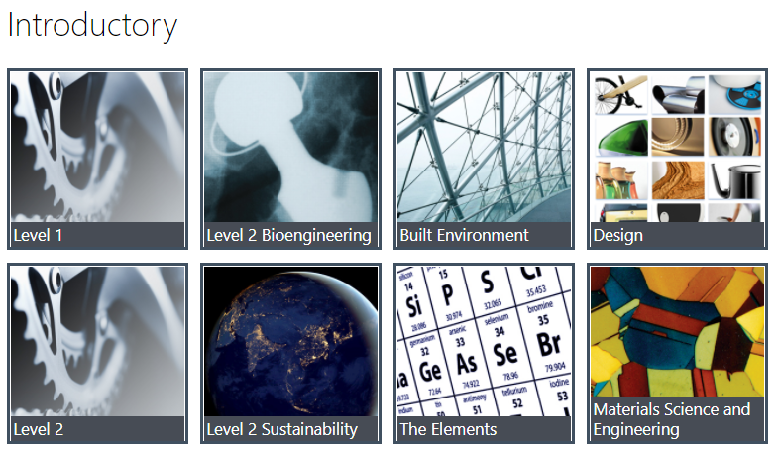
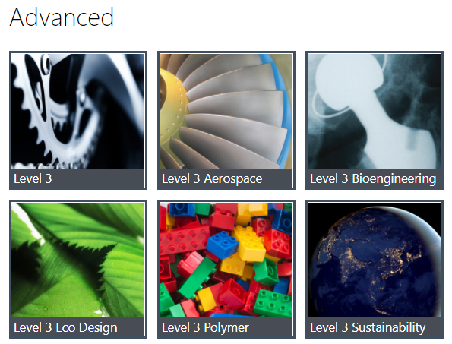
Granta EduPack
Notes:
Granta EduPack
There are two databases within Granta EduPack, which are relevant for bioengineering.
Level 2 Bioengineering
Level 3 Bioengineering

Slide 9
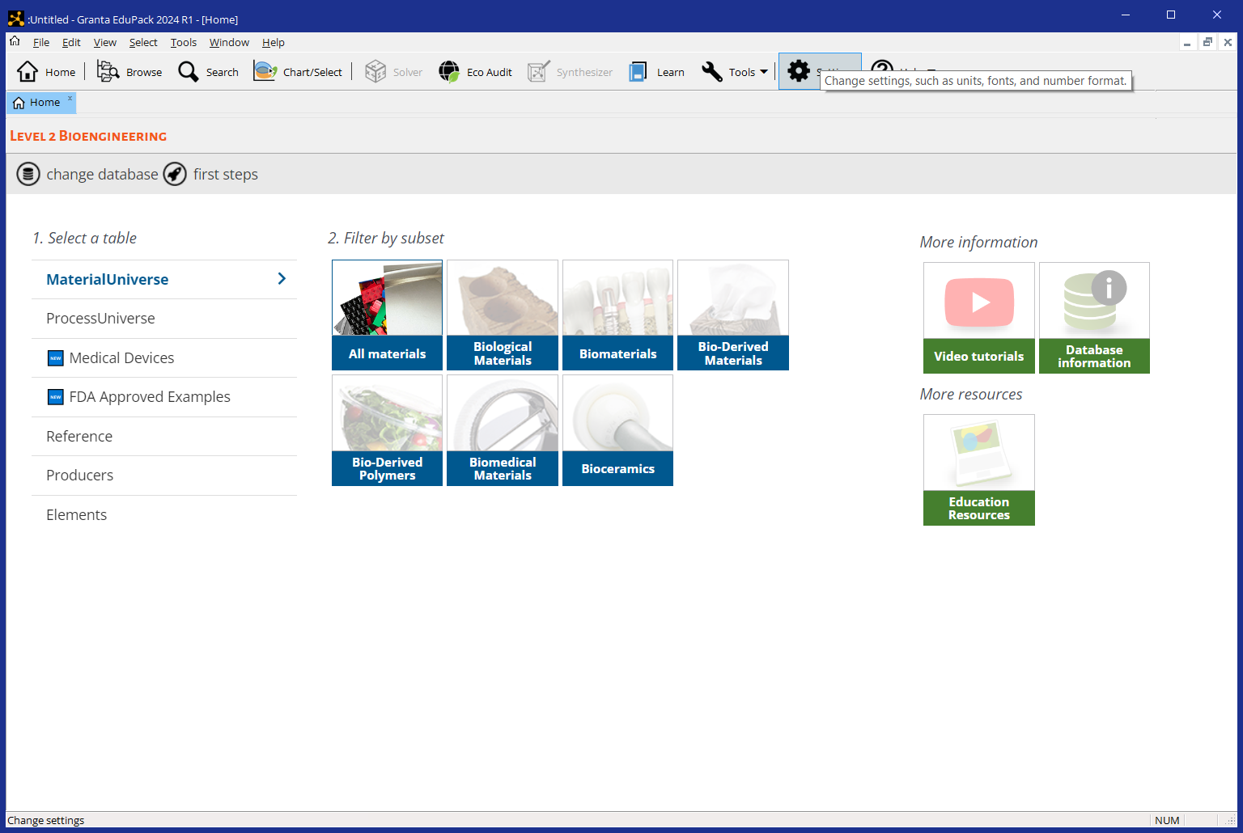

Granta EduPack: Level 2 Bioengineering
Produced by a biological system i.e., plant and animal
321 materials
Blanket term for biological, natural, bio-derived, bio-inspired and biomedical materials
116 processes
Uses natural/ biological source as raw material
62 medical devices
117 FDA examples
Specific subset useful for biomedical materials
Elements
Biocompatible materials used in medical applications
Tools
Polymers which use natural/biological source as raw material
Eco Audit
Notes:
Level 2 Bioengineering
Here is a screenshot taken from the homepage of Granta EduPack Bioengineering- Level 2
In total there are 321 materials and 116 processes. There is also an Eco Audit tool, which allows students to assess the environmental impact of materials choice through the early design stages.
There are seven subsets, including ‘All materials’, which can be easily filtered from the home screen. A short description of each is shown above.

Slide 10
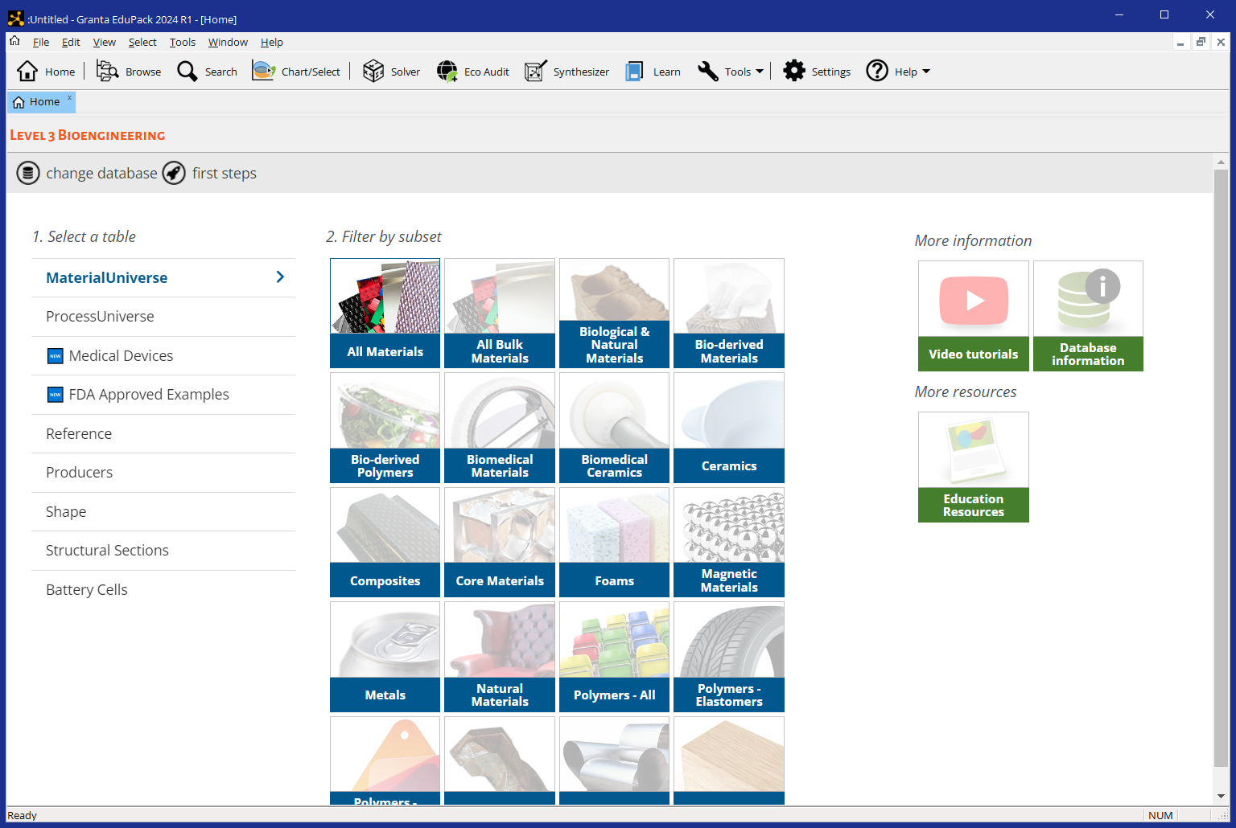


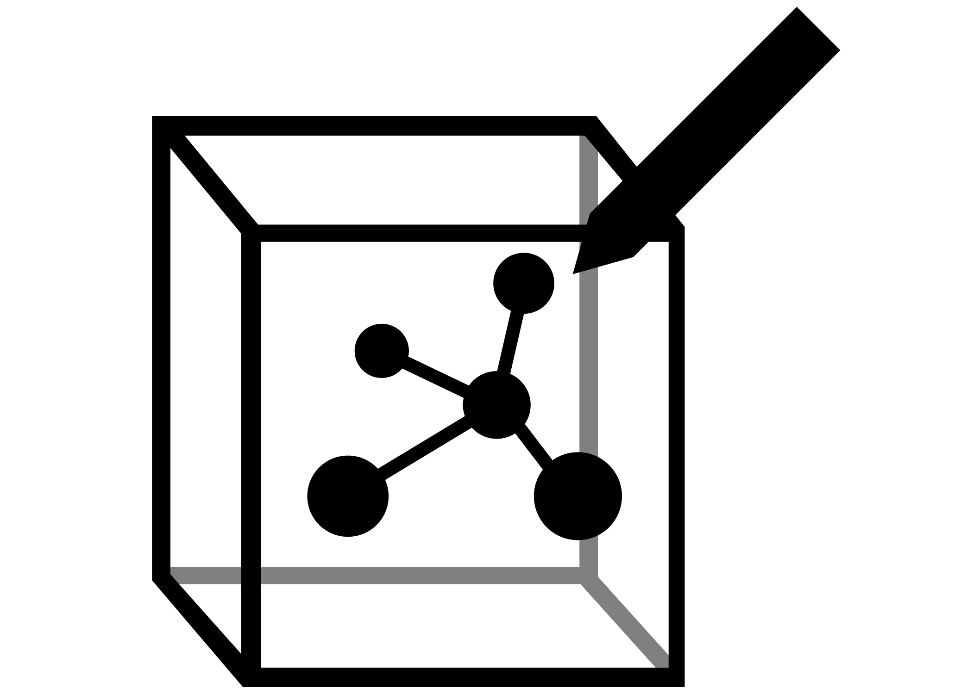
Granta EduPack: Level 3 Bioengineering
4261 materials
Tools
250 processes
Engineering Solver
62 medical devices
117 FDA examples
Enhanced Eco Audit
Shape
Structural Sections
Hybrid Synthesizer
20 subsets e.g., Natural Materials, Biomedical Materials, Composites, Polymers-Elastomers
Notes:
Level 3 Bioengineering
Here is a screenshot taken from the homepage of Granta EduPack Bioengineering- Level 3
In total there are 4261 materials and 250 processes, as well as more advanced tools including the Engineering Solver; the Enhanced Eco Audit; and the Hybrid Synthesizer.
This database has been designed for more advanced students, so that is can support real design project work.

Slide 11
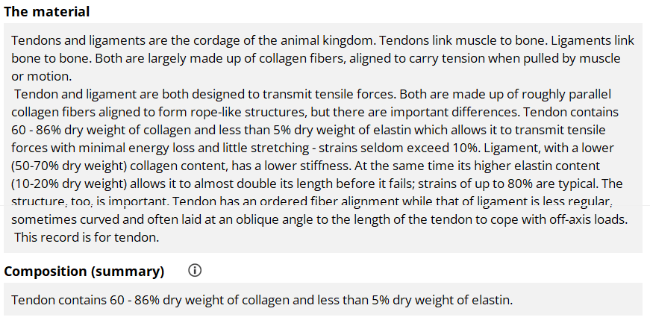

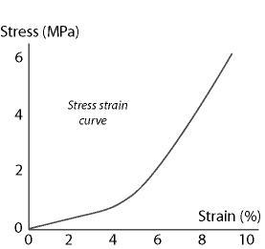
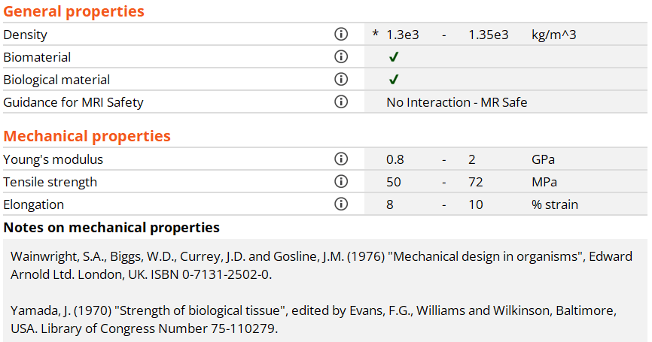


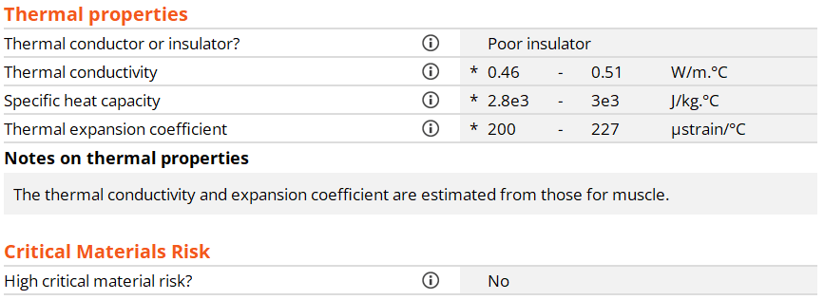
Record of a Tendon, Level 2 Bioengineering
Notes:
Level 2 Bioengineering datasheet- tendon
An example of a record in level 2 of the Bioengineering database is shown here. The record, here tendon, contains a description of the material as well as list of properties that are further categorized into different sections. An image of a tendon is shown; and stress-strain curves are provided where behaviour is strongly non-linear. The properties in the record will depend on the sources. Material properties for biological materials come from many different sources, and references used are indicated in the record itself for clarity.

Slide 12
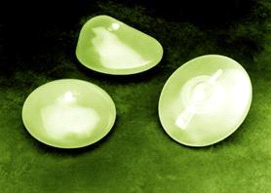
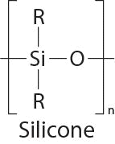
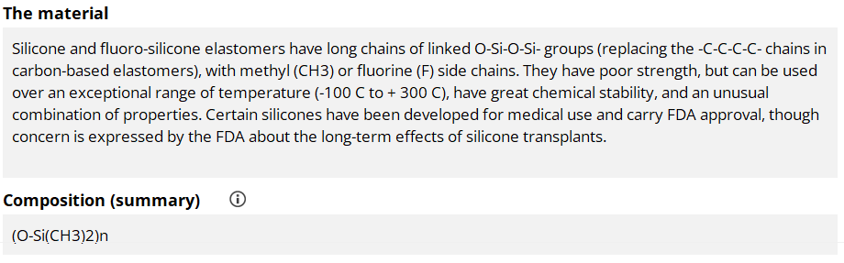
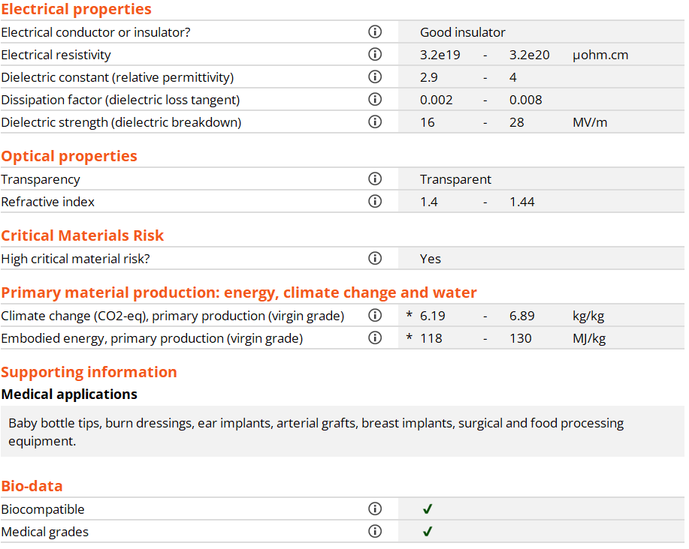
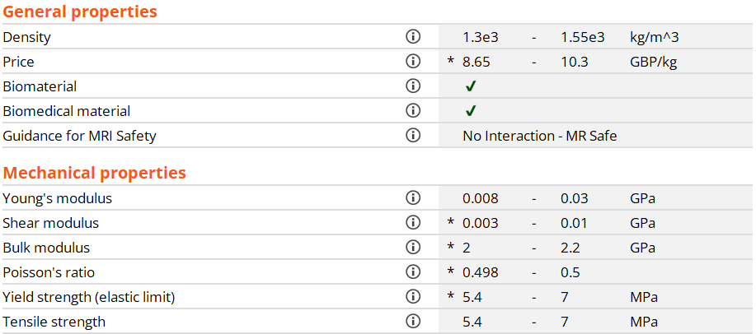
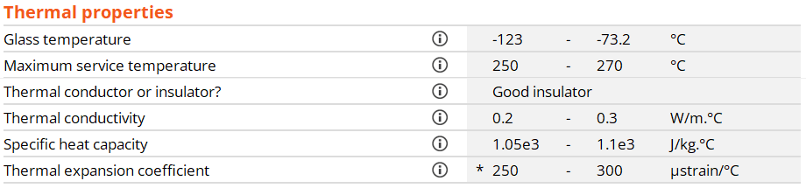
Record of silicone, Level 2 Bioengineering
Notes:
Level 2 Bioengineering datasheet- silicone
A second example of a record in level 2 of the Bioengineering database is provided here. In this case, silicone, unlike tendon, is a man-made material. This record contains additional properties such as price and bio-data information. All engineering records in the database have a similar format.

Slide 13
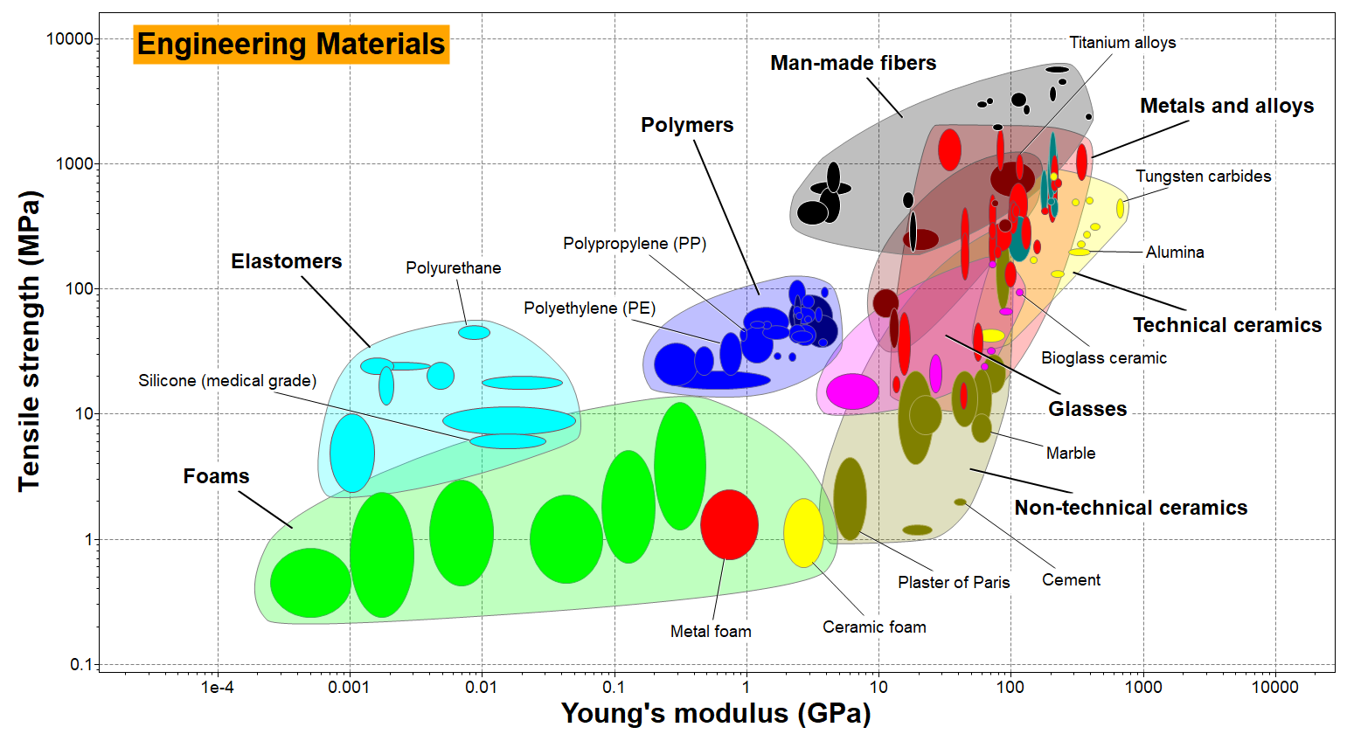
Material property chart, Level 2 Bioengineering
Notes:
Material Property Chart- modulus and strength
To show how Level 2 of the Bioengineering database can be used to introduce biomaterial properties, a series of charts will be displayed.
This slide shows the tensile strength of engineering materials plotted against Young’s modulus. Each small bubble encloses the range of a single material. The large envelopes enclose material classes: metals and alloys, polymers, elastomers, technical ceramics, glasses, non-technical ceramics, man-made fibers and foams.

Slide 14
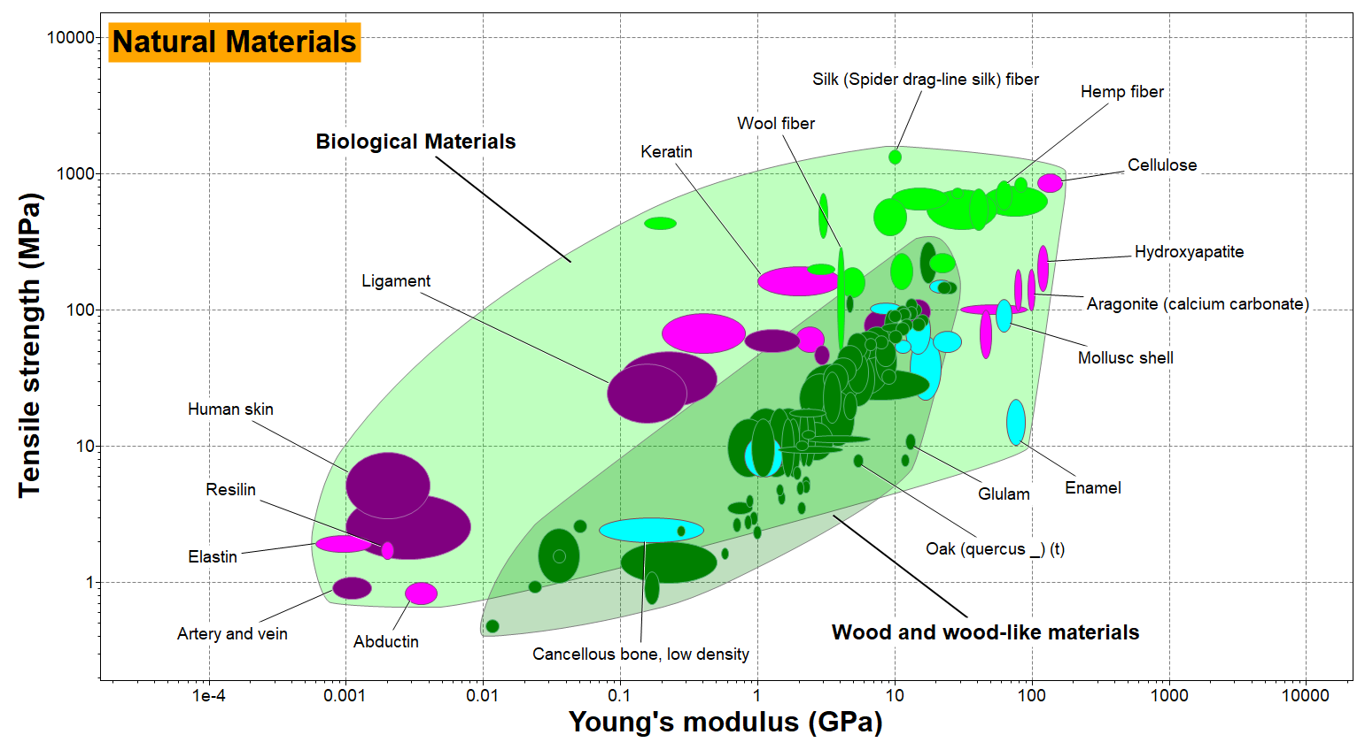
Material property chart, Level 2 Bioengineering
Notes:
Material Property Chart- modulus and strength
This second chart shows the same properties that appear on the previous frame under the same scale on both axis, but in this case for natural materials. Charts like these allow a direct comparison of the properties of natural and man-made materials.
Again, the little bubbles describe single materials while the larger envelopes show which category the material is in, including soft tissue, mineralized tissue, fibers and wood-like materials.
This second chart reveals that nature is able to synthesize materials with properties that cover a range almost as large as those of the engineering materials we use today.

Slide 15
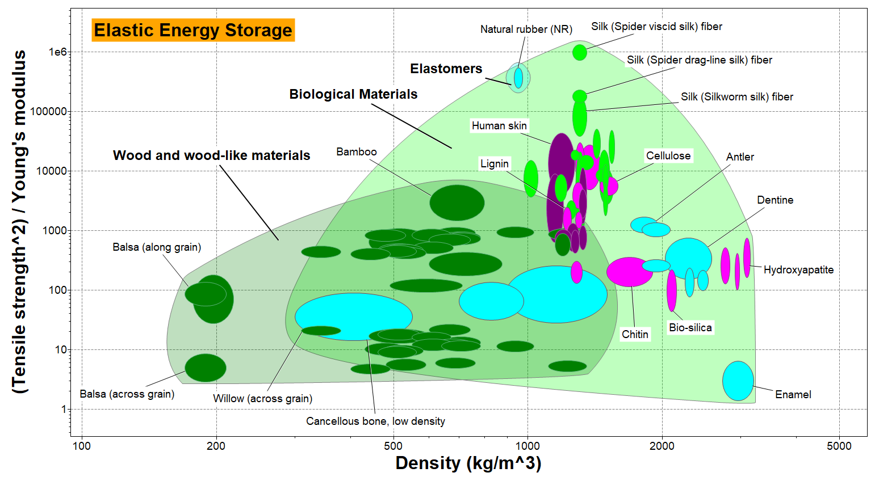
Material property chart, Level 2 Bioengineering
Notes:
Material Property Chart- stored elastic energy
This chart compares elastic energy storage and density. It displays the remarkable properties of natural materials. As you can see, such materials have evolved with particularly good values of both. Spider and silkworm silk excel by both criteria.

Slide 16
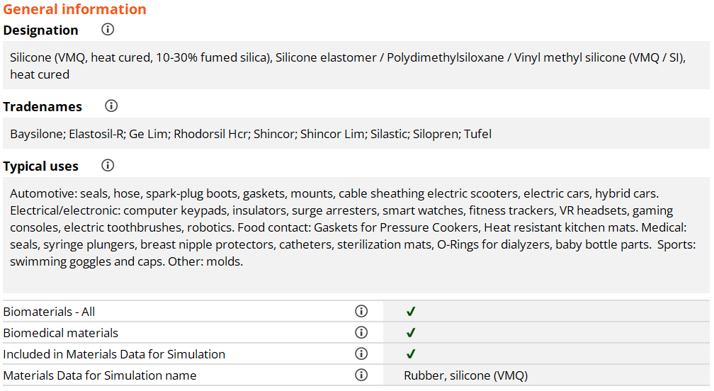
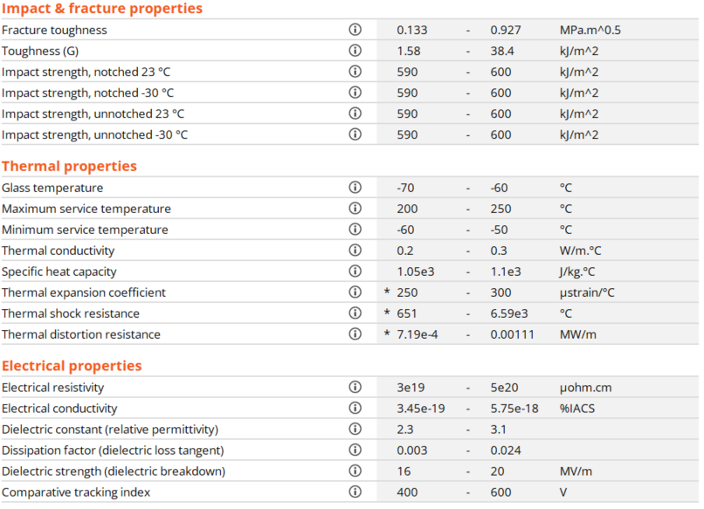
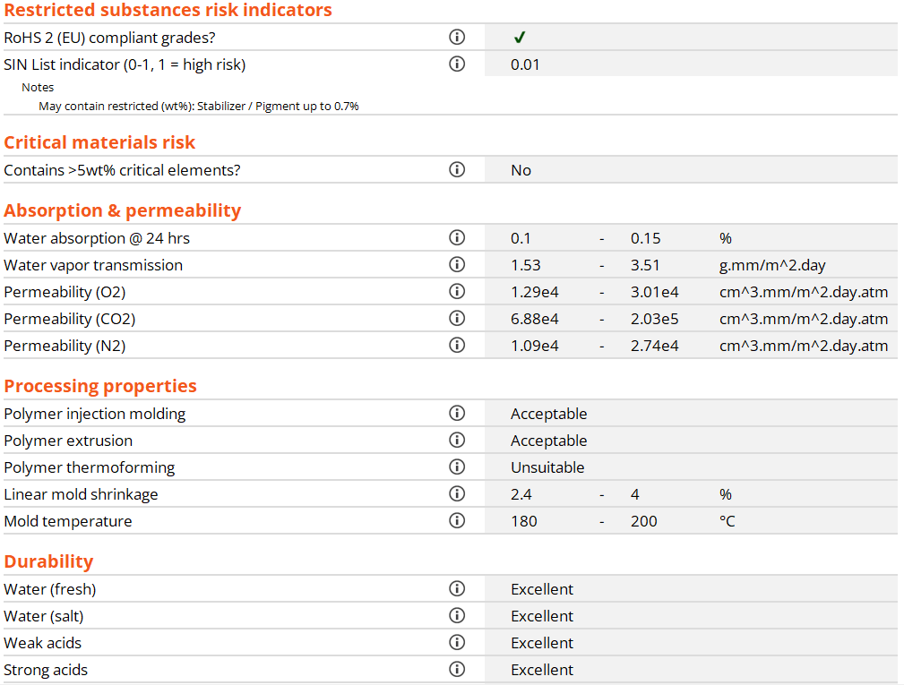
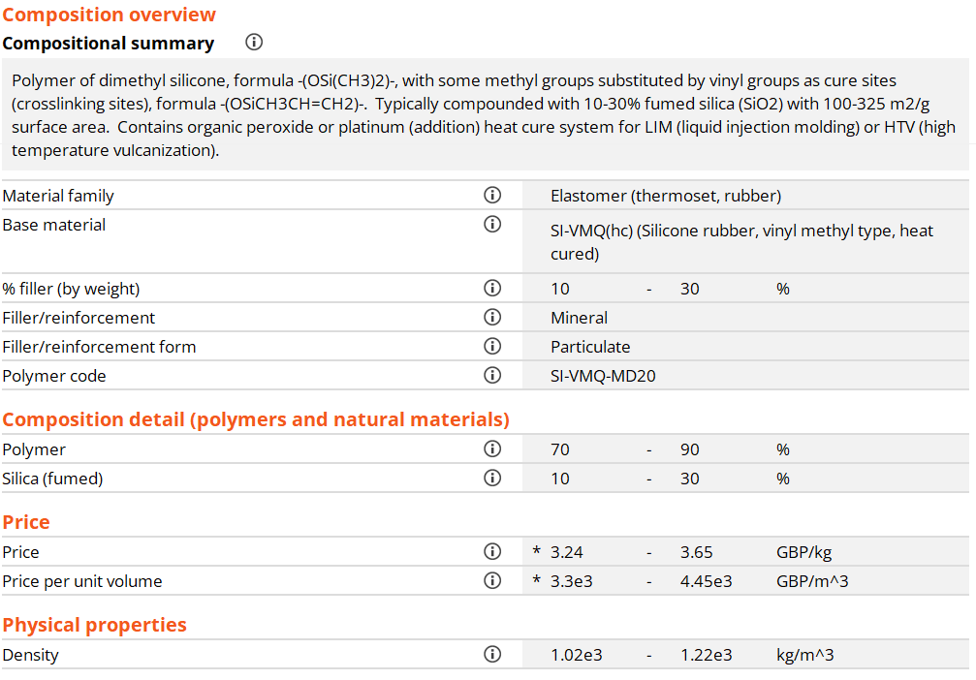
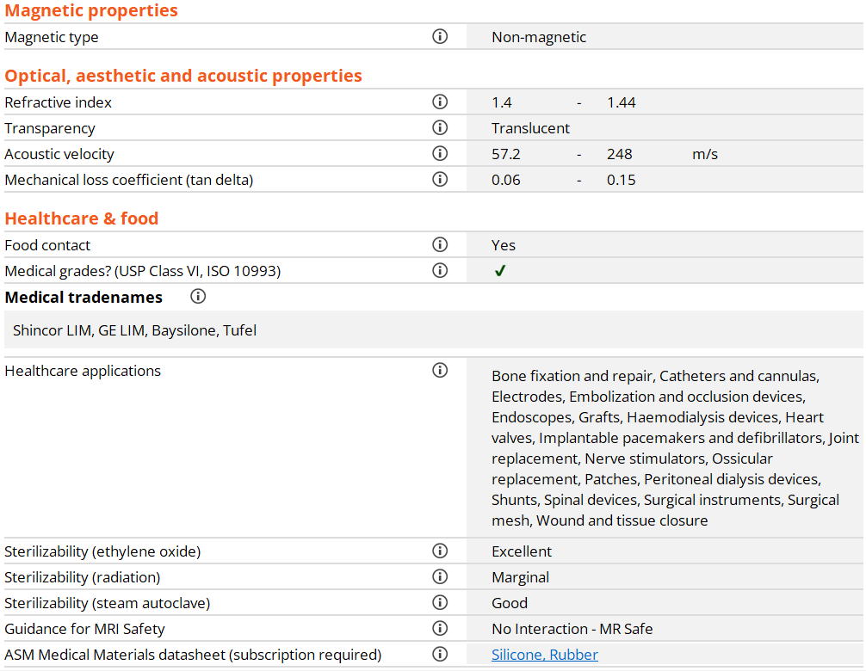
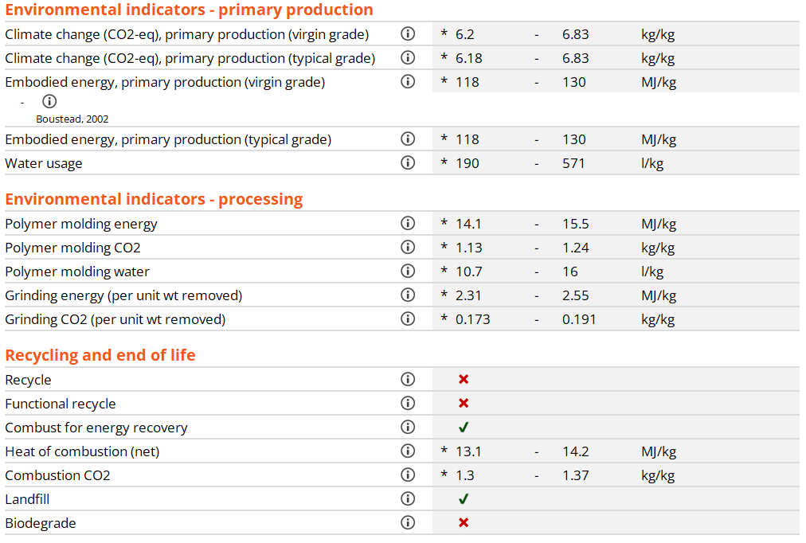
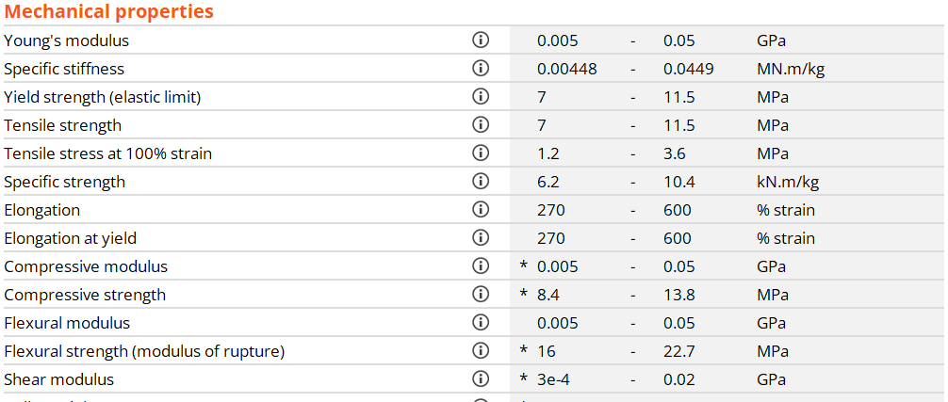
Record of silicone, Level 3 Bioengineering
More data at Level 3
External Link
Notes:
Level 3 Bioengineering datasheet- silicone
Here is a record of Silicone at level 3 of the bioengineering database. It contains more properties than at level 2 (as shown previously). It has a section on Healthcare and Food where attributes such food contact, medical grades, medical tradenames and healthcare applications as well as sterilizability and guidance for MRI safety are highlighted. It also contains a link to access the ASM Medical Materials Database.

Slide 17
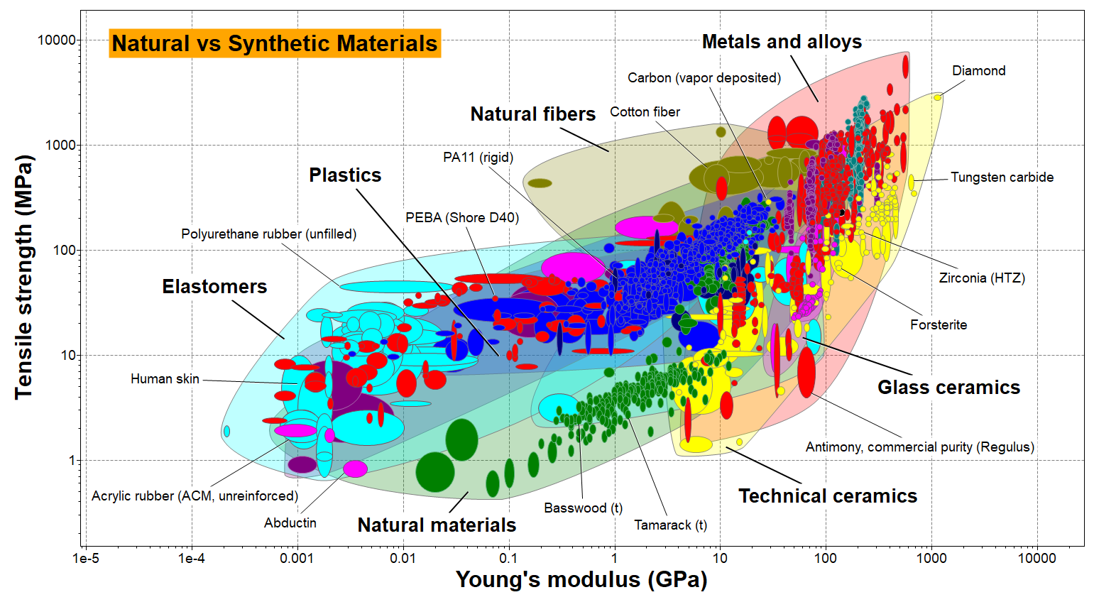
Material property chart, Level 3 Bioengineering
Notes:
Material Property Chart- modulus and strength
A chart of Tensile Strength vs Young’s modulus is plotted using all materials present in the level 3 Bioengineering database. Both natural and synthetic materials can be plotted in the same chart for easy comparison. In contrast to the charts plotted in level 2, there is a higher number of materials and grades represented here.

Slide 18


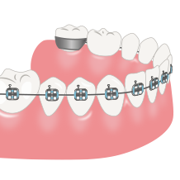

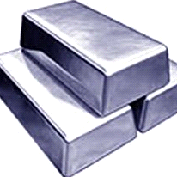
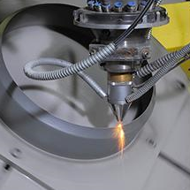
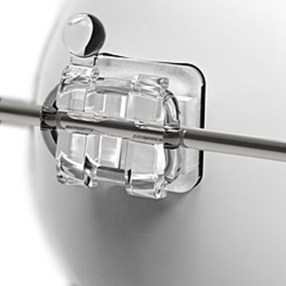
Database contents and structure
Granta EduPack is therefore an excellent source of material and medical device information.
But the structure of its datatables also allows students to explore specific links between medical devices and the materials that have been used to make them.
Medical Devices
Datatable
Links
Material Universe
Process Universe
FDA Approved Examples
The next two slides show an example from the medical devices and FDA approved examples, as well as the links which connect them.

Slide 19

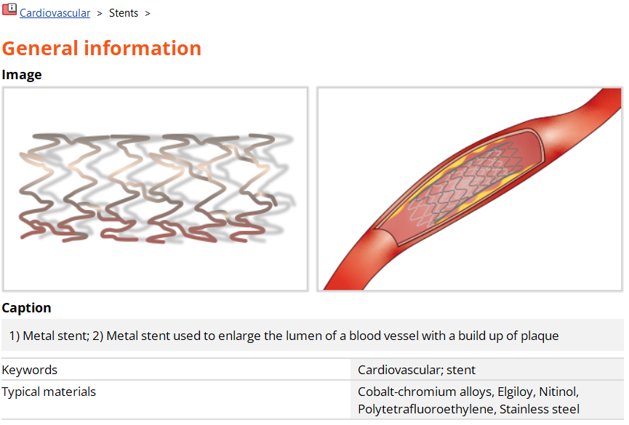
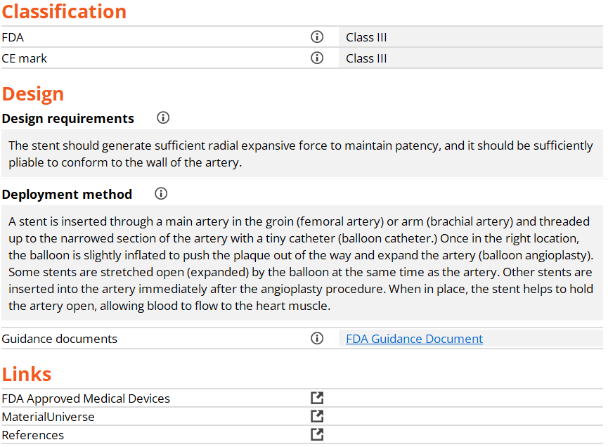
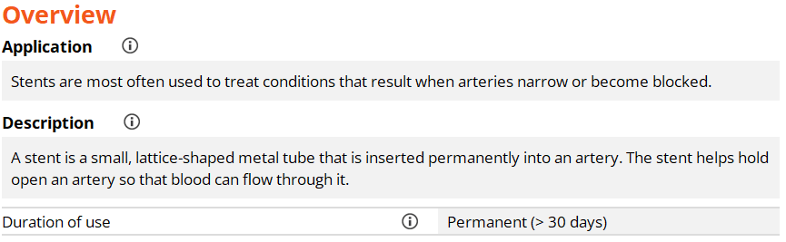

Medical Device record
Easy links from this generic metal stent to real-life FDA Approved Examples; typical materials used for application and references.
Notes:
Medical Device Record
An example record from the Medical Devices datatable is shown here, specifically for a Bare Metal Stent.
All Medical Device records start with an image followed by information about its application, classification and design requirements etc.
Links to relevant datatables are shown.

Slide 20


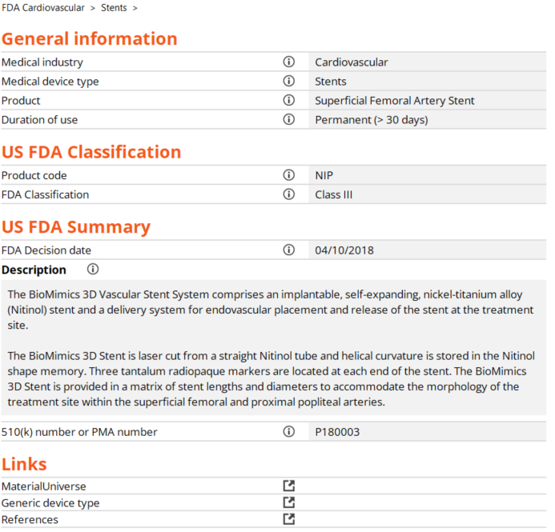
FDA Approved Example
General introduction to the 16 medical specialties, referred to by the FDA as panels.
3 letter combinations which associate a device’s type with the product’s classification e.g. NIP (Stent, Superficial Femoral Artery)
Specific details about the device including physical characteristics, date it was approved by the FDA and it’s 510(k) or PMA number.
Notes:
FDA Approved Example Record
An example record from the FDA Approved Examples datatable is shown here, specifically for a BioMimics 3D Vascular Stent. This was one of the relevant records which can be easily linked to the generic medical device bare metal stent shown on the previous slide.
FDA Approved Example contain specific, real-life information on a medical device which is currently on the market.
Links to relevant datatables are shown at the end.

Slide 21
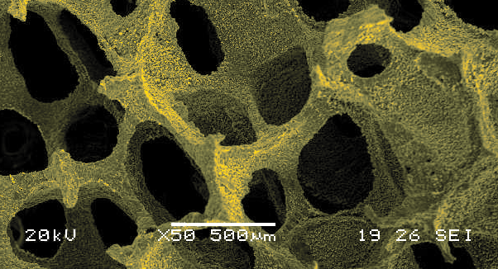
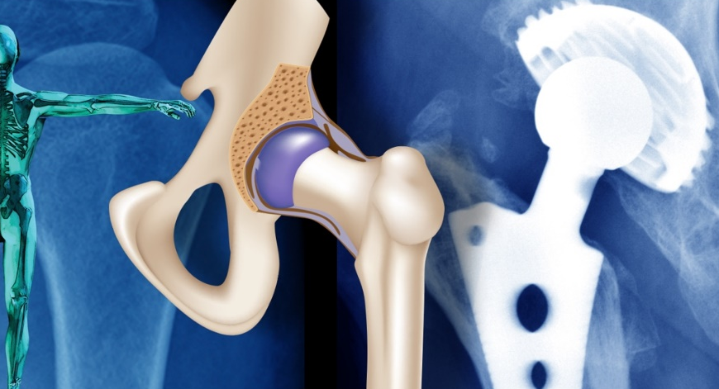
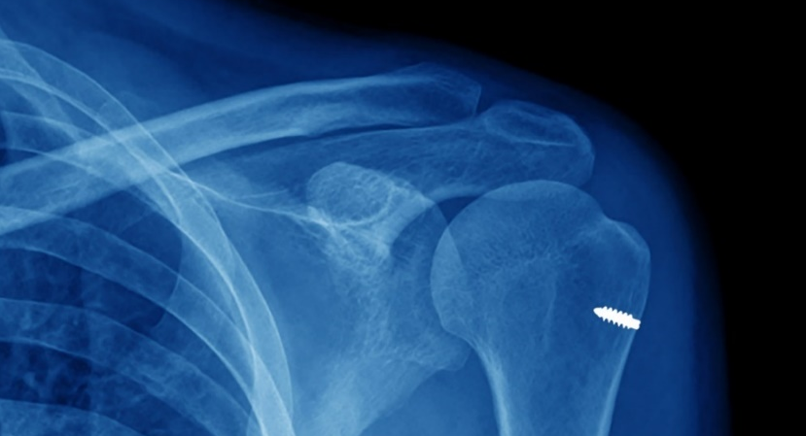

Ashby’s materials selection methodology
All Materials
1. Porous Scaffolds for Bone Tissue Engineering
3. Biomaterials Selection for a Joint Replacement
Breakdown design requirements into:
Function – What does the component do?
Constraints – What essential conditions must be met?
Objectives – What is to be maximized or minimized?
Screen on constraints – ‘Go/ no-go’ criteria (usually many)
Rank on objectives – Ordering of materials that ‘go’
Top Candidate Materials
4. Biomedical Waste: Health vs Environment
2. Suture Anchor Implant
Supporting information – Specialist databases, contact suppliers
Local conditions – Preferred suppliers, process capability, location
Final Selection
Notes:
Ashby’s Materials Selection Methodology
Granta EduPack can provide a systematic approach for materials selection i.e. screening and subsequent ranking based on material performance indices.
You can identify materials that meet your bioengineering design requirements and study top-ranking alternatives against an objective or the trade-off between two objectives. This enables an informed material choice based on the widest range of available information, while maintaining traceability to facilitate critical discussions about decisions. Above is a schematic description of a typical selection process.
Four advanced case studies are shown here, all of which are explored in the following slides.

Slide 22
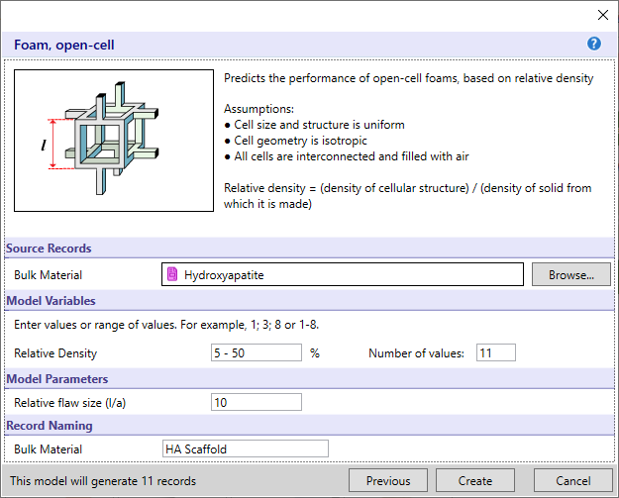

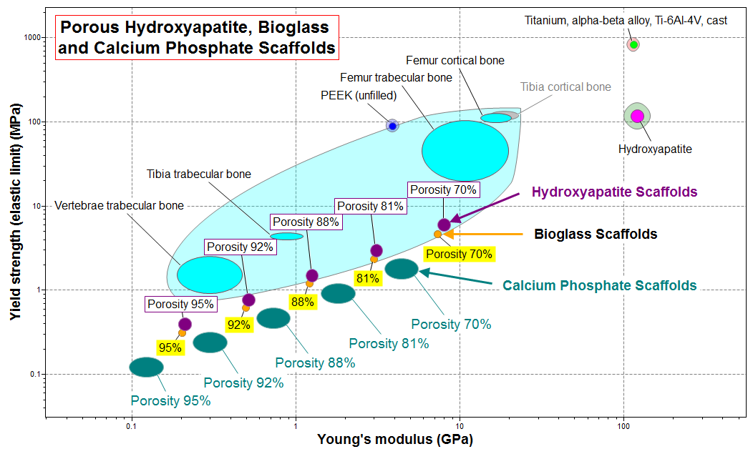
1. Porous scaffolds for bone tissue engineering
Objective: investigate the influence of porosity on the biomechanical properties of a hybrid scaffold materials (foam) using the Synthesizer tool in Granta EduPack.
Synthesizer
*Granta EduPack 2022R2 used for Case Study.
Notes:
1. Advanced Case Study- Porous Scaffolds
This case study investigates hybrid materials for scaffolds in bone tissue engineering. Implants are modeled using the Synthesizer tool as bioceramic foams with a range of porosities. The resulting materials can be compared to human tissue and biomaterials in property charts.
Link to the resource can be found here: https://www.grantadesign.com/teachingresources/caspsben17/
Granta EduPack 2022R2 used for Case Study.

Slide 23
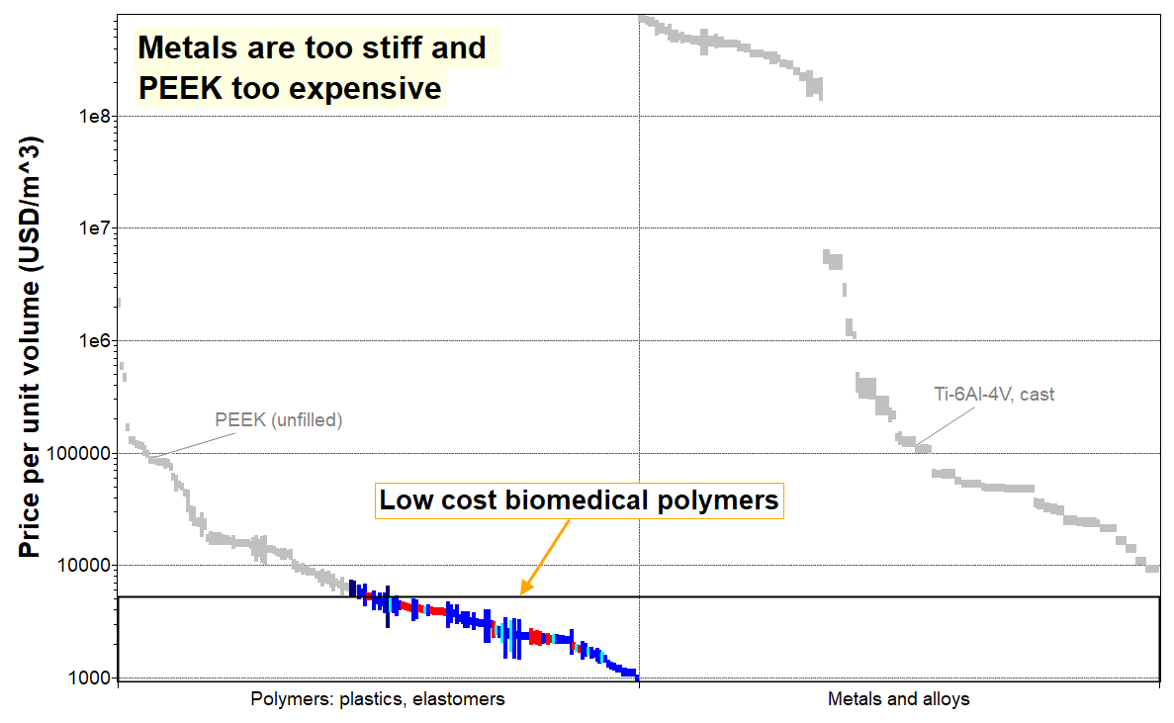
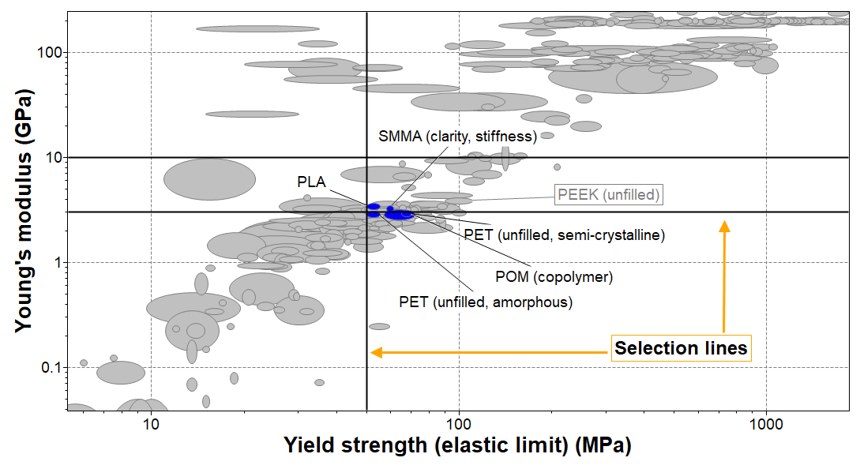
2. Suture anchor implant
Objective: to minimize the cost per volume, since the geometry is fixed.
Constraints:
Unfilled thermoplastics, no additive
Young’s modulus Min 3 GPa and Max 10 GPa
Adequate yield strength Min 50 MPa
Fracture toughness Min 4 MPam^0.5
Max Service temperature: Min 40 °C
Excellent resistance to water
*Granta EduPack 2022R2 used for Case Study.
Notes:
2. Advanced Case Study- Suture Anchor
This case study investigates candidate materials for a suture anchor implant. As shown above, the objective is to minimize cost under a set of constraints, typical for biomedical implants.
Details of the selection procedure can be found in the following link: https://www.grantadesign.com/teachingresources/cassaien15/.
Granta EduPack 2022R2 used for Case Study.

Slide 24



3. Biomaterials selection for a joint replacement
Objective: 1) Femoral stem, maximize specific strength and minimize cost; 2) Femoral head, maximize compressive strength and minimize wear (blunt abrasion)
*Granta EduPack 2022R2 used for Case Study.
Notes:
3. Advanced Case Study- Total Hip Replacement
This case study investigates the optimum materials for a total hip replacement, with a specific look at the roles of the main material classes in the implant. Metal alloys for structural integrity, ceramics for minimizing wear in the articulating surfaces or polymers as a lightweight alternative. All under the constraints of biocompatibility.
Full details can be found here: https://www.grantadesign.com/teachingresources/casbjren18/.
Granta EduPack 2022R2 used for Case Study.

Slide 25





4. Biomedical waste: health vs environment
Objective: investigate suitable materials for a biomedical sample vial and primarily assess options to minimize carbon footprint and then cost.
Changing this section allows comparison between the two material combinations:
Polystyrene vial with a polypropylene cap
Polypropylene vial with a polyethylene cap
Energy (MJ)
CO2 Footprint (kg)
*Granta EduPack 2022R2 used for Case Study.
Notes:
4. Advanced Case Study- Health vs Environment
This case study explores various aspects of materials and waste in the healthcare sector. It includes both materials selection for performance and clinical requirements as well as environmental consequences of disposable material and waste. For realism, there are easy links out to an external resource, the ASM Medical Materials DatabaseTM which contains over 60,000 approved medical devices.
Full details can be found here: https://www.grantadesign.com/teachingresources/casbmwen19/
Granta EduPack 2022R2 used for Case Study.

Slide 26






Overview of bioengineering resources
Bioengineering Level 2 and 3
Advanced Teaching
Research Online Database:
Medical Devices
Research
Human Biological Materials
Enhanced Eco Audit
Materials Selection
ASM Medical Materials Database
Undergraduate
Research / Industry
Notes:
Resource Overview
So far, we have seen two databases within Granta EduPack which are used for undergraduate teaching.
Granta Selector is a more advanced version of EduPack and an industry-standard tool for materials selection and graphical analysis of materials properties. Usual for engineers and designers of medical devices.
Granta Mi is the corporate web-based platform used to handle more extensive material information.

Slide 27
Summary
The Bioengineering databases in Granta EduPack presents natural and biomaterials in a well-organized and comprehensive format
Ashby charts help to visual the remarkable properties of natural materials
Enables comparison with man-made materials and systematic selection
Stimulates thinking about replacement and mimicry
Introduced in 2023R1, Medical Devices and FDA Examples are included in both Level 2 and Level 3 databases, with links between materials, devices, and FDA examples
Links to the Advanced Case Studies can be found here: www.ansys.com/education-resources
Notes:
Summary
This brief introduction to the Granta EduPack Bioengineering database gives a flavor of how it can be used to explore the properties of natural materials and compare them with those of man-made materials. It provides a tool to engage the interest of students, with supporting exercises and project work.

Slide 28
Lecture unit series
PowerPoint lecture units, as well as many other types of resources, can be found in the Ansys Education Resources webpage.
Finding and Displaying Information
Unit 1 | The materials of engineering
Unit 2 | Material property charts: mapping materials
Unit 3 | The Elements database: properties, relationships and resources
Material Properties
Unit 4 | Manipulating properties: composition, microstructure, architecture
Unit 5 | Designing new materials: filling the materials-property space
Unit 6 | Materials Science and Engineering
Selection
Unit 7 | Material selection: translation, screening, ranking, documentation
Unit 8 | Objectives in conflict: trade off methods and penalty functions
Unit 9 | Material and shape: materials for efficient structures
Unit 10 | Manufacturing processes and cost modeling
Unit 11 | Eco-informed material selection
Unit 12 | Eco design and the Eco Audit tool
Sustainability
What is a sustainable development? A materials perspective
Exploring Critical Materials using Ansys Granta EduPack
Special Topics
The Built Environment: materials for construction
Structural sections: shape in action
Materials in industrial design: Why do consumers buy products?
The Design database for Products
The Medical Devices database
The Battery Designer tool
Advanced Teaching and Research
Advanced databases: a lightning tour
The Aerospace edition
The Polymer edition
The Synthesizer tool: hybrids and other models
Materials for Bioengineering
www.ansys.com/education-resources
Notes:
Lecture Units Series
This is a list of the Lecture Units available for teaching with the Ansys Granta EduPack. These PowerPoint presentations and more information can be found on the Ansys Education Resources webpage:
www.ansys.com/education-resources.

