Slide 1
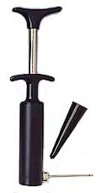
Unit 7.
Material selection:
Translation, screening, ranking, documentation
Mike Ashby
Department of Engineering,
University of Cambridge
Notes:
The PowerPoint Lecture Units For 2024
The Lecture Units developed for teaching in connection with Granta EduPack are listed at the end of this presentation.

Slide 2
Learning objectives for this lecture unit
Intended Learning Outcomes
Knowledge and Understanding | Knowledge and understanding of the design process using Material Indices
Skills and Abilities | Ability to use Granta EduPack to apply screening and ranking to material properties
Values and Attitudes | Appreciation of design-led decision-making using Granta EduPack tools
Resources
Text: “Materials: engineering, science, processing and design” 4th edition by M.F. Ashby, H.R. Shercliff and D. Cebon, Butterworth Heinemann, Oxford, 2019, Chapter 3, 5 and 7.
Text: “Materials Selection in Mechanical Design”, 5th edition by M.F. Ashby, Butterworth Heinemann, Oxford, 2016, Chapters 4-5
Notes:
Learning Objectives
These Intended Learning Outcomes are based on a taxonomy of knowledge and understanding as the basis, skills and abilities as necessary for the practical use of knowledge and understanding, followed by acquired values and attitudes enabling assessments and responsible use of these abilities.
Combined with a suitable assessment, they should be helpful in the context of accreditations or for the CDIO Syllabus.
The Texts listed are from books authored or co-authored by Mike Ashby but other texts are also referred to in the Science Notes.

Slide 3
Outline of lecture unit 7
Linking materials to design
The selection strategy:
Translation – Screening – Ranking - Documentation
The Ansys Granta EduPack selection toolbox
Limit stages
Graph stages
Tree stages
Material indices do the job
Notes:
Outline
This is the seventh Unit of a course on Material and Process Selection. The Units link closely to the first two Texts listed on this frame but can equally by used in conjunction with texts such as Callister, Budinski, Askeland and others. The relevant chapters of the Texts are listed on the Outline frame of each Unit. The methods developed in the course are implemented in the Granta EduPack software, which is structured to evolve in pace with the student throughout a four-year engineering program. This first Unit introduces materials and processes, and the way in which information about them can be classified, stored, retrieved and explored.

Slide 4
The design process
Market need
Material data needs
Data for material family
(metals, ceramics, polymers..)
Data for material class
(Steel, Al-alloy, Ni-alloy…..)
Data for single material
(Al-2040, Al-6061, Al-7075…..)
Problem statement
Concept
Embodiment
Detail
Product specification
Notes:
The three stages of Design
Design starts with the identification of a market need. Concepts (general working principles) are identified to fill the need. The most promising of these are developed into sketches or diagrams indicating configuration, lay-out and scale (“embodiment”). One or more of these is selected for detailed development, analyzing performance, safety and cost. The output is a design enabling the construction of a prototype that, after testing and development, goes to manufacture.
Material information enters all stages of the design. At the concept stage the design is fluid and all materials are candidates. Here the need is the ability to scan the entire Materials Universe, but at a low resolution. As the design gels and the requirements become sharper, the need becomes that for information about fewer materials but at a higher level of precision. In the final, detailed stage when finite element, optimization and other analyses are undertaken, the need is for data for just one or a very few materials at the highest precision. The screening process narrows the initially wide material search space containing all materials ultimately leading to a final single choice.

Slide 5
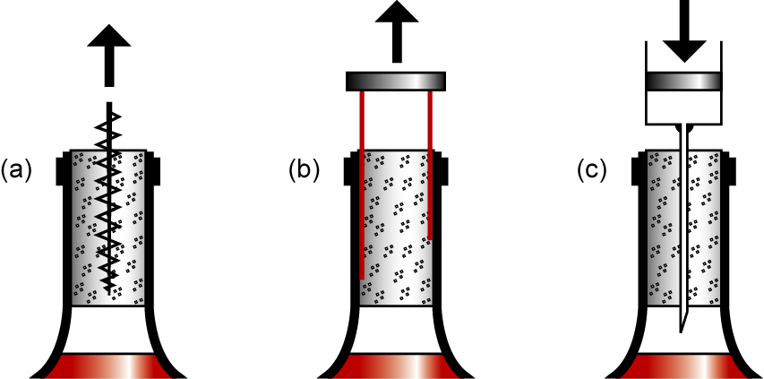
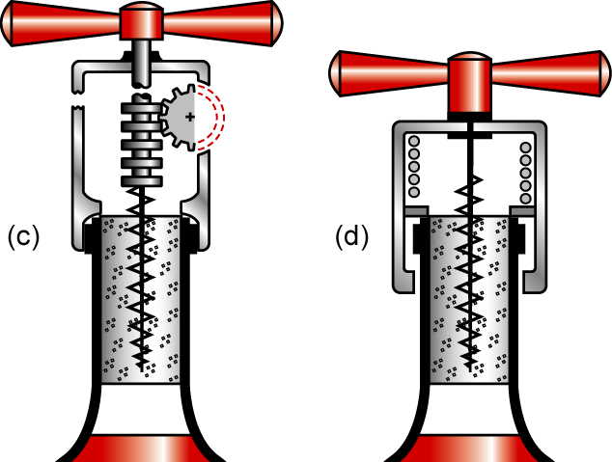
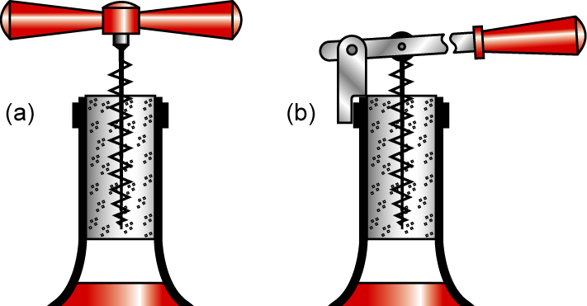
Need – Concept – Embodiment
Need
Concepts
Embodiments
Direct pull
Levered pull
Geared pull
Spring-assisted pull
Notes:
Concepts and embodiments for corkscrews
Here is an example of the design process at work. By storing wine in a corked bottle, a need is created – that of a device to remove the cork when you want to drink it. Three concepts are shown at the top left: (a) a tensile force is exerted on the cork using a threaded screw, (b) shear tractions are applied to the cork via thin elastic blades, and (c) a pressure is applied below the cork by forcing air into the bottle. (All three concepts have been developed into products and are marketed.)
The lower row shows four embodiments of just one of these – the tensile pull. At (a) is direct pull, and (b) is levered pull, at (c) is geared pull and at (d) is spring-assisted pull.

Slide 6
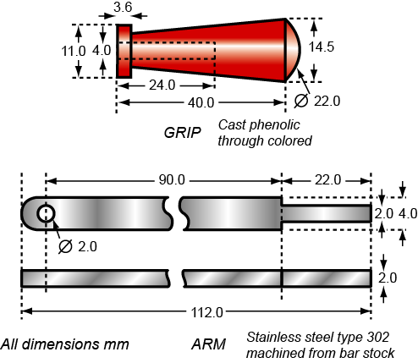
Embodiment – detail
Embodiment
Detail
How are those choices made?
Notes:
Detail design
Here we show the detailed design stage for the lever and grip of the cork screw design ringed in red on the previous frame. The output is a set of drawings or CAD files from which a prototype can be made.

Slide 7
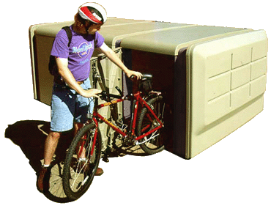
The selection strategy: materials
Design requirements:
expressed as
Constraints and
Objectives
Data:
Material attributes
Process attributes
Documentation
Comparison engine
Screening
Ranking
Documentation
Able to be molded
Water and UV resistant
Stiff enough
Strong enough
As cheap as possible
(As light as possible)
Density
Price
Modulus
Strength
Durability
Process compatibility
More…….
Final selection
Notes:
The strategy applied to material selection
This frame illustrates the decision-making strategy applied to the selection of a material.
The Design requirements (upper left) are expressed as constraints that the material must meet and the objectives, defined in a moment, that are chosen as measures of the excellence of choice.
The Data (upper right) takes the form of a database of the attributes of the materials and processes that are possible candidates for the design.
The comparison engine applies the constraints, eliminating materials that cannot meet the requirements, and then ranks the survivors, using the objectives, to create a short list. The final choice is made by exploring documentation of the top-ranked candidates.

Slide 8
Translation is important
Translation: “express design requirements as constraints and objectives”
Design requirements
Typical Constraints
What essential conditions must it meet ?
Be strong enough
Conduct electricity
Tolerate 250˚C
Be able to be cast
Typical Objectives
What measure of performance is to be maximized or minimized ?
Mass
Volume
Eco-impact
Cost
Screening: “use constraints to eliminate materials that can’t do the job”
Notes:
Converting design requirements into selection criteria
The first step is that of translating the design requirements into a specification for materials selection. This frame outlines how this is done.
The steps are summarized here:
Identify the function of the component for which the material is sought.
Identify and list the constraints it must meet: its ability to carry loads safely, satisfy limits on thermal or electrical properties and so forth.
Identify the objective(s) – what is the ultimate goal fo selecting the best material: minimize the mass? The cost? The environmental impact?
Finally, identify the free variables – those that the designer is free to change: usually dimensions or shape, and, of course, the choice of material.
From this analysis emerges the inputs to the next two key steps in selection: screening and ranking. We will see examples of translation and screening in a moment. First, the Granta EduPack selection toolbox..

Slide 9
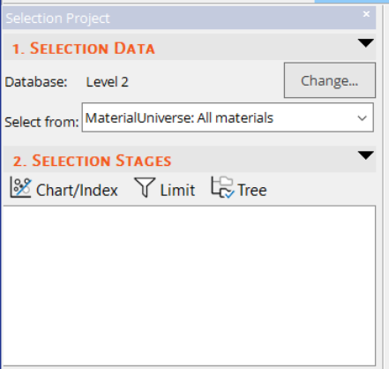
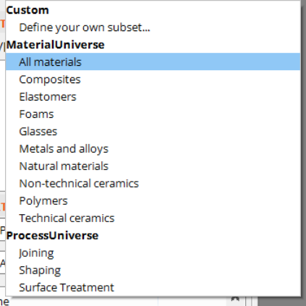
Creating Charts – choosing materials to plot

Slide 10
Creating Charts – single property charts
Bar chart
Property
Choose:
X-Axis
Y-Axis
Y-Axis
Bubble chart
List of properties
Density
Yield strength
Young’s modulus
etc.
Property 1
Property 2

Slide 11
Creating Charts – advanced property charts
Bar chart
Modulus / Density
Modulus / Density
Choose:
+
-
/
*
^
(
)
X-Axis
Y-Axis
List of properties
Density
Yield strength
Young’s modulus
etc
List of properties
Advanced
Density
Yield strength
Young’s modulus
etc.
Bubble chart
Modulus / Density
Yield strength / Density

Slide 12
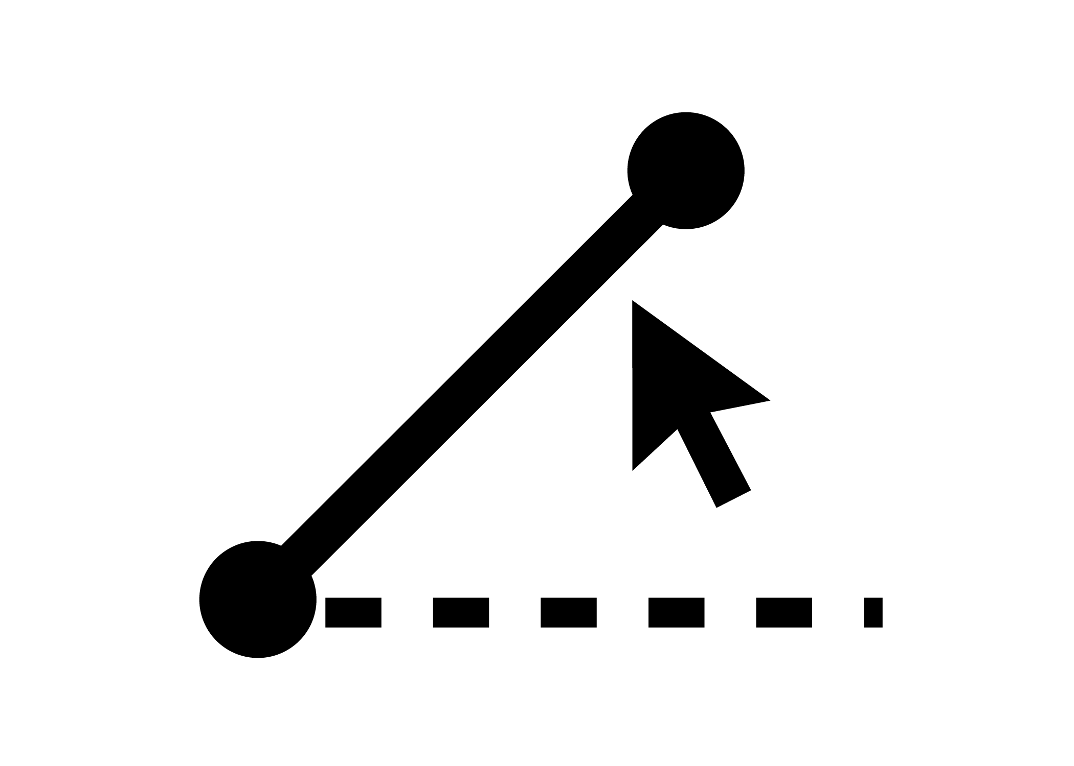
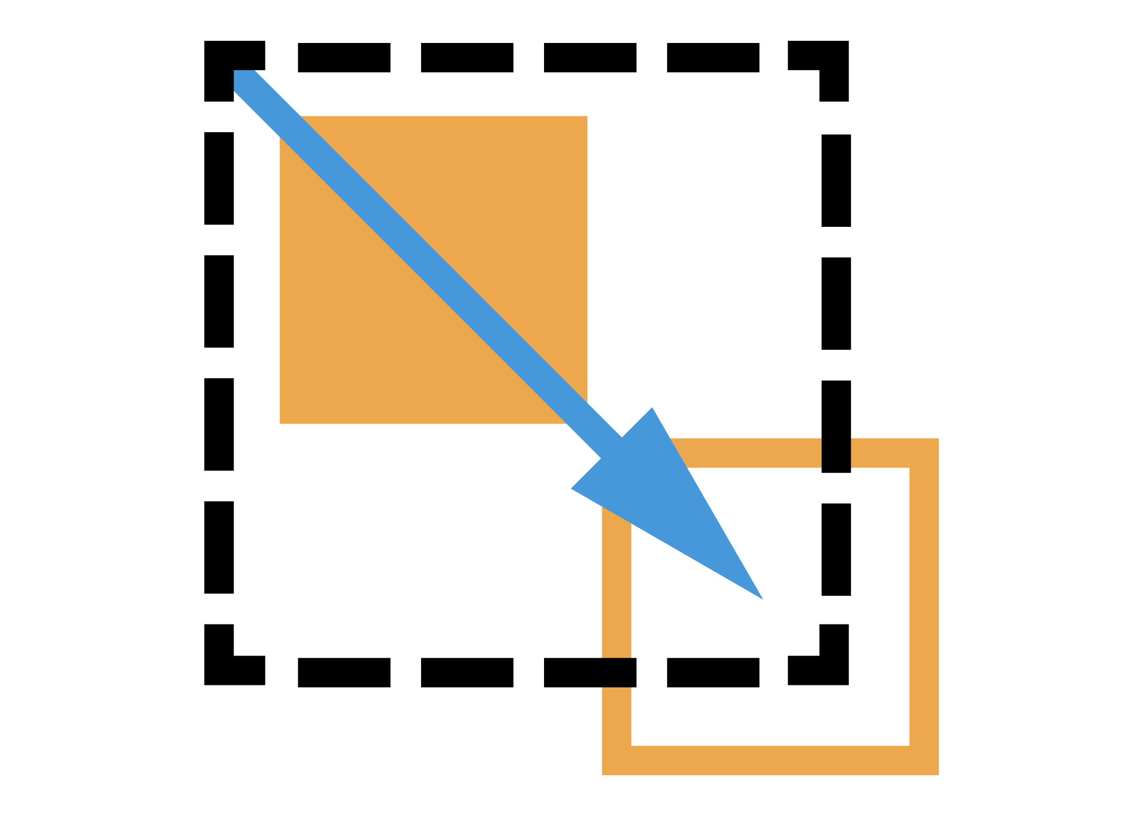
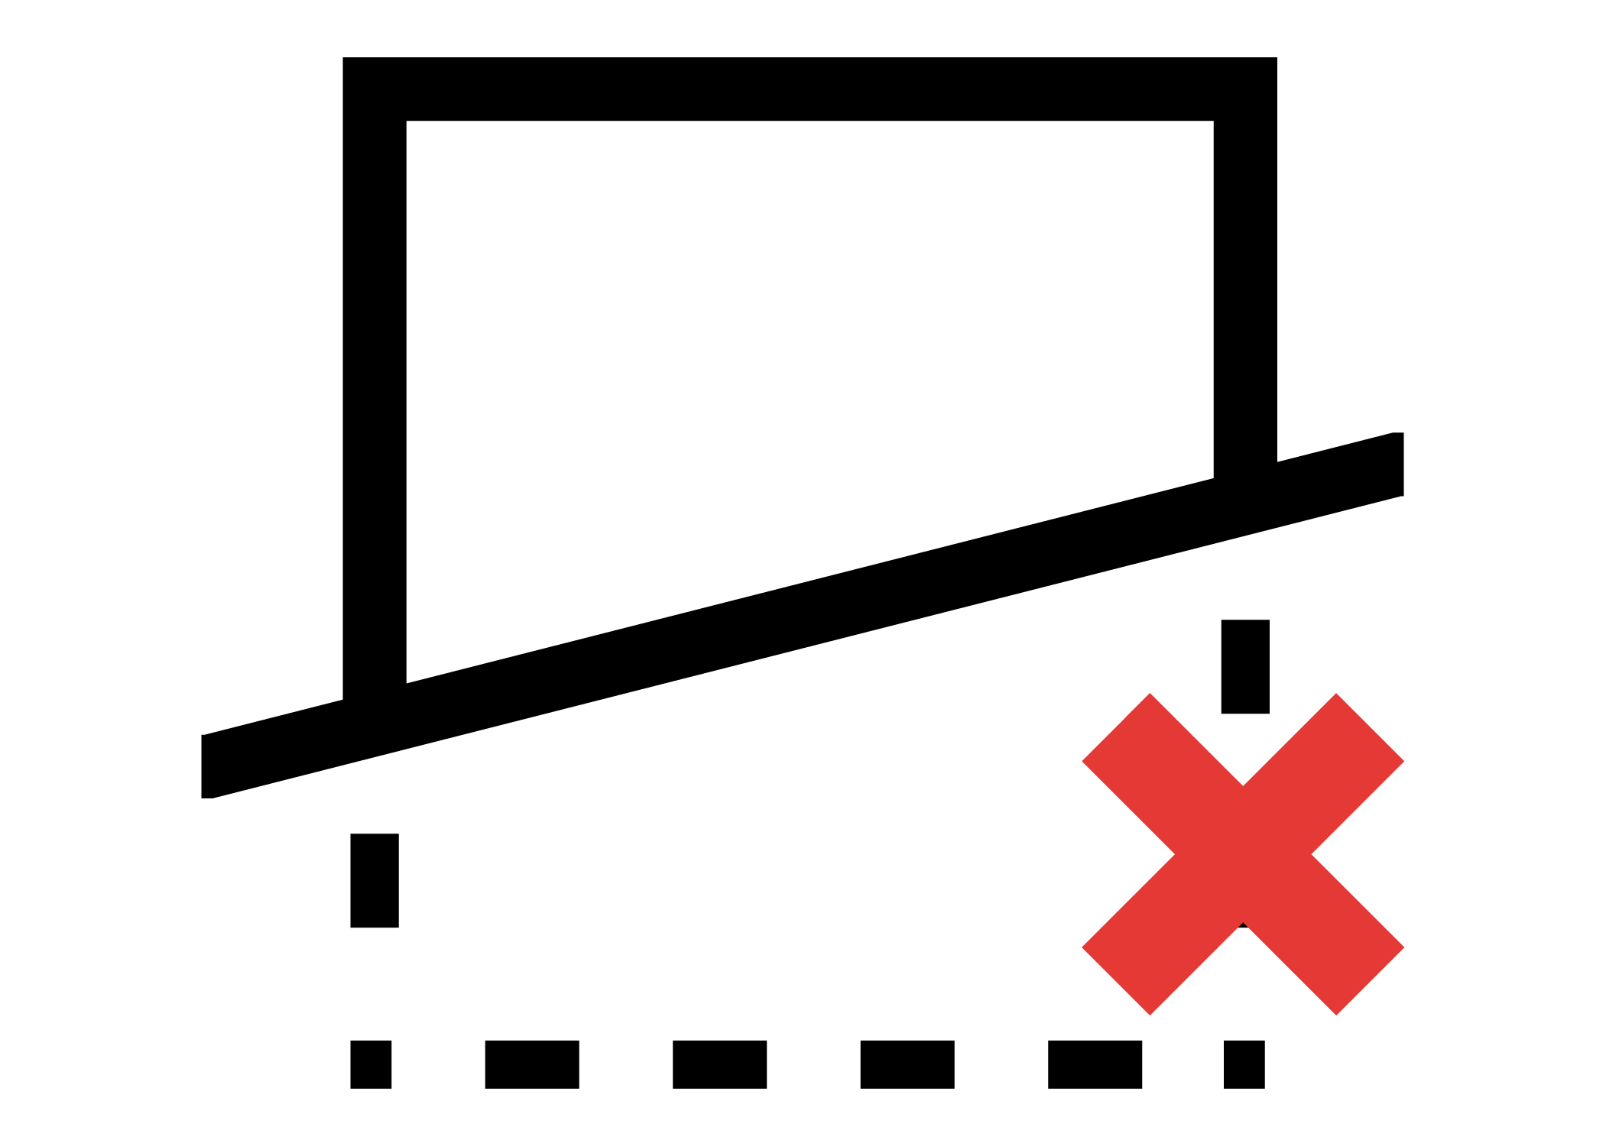
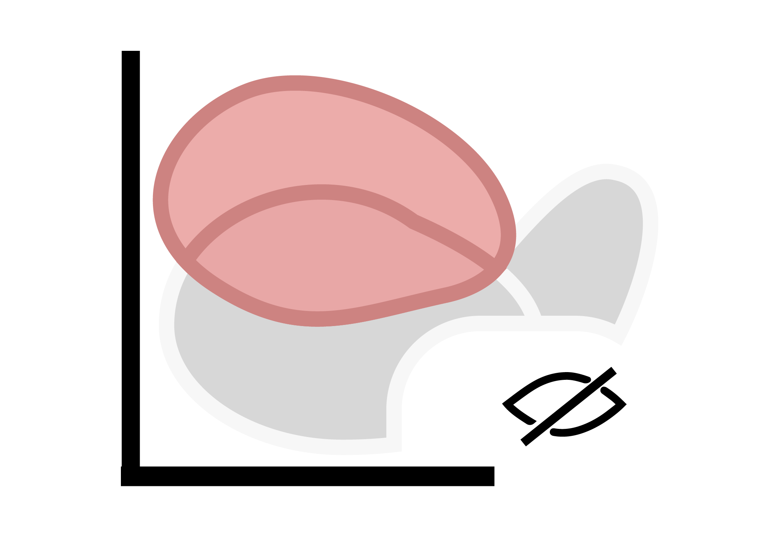
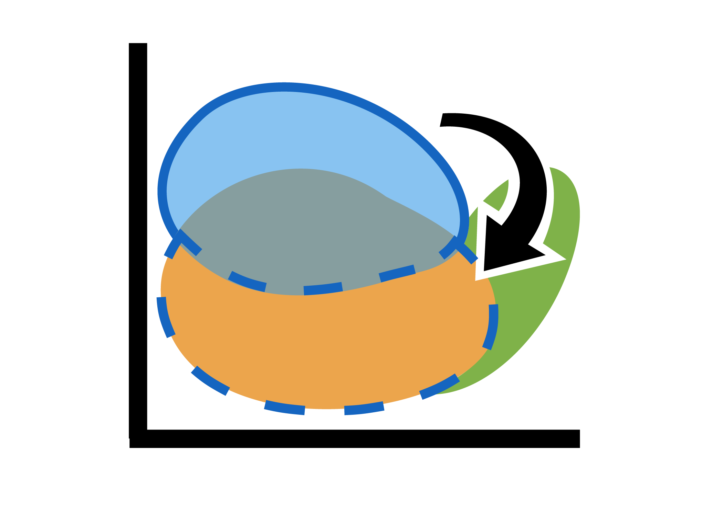
The Chart tool bar
Materials Selection Tools
Chart Annotation Tools
Data highlight tools*
Delete lines & boxes
Curve
Change to nearby record
User defined records
Box selection
Arrow
Synthesized records
Index line
Text
Reference Record
Favorite records
Zoom in
Show family
envelopes
Hide failed results
Chart settings
Zoom out
*these icons will be grayed out unless (1) record type is available in project or
(2) single material is selected on chart
Cursor
Autoscale
Show results from all enabled stages
Chart Scale
Tools
Choosing data shown in chart
Notes:
Selection and Chart Customization tools
All the charts shown in these Units were made with the Granta EduPack software. When a chart is created the chart management tool bar appears across its top edge.
The chart management tool bar provides tools for:
Exploration – of the chart by zooming into selected areas of it
Selection – applying a box or line selection, and removing it again
Customization – of the chart by adding text labels, adding envelopes round the families of materials, making materials that have failed other selection stages appear in grey or disappear altogether
Curve and Arrow annotation can be added to aid comments on the charts

Slide 13
Screening with a CHART STAGE
Bar chart
Property
Box Selection Tool
Results
X out of 100 pass
Ranking
Prop 1 Prop 2
Material 1 2230 113
Material 2 2100 300
Material 3 1950 5.6
etc...
Bubble chart
Property 2
1
Index &
Display Line Tool
Property 1
Notes:
Selection by applying box or line criteria to charts
The use of the Chart facility to create bar charts and bubble charts was described in Unit 2. The tool bar that appears above a chart contains selection tools. Two are illustrated here.
A box selection isolates a chosen part of a chart. Any material bar or bubble lying in, or overlapping the box is selected; all others are rejected. The selected materials appear in the Results window, where they can be ranked by the value of the property.
A line selection divides a bubble chart into two regions. The user is free to choose the slope of the line, and to select the side on which materials are to be chosen. This allows selection of materials with given values of combinations of material properties such as E/ρ, where E is Young’s modulus and ρ is density. As before, the selected materials appear in the Results window where they can be ranked by either property or by the combination.
Chart stages can be combined with Limit stages (and with Tree stages, coming next) in any combination and any order. The Results window lists the materials that meet all the constraints, regardless of the way they are applied.

Slide 14
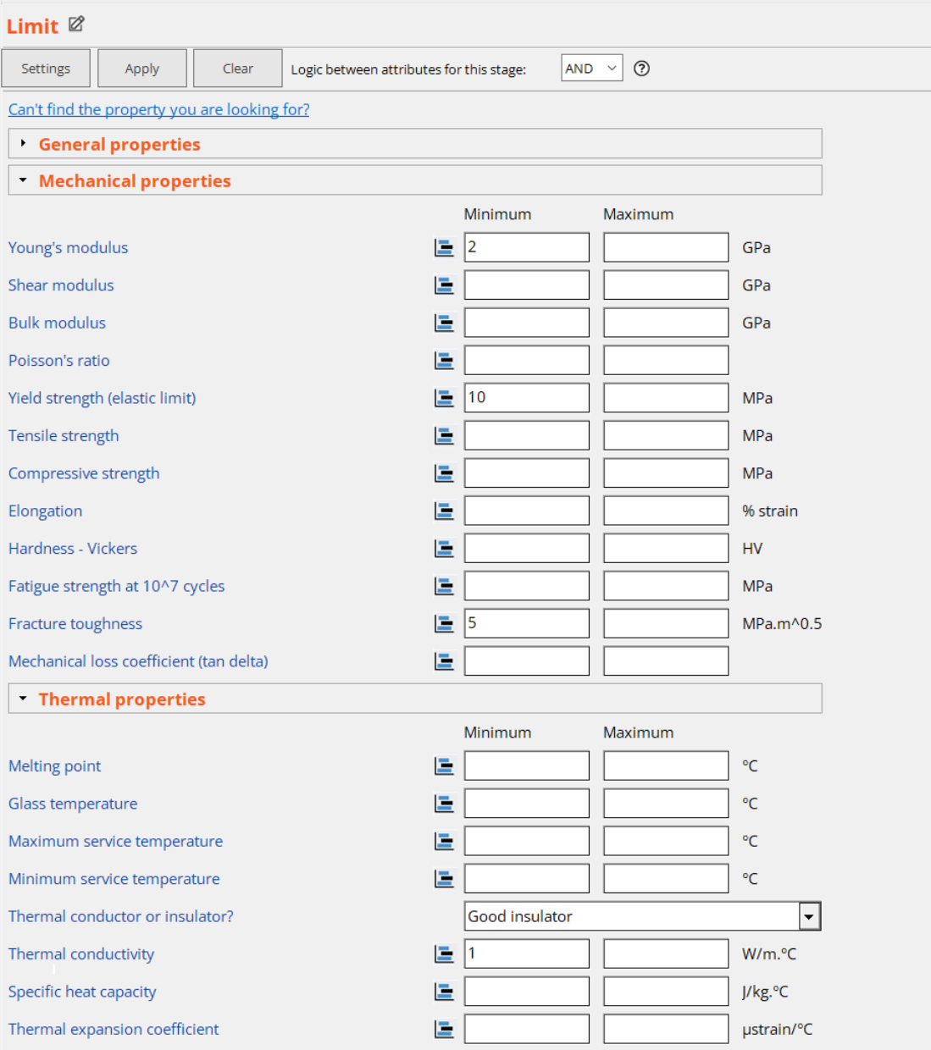
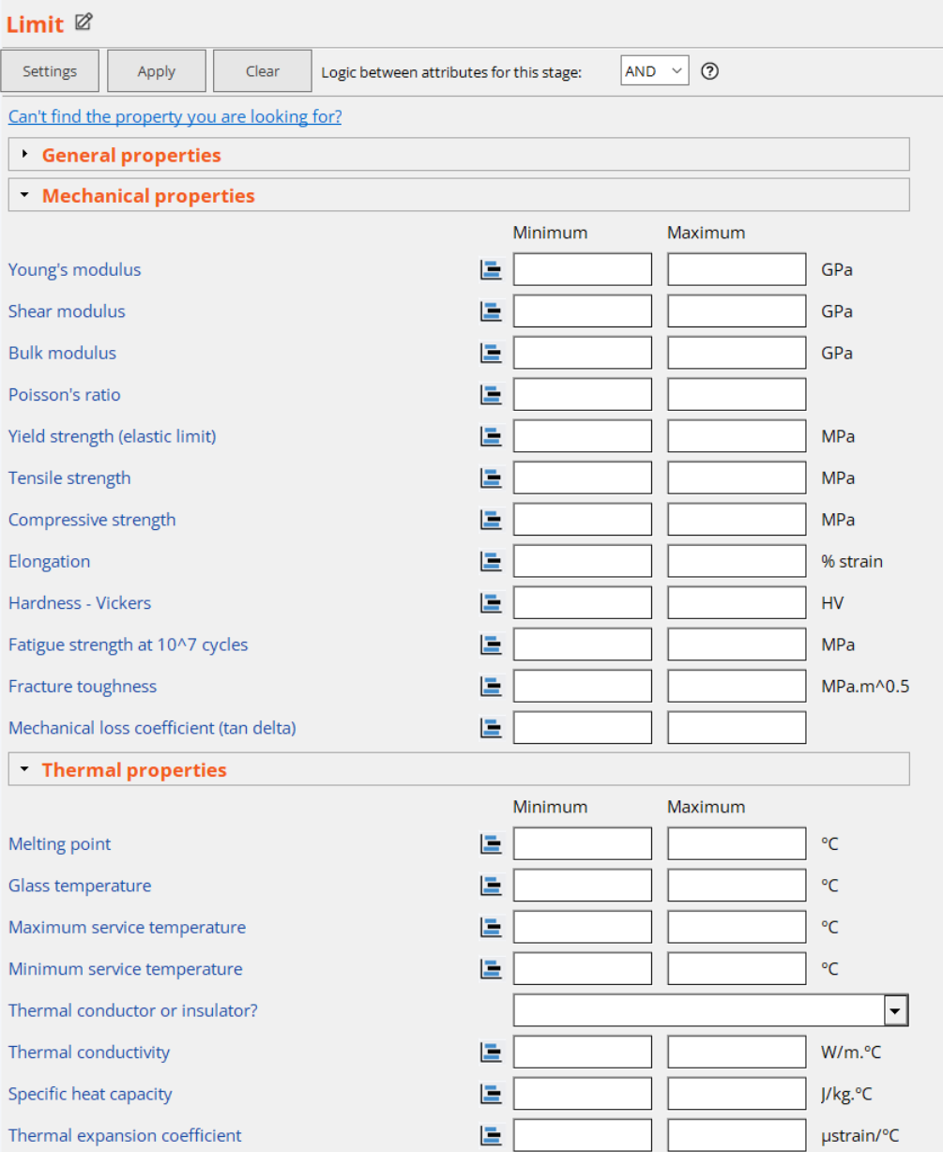
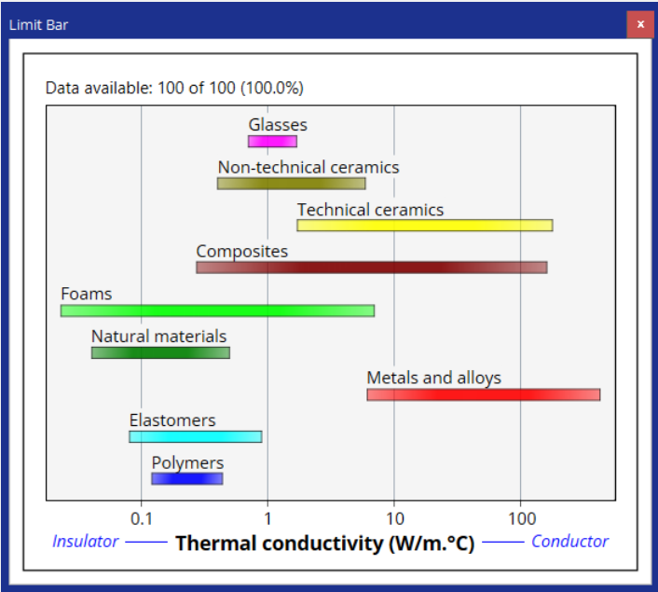
Screening with a LIMIT STAGE
Results
X out of 100 pass
Ranking
Prop 1 Prop 2
Material 1 2230 113
Material 2 2100 300
Material 3 1950 5.6
etc...
Notes:
Selection by applying acceptance limits to properties
The frame illustrates screening using a Limit stage. A Limit stage applies numeric and discrete constraints. Required lower or upper limits for material properties are entered into the Limit stage property boxes. If a constraint is entered in the Minimum box, only materials with values greater than the constraint are retained. If it is entered in the Maximum box, only materials with smaller values are retained. The Results window at the lower left then lists the selection. The list can be ranked by the value of any one of the selected properties.
It is helpful, in setting the upper or lower limits for a property to know the range that the property spans for each material family. Clicking on the icon to the left of the Min. box generates a bar chart showing the property ranges.

Slide 15
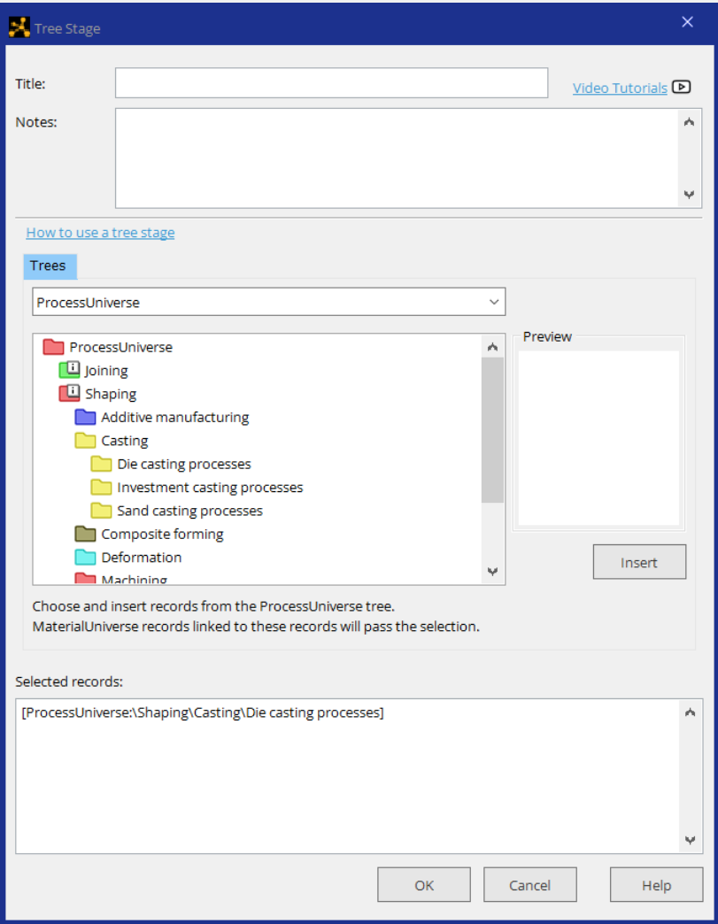
Screening with a TREE STAGE
Materials that
can be die-cast
Results
X out of 100 pass
Material 1
Material 2
Material 3
etc...
Notes:
Selecting on links between data-tables
A Tree stage allows the search to be limited to either:
a subset of materials, or
materials that can be processed in chosen ways.
Opening a Tree stage gives access to the tree-like hierarchical classification of materials (exactly as in the Browse window), or to the of processes. If any part of either tree is selected, only materials that belong to that subset of materials, or that can be processed in the chosen way, are retained.
A Tree stage can be combined with Limit stages and Chart stages in any combination and any order. The Results window lists the materials that meet all the constraints, regardless of the way they are applied.

Slide 16
Selection on links
Select on material properties
The
database
References
data-table
DATA FOR
Metals & alloys
Polymers
Ceramics & glasses
Hybrids
DATA FOR
Joining
Shaping
Surface treatment
Materials
data-table
Links
Processes
data-table
Suppliers
data-table
Select on links
Notes:
Selection on links
This frame is a reminder of the linked data-table structure of Granta EduPack. We have just seen how to select on material properties. The Tree tool allows selection on links (the name of the tool – Tree – refers to the tree-like structure of each of the data-tables).

Slide 17
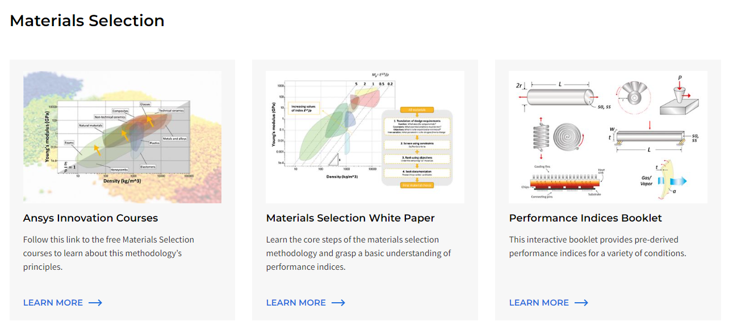
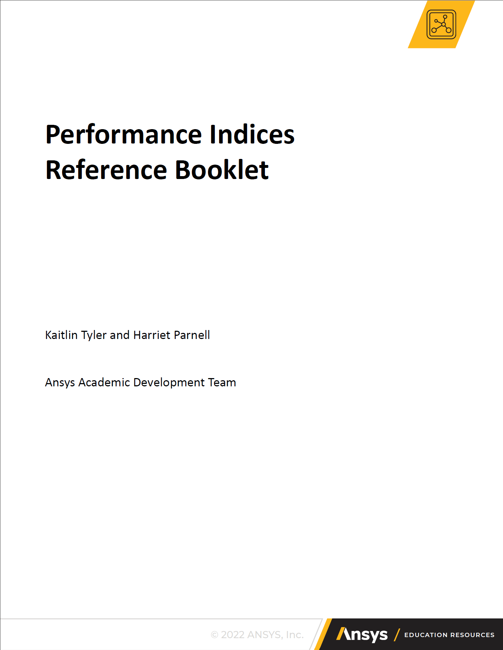
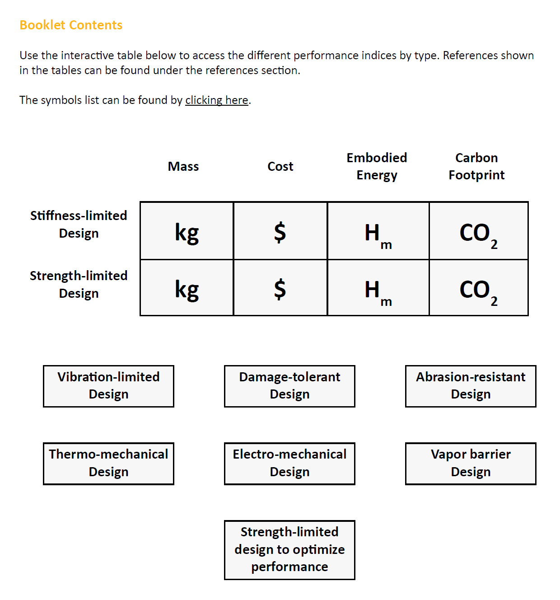
What is a “material index”?
To maximize performance:
First apply all constraints
Then select materials with the biggest or smallest index
Component performance is limited by either:
a single material property e.g. tensile strength, σ_{ts}
The
material index
for the design
a material property group, e.g. modulus / density, E / ρ
Notes:
Material indices – the key property-combinations
An objective defines a measure of excellence of performance. If the objective is to minimize mass, the material choice that gives the lightest component is the best choice provided it meets all the constraints of the design. If it is to minimize cost, then the material choice that minimizes the cost while meeting all constraints is the best choice. Here performance is measured by mass or cost.
Performance is limited by one or a combination of material properties. This property or property-group is called the material index for the design. Materials are selected by first applying all constraints and then ranking those that remain by the value of the appropriate index. The materials with the largest or smallest values of the index (depending on how the analysis is done) are the best choices.
This Unit is about deriving material indices. More information and numerous examples can be found in the Texts listed at the start of the Unit and in Learn.
Now some examples of indices.

Slide 18
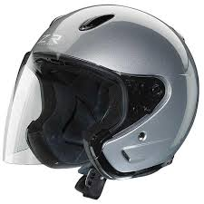
Simple one-property indices
Design requirement
Constraints
Transparent - of optical quality
Able to be molded
Protective visor for motorcyclists
Objective
As tough as possible –
maximize fracture toughness K_{1c}
The material index: choose material with largest K_{1c}
Alternative objective
As cheap as possible –
minimize material cost C_{m}
The material index: choose material with smallest C_{m}
Notes:
A material index can be a single property
A material index is a metric of excellence for the component. Frequently, the index for is a single property. Here are two examples. Sometimes it is to be maximized, sometimes minimized.

Slide 19
Minimum weight design - indices
Tensile ties
Main spar
- beam
Compression
strut
Undercarriage - bending and compression
E = Young’s modulus
= Density
= Yield strength
Notes:
A material index is often a combination of properties specific to the application
The marked components of this plane perform different functions. The ties carry tension, the struts carry compression (they act as columns) and the spars carry bending moments – they are beams. They are chose to be as light as possible: thus the objective is to minimize mass.
The mass of a tensile tie of prescribed strength depends on two material properties – yield strength and density – in the combination ${σ_{y}}/ρ$; it is the material index for this component.
The mass of a strut that must carry a compressive load without buckling elastically is proportional to the material group ${E^{1/2}}/ρ$ so this becomes the material index.
The mass of a beam, loaded in bending, with restriction on elastic deflection is also proportional to ${E^{1/2}}/ρ$ so the index here is the same as that for the strut.
Thus the index depends on the mode of loading (tension, compression, bending) and on the requirement for stiffness or strength.

Slide 20
Index for a strong, light tie-rod
Strong tie of length L and minimum mass
Function
Tie-rod
F
F
Area A
L
Constraints
Length L is specified
Must not fail under load F
m = mass
A = area
L = length
ρ = density
= yield strength
Equation for constraint on A:
F/A < σ_{y}
Objective
Minimize mass m:
m = A L ρ
Performance metric
Chose materials
with largest
Notes:
Deriving a material index for a light, strong rod in tension
This and the next frame work through examples illustrating how to derive material indices when there is a free variable in addition to the choice of material; more appear in later frames. Here we have the simplest of components – a tie rod. Its length L is defined. It must carry a prescribed tensile load F without failure (a constraint) and at the same time be as light as possible (an objective). The frame shows the steps. Materials satisfying all the other constraints (such as operating temperature, corrosion resistance and so forth) and that have a large value of the index (M) σ_{y}/ρ (or, equivalently, a small value of ρ/σ_{y}) are the best choice.
If the constraint had been on stiffness rather than strength, the index becomes E/ρ (E is Young’s modulus).

Slide 21
Index for a stiff, light beam
Stiff beam of length L and minimum mass
Function
Beam
F
b
Square
section,
area
A = b²
b
L
Constraints
Length L is specified
Must have bending stiffness > S*
δ
Equation for constraint on A:
m = mass
A = area
L = length
ρ = density
S = stiffness (F/δ)
This beam: δ = FL³/CEI
C = constant (here, 48)
E = Young’s modulus
I = second moment of area
(I = b⁴/12 = A²/12)
Objective
Minimize mass m:
m = A L ρ
Performance metric
Chose materials
with largest
Notes:
Deriving a material index for a light, stiff beam in bending
The most usual mode of loading of engineering structures is bending: wing-spars of aircraft, ceiling and floor joists of buildings, golf club shafts, oars, skis … all these structures carry bending moments; they are beams. The requirement here is for a beam of specified stiffness and minimum mass. The frame lays out the steps, leading to the index ρ/E^{1/2} ; it differs from the index for a light stiff tie-rod because the mode of loading is bending, not tension. Later frames show how these indices are used to rank materials.
A panel is a flat sheet of given length and width: a table top, for instance. It differs from a beam in that the width of the beam is a free variable, whereas the width of the panel is prescribed. Otherwise the method, given in this frame, is the same. It leads to the index ρ/E^{1/3}.

Slide 22
Ranking, using charts
Light stiff beam:
1000
Index
Ceramics
100
Composites
Increasing M
Rearrange:
E = ρ² M²
Woods
Take logs:
10
Young’s modulus E, (GPa)
Log E = 2 log ρ + 2 log M
Metals
1
2
Polymers
Function Index Slope
Tie 1
Beam 2
Panel 3
0.1
Foams
Elastomers
0.01
100
1000
10,000
100,000
Density ρ (kg/m³)
Notes:
Plotting indices on charts
We take the index M = E^{1/2}/ρ as an example (E is modulus and ρ is density). Rearranging and taking logs gives
Log(E) = 2Log(ρ) + 2 Log(M)
The schematic shows the chart used in Unit 2; its axes are Log(E) and Log(ρ). The equation describes a family of lines of slope 2, each corresponding to a value of M. Materials above the line have higher values of M than those below it; the ones above are the best choice. By moving the line upwards the number of materials above it decreases, narrowing the list of those that maximize performance. The other indices involving E and ρ can be shown on the same chart. The index M = E/ρ appears as a line of slope 1; that for M = E^{1/3}/ ρ as a line of slope 3. They are used in the same way.

Slide 23
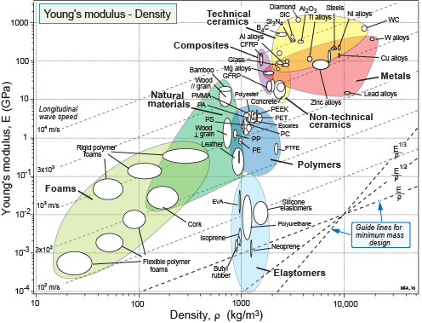
Selection using index in a bubble chart
Search
area
Results
22 pass
Ranked
by Index
Material 1 2230
Material 2 2100
Material 3 1950
etc...
2
Notes:
Plotting indices on a real chart
This frame show index-based selection on a real property chart. The selection can be done using a hard copy chart, as illustrated here. The EduPack software gives greater flexibility, allowing the selection line to be moved and additional constraints to be applied. It lists, in the Results window, the materials that meet all the constraints and makes records for them immediately accessible. The list can be ranked by the value of any property used as a constraint or by the value of the index.
Here it is interesting to point out an interesting fact brought out by the method. Many components of aircraft are stiffness-limited – the wing spar is an example – and the objective here is to minimize mass. Materials texts often assert that, for aerospace, material with high specific modulus E/ρ are the best choice when stiffness is important. But aluminum and steel have the same value of specific stiffness, and steel is much cheaper that aluminum – so why are wing spars not made of steel? The answer is that they are loaded in bending, and then the correct criterion of choice is not E/ρ but E^{1/2}/ρ . By that criterion aluminum is much better than steel, as the chart shows.

Slide 24
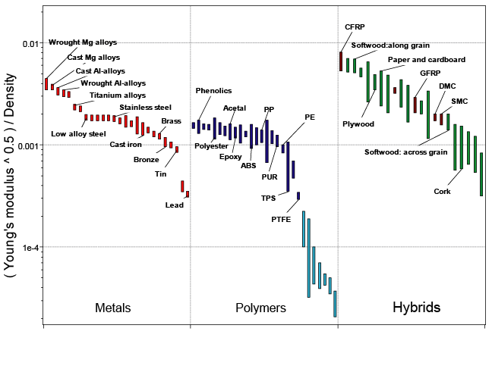
Selection using index directly on chart axis
Index
Results
22 pass
Ranked
by Index
Material 1 2230
Material 2 2100
Material 3 1950
etc...
Notes:
A real bar chart of an index
This is a bar chart of the index E^{1/2}/ρ. The box selects the materials with the largest values of the index. The materials captured in the red box have the highest values: magnesium alloys, aluminum alloys, CFRP and certain woods – the materials of aerospace, past and present.

Slide 25
Documentation: the pedigree
Documentation: “now the number of candidates is small, explore their character in depth”
Handbooks
Specialized
databases
Suppliers’
data sheets
The Internet
Notes:
Sources of information for the Documentation step
Documentation provides the additional information and knowledge that cannot be adequately captured in a record for a material, usually because it is of the sort that is not contained in the structured databases required for screening and ranking. Examples are: detailed analyses of resistance to wear, corrosion and oxidation; case studies (“experience”) in the use of materials; failure analysis; design guide-lines and – often – details of supply and availability. Each record in the Granta EduPack database contains a limited amount of documentation. More is found by searching the sources listed on this frame:
Handbooks such as the ASM Materials Handbook series
Specialized databases like the Granta EduPack Aerospace, Polymer and Biomaterials databases
Suppliers datasheets for specific grades of materials
Internet: sites such as Matdata.net give access to properties and applications of specific material grades

Slide 26
Summary
The selection strategy:
Translate - Screen - Rank - Documentation
EduPack allows Screening using ‘Limit – Chart – Tree stages’ in any number and sequence
The progression:
Data
(Numbers, text)
Visualization
(understanding the data)
Selection
(using the data)
Notes:
Summary
The frame summarizes the points made in the Unit.

Slide 27
Lecture unit series
PowerPoint lecture units, as well as many other types of resources, can be found in the Ansys Education Resources webpage.
Finding and Displaying Information
Unit 1 | The materials of engineering
Unit 2 | Material property charts: mapping materials
Unit 3 | The Elements database: properties, relationships and resources
Material Properties
Unit 4 | Manipulating properties: composition, microstructure, architecture
Unit 5 | Designing new materials: filling the materials-property space
Unit 6 | Materials Science and Engineering
Selection
Unit 7 | Material selection: translation, screening, ranking, documentation
Unit 8 | Objectives in conflict: trade off methods and penalty functions
Unit 9 | Material and shape: materials for efficient structures
Unit 10 | Manufacturing processes and cost modeling
Unit 11 | Eco-informed material selection
Unit 12 | Eco design and the Eco Audit tool
Sustainability
What is a sustainable development? A materials perspective
Exploring Critical Materials using Ansys Granta EduPack
Special Topics
The Built Environment: materials for construction
Structural sections: shape in action
Materials in industrial design: Why do consumers buy products?
The Design database for Products
The Medical Devices database
The Battery Designer tool
Advanced Teaching and Research
Advanced databases: a lightning tour
The Aerospace edition
The Polymer edition
The Synthesizer tool: hybrids and other models
Materials for Bioengineering
www.ansys.com/education-resources
Notes:
Lecture Units Series
This is a list of the Lecture Units available for teaching with the Ansys Granta EduPack. These PowerPoint presentations and more information can be found on the Ansys Education Resources webpage:
www.ansys.com/education-resources.

