Slide 1
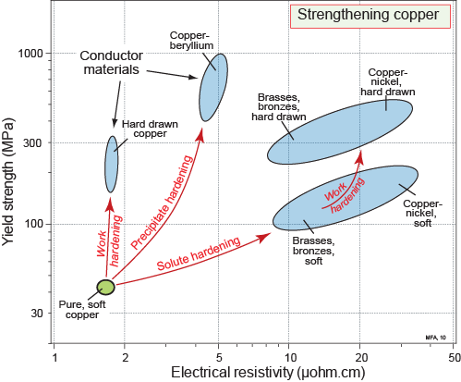
Unit 4.
Manipulating properties:
Composition, microstructure, and architecture
Mike Ashby and Hugh Shercliff
Department of Engineering,
University of Cambridge
Notes:
The PowerPoint Lecture Units For 2024
The Lecture Units developed for teaching in connection with Ansys Granta EduPack are listed at the end of this presentation.

Slide 2
Learning objectives for this lecture unit
Intended Learning Outcomes
Knowledge and Understanding | Understanding the effect of processing on properties
Skills and Abilities | Ability to plot property trajectories as a function of processing
Values and Attitudes | Appreciation of Materials Science linking Physics, Chemistry, and Engineering
Resources
Text: “Materials: engineering, science, processing and design” 4th edition by M.F. Ashby, H.R. Shercliff and D. Cebon, Butterworth Heinemann, Oxford, 2019, Chapters 1-2
Texts: Callister, Budinski, Askeland and others – recommended reading in records
Lecture Unit 3: The Elements Database
Software: Ansys Granta EduPack
Notes:
Learning Objectives
These Intended Learning Outcomes are based on a taxonomy of knowledge and understanding as the basis, skills and abilities as necessary for the practical use of knowledge and understanding, followed by acquired values and attitudes enabling assessments and responsible use of these abilities.
Combined with a suitable assessment, they should be helpful in the context of accreditations or for the CDIO Syllabus.
The Texts listed are from books authored or co-authored by Mike Ashby but other texts are also referred to in the Science Notes.

Slide 3
Outline of lecture unit 4
Modulus and density
Strength and toughness
Other property combinations…
Appendix: examples and exercises
Notes:
Using property charts to illustrate the underlying materials science
Property charts are central to the Granta EduPack methodology for selection of materials in design. But engineers and material scientists will also explore the underlying physics of the properties – in particular to appreciate how manufacturing processes enable us to manipulate properties. Since changes in composition and process history lead to new property profiles, we can readily track how pairs of properties evolve on a chart – a so-called process trajectory.
Charts not only show the trade-offs between properties in design – they also conveniently illustrate the property compromises that are made when materials are manufactured.
The concept is illustrated here with some standard combinations of mechanical properties that crop up in design and material selection, for all materials classes – but the concept extends to any property combination (thermal-electrical-mechanical).
Examples of the approach are scattered throughout Ashby, Shercliff and Cebon – but particularly in Chapter 19 “Follow the recipe: processing and properties”.

Slide 4
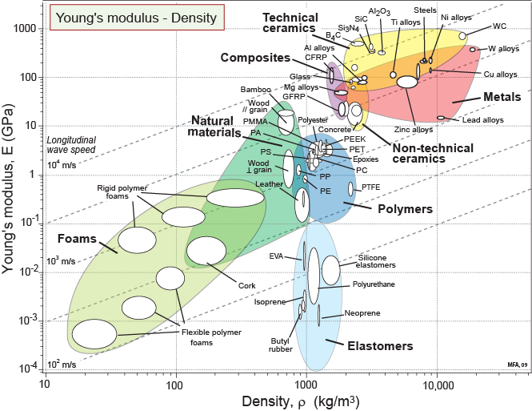
Manipulating properties: Modulus – density
Why the differences?
Notes:
The starting point: Modulus and Density
The charts can be used as a lead-in to ideas of materials science. This chart shows two properties: Young’s modulus and density, as before. The positions occupied by the families on the charts are explained in brief in the following slides, for example for metal and ceramics, through an understanding of inter-atomic bonding and crystal packing. Other concepts of materials science and engineering explain the other classes, and similarly the positions of each class on the other charts.
Broadly speaking, we can classify the ways that properties are manipulated into 3 classes:
Composition – the elements that are present, and their interaction at the atomic/molecular scale
Microstructure – internal arrangements of regions that are distinct in composition and/or atomic/molecular structure (usually formed in-situ via processing), from sub-micron to sub-millimeter scale
Architecture – mixtures of two (or more) materials (including air) that pre-exist in a bulk form and are combined, from micron up to millimeter scale
Processing is key to manipulating composition, microstructure and architecture.
The Science Notes attached to each field name in Granta EduPack introduce the property and explain its origins in more detail. The references at the end of each Science Note direct you to the relevant chapters of standard Engineering Materials and Materials Science texts.
Hardcopy versions of most Charts can be copied for teaching purposes without restriction of Copyright from the Texts, or downloaded from www.Grantadesign.com/education. The Granta EduPack software allows any pair of properties to be plotted as a chart (even functions of properties can be plotted), giving enormous freedom to explore the world of materials visually.

Slide 5
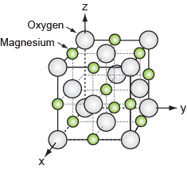
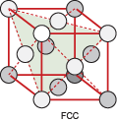
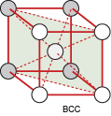
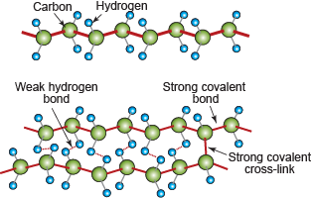
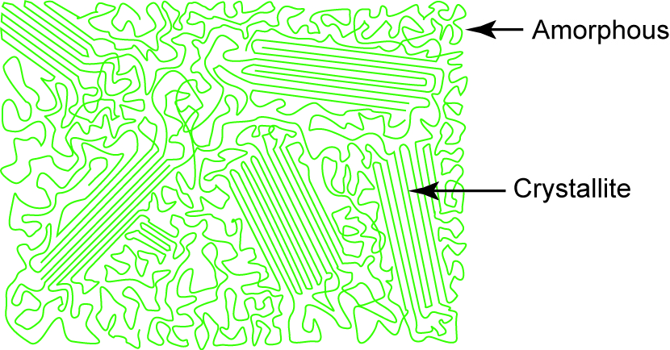
Drilling down: modulus and density
Density: atomic weight, atom size and packing density
Modulus: interatomic bonds and packing density
The elements
(most are metals)
Inorganic
compounds
Crystalline packing, metallic bonding
Crystalline
oxides, nitrides, carbides,
Ionic / Covalent bonding
Organic
compounds
Amorphous thermoplastics, thermosets, elastomers
Notes:
Drilling down – what determines modulus and density?
The conventional starting point for interpretation of modulus and density is the “hard sphere” model, with atoms of one type packed into a crystal.
Density simply reflects weight of the atoms and how many are packed into a given volume.
Modulus is interpreted by treating the interatomic bonds as approximately linear springs, with equilibrium spacing determined by an energy well. This is more or less sufficient to account for the behaviour of metals (including their alloys) – we expect metals to fall in the same domain as the elements on which they are based: we can check this back on the chart.
Turning to inorganic compounds, the “hard sphere” model extends to crystalline compounds between two metals, or between metals and O, C, N (i.e. technical ceramics). Changing the composition in this way introduced ionic and covalent bonding – generally stiffer than the metallic bond, giving a higher modulus than metals, at comparable density.
Organic compounds – polymers and elastomers – are built of hydrocarbon molecules, with stiff covalent bonding along the chain, but the modulus is dominated by the weak hydrogen bonds between the chains. A very wide range of modulus results from composition variations at the molecular level (including variation in chain length, degree of cross-linking, and the effect of the glass transition temperature). Semi-crystalline polymers show distinct regions of amorphous and crystalline packing, developed in-situ during cooling on a scale much larger than the chain diameter – in this case, the modulus also depends on this microstructure. Polymer densities are lower than for crystalline materials: packing is less efficient, and C and H are light elements.

Slide 6
Drilling down: modulus and density
The elements
Composition
Metals:
Composition – Metallic bond of base element.
600
Range of modulus
2
1,000
Range of density
20,000
Notes:
6
Properties determined by the nature of interatomic bonding
The Elements database gives the ranges of modulus and density for all pure metals – these are superimposed on the chart. The hard sphere model works well – the modulus and density of metals only depends on the composition (and even then only the base element – the “bubbles” on the property chart are small: look at steels for example, with literally hundreds of compositions contained in one small bubble). For the same reasons, microstructure plays no significant role for these properties in metals.
All other material classes involve some degree of manipulation, explored next.
6

Slide 7
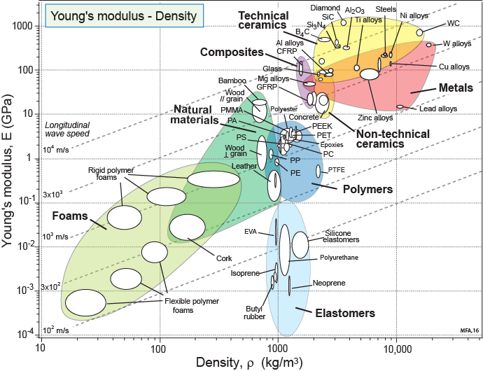
Drilling down: modulus and density
Composition (and Microstructure)
Crystalline materials:
Composition – Metallic bond vs. ionic/covalent bonds.
Small “bubbles” –
insensitive to Microstructure
But what about these?
Polymers & Elastomers:
Composition (& Microstructure) – hydrogen-bonded C-chains;
cross-linking and crystallinity
Notes:
7
Properties determined by the nature of interatomic bonding
Summarising these observations on the chart, we now understand the impacts of composition and microstructure on these properties.
Metals and ceramics: both properties determined by the elements present, with almost no sensitivity to microstructure for these properties (hence property bubbles on this chart or small, in spite of a large number of alloy variants within a bubble).
Polymers and elastomers: many orders of magnitude in modulus over a small range of densities, mostly determined by the molecular composition, plus microstructural effects such as crystallinity and cross-linking (hence somewhat larger variation in modulus for a given polymer/elastomer, due to variations in molecular weight, cross-link density etc).
7

Slide 8
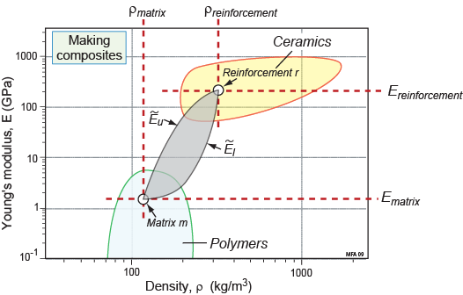
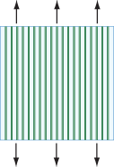
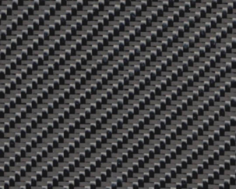
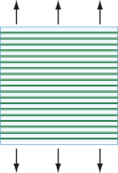
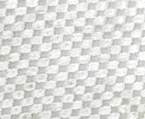
Manipulating modulus & density: architecture
(1) Composites: “solid – solid hybrids”
Density:
Modulus:
Upper bound:
CFRP
GFRP
Lower bound:
Notes:
Manipulating modulus - composites
Modulus and density are also manipulated by architecture – by making hybrids of more than one bulk material. The first example is composites – hybrids of two solids.
Density is straightforward – mixing two fractions of different density materials leads to a composite density given by a linear rule of mixtures. For modulus, simple stress-strain analysis produces two familiar bounds – upper and lower limits on the property, between which the actual value must fall. These bounds can also be interpreted graphically as a “lozenge” of property space between the bulk values for the two constituents.

Slide 9
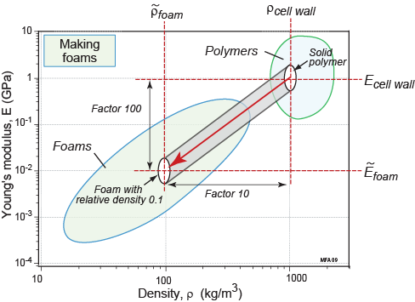
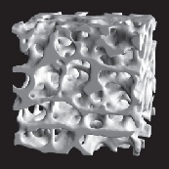
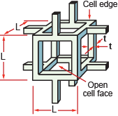
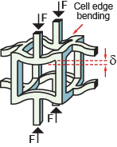
Control of modulus by architecture
(2) Foams: “solid – air hybrids”
Density:
Ceramic foam
Metal foam
Modulus:
Notes:
Manipulating modulus and density – cellular structures
The second architecture example is foams – porous solids, or a hybrid of solid and air. The density is again easily explained – the air is effectively weightless, so the relative density (the proportion of the foam that is solid) determines the density of the foam, given the density of the solid in the foam.
Interpreting the modulus requires some simple solid mechanics. In many foams, the overall displacement imposed is accommodated internally by bending the solid edges of the cells. This leads to simple scaling laws, suggesting for example that a foam which is 10% solid will have a modulus 1/100 that of the solid in the cell walls. Here is an example of a “trajectory” on a property chart – foaming a solid moves the resulting properties downwards to the left on a characteristic slope (of 2, for the model illustrated).

Slide 10
Manipulating properties: modulus – density
Composition, microstructure and architecture
Crystalline materials:
Composition – metallic bond vs. ionic/covalent bonds.
Composites:
Architecture –
Components, lay-up
Natural
materials:
Composition,
microstructure,
architecture
Polymers & Elastomers:
Composition & Microstructure – hydrogen-bonded C-chains;
cross-linking and crystallinity.
Foams:
Architecture –cell structure
Notes:
What controls the differences?
Returning to the chart, we find composites falling between the polymers (matrix) and ceramics (glass and carbon fibres). And polymer foams fall below and to the left of the solids of which they are made. Finally, note the position of natural materials, governed by a bit of everything: complex polymers, with both cellular and fibrous architectures.
Designers might just take all this as “given data”. But by “drilling down” into the origin of the properties, we not only understand the physical world around us, but can turn the problem around and ask how we engineers and scientists can manipulate properties. For modulus and density, composition largely dictates the outcome – only architecture enables completely new combinations of properties to be developed.
The potential for innovation afforded by making composite materials (and other “hybrid” combinations of materials, such as sandwich panels”) is a good motivator for students – expensive composites often emerging from high performance applications (e.g. sports goods).
10

Slide 11
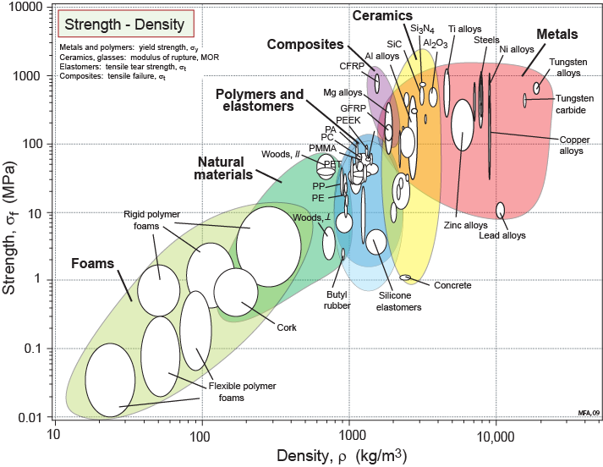
Manipulating properties: strength
Greatly elongated bubbles
Composition,
microstructure
and architecture
Polymer strengths overlap with metals.
Notes:
Manipulating strength – a microstructure-dependent property
Strength vs. density is another standard property combination for lightweight design.
The behaviour of crystalline materials differs significantly compared to modulus. First the strength of ceramics (in tension) is dominated by fracture, whereas metal strength is governed by yielding (though the actual strength values cover the same range). Metals in particular now show wide ranges in a given alloy system (long, thin bubbles), reflecting sensitivity to the microstructure (which itself depends on the alloy composition and process history).
For polymers and elastomers, the same factors govern the strength as the modulus: composition, crystallinity and cross-linking. But note that the range of strength is much lower than for modulus, and now overlaps with the metals. This is because all the failure mechanisms now involve some degree of loading and breaking of the covalent bonds along the molecular chains.
The strength of foams reflects the strength of the cell edges (bending leading to yield or fracture of the cell walls). And the architecture of composites leads to strengths which are some combination of the strengths of the components.
The greatest diversity in behaviour (and also commercial significance) is seen in the strength characteristics of metallic alloys – hence “drilling down” will highlight examples in this area.

Slide 12
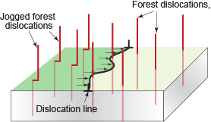
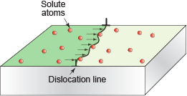
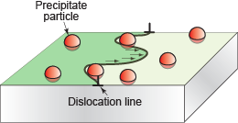
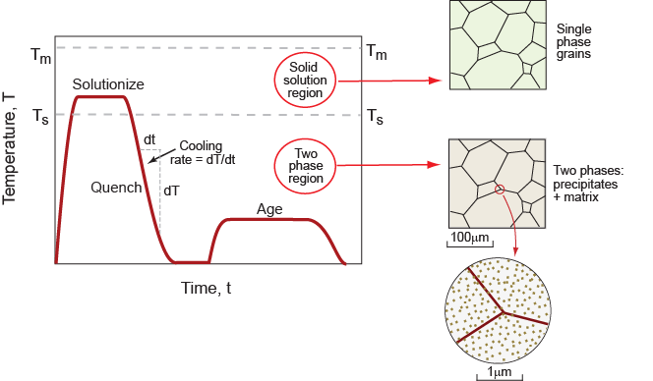
Drilling down: control of microstructure
Solid solution hardening
(Composition)
Precipitation hardening
(Composition and microstructure)
Work hardening
(Microstructure)
Examples:
Heat-treatable Al alloys
(age hardening)
Carbon & alloy steels
(quench and temper)
Notes:
Hardening mechanisms
Understanding alloy strengthening requires an appreciation of dislocation behaviour. The key generic concepts are dislocation pinning, and the spacing and effectiveness of the obstacles introduced as pinning points: solute atoms, precipitates and other dislocations.
- Solute distributed atomically within the lattice is a simple outcome of changing composition.
- Precipitation is the most effective, exploiting microstructures of more than one phase that depend in complex ways on the composition and the process history (examples below).
- Dislocation microstructures evolve in complex ways with deformation.
Control of structure and properties by heat treatment
Precipitation hardening is most effective when fine-scale second phase particles are dispersed throughout every grain. – this microstructure is achieved by heat treatment. The science behind the evolution of precipitates requires a basic understanding of phase diagrams and phase transformations* – taking alloying elements into solution, quenching to avoid the formation of coarse two-phase distributions, with controlled low temperature, solid-state transformation of fine-scale precipitates.
Two prominent examples are: age hardening of Al alloys, quenching/tempering of steels.
Property charts again offer a neat graphical illustration of the consequences of these heat treatments.
*Note that a “Guided Learning Unit” teach-yourself resource on phase diagrams and phase transformations may be found in “Materials: engineering, science, processing and design” by Ashby, Shercliff and Cebon, Butterworth Heinemann, Oxford, 2019, 4th edition.

Slide 13
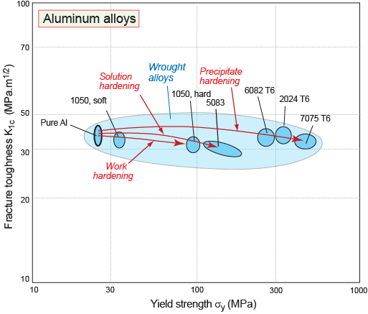
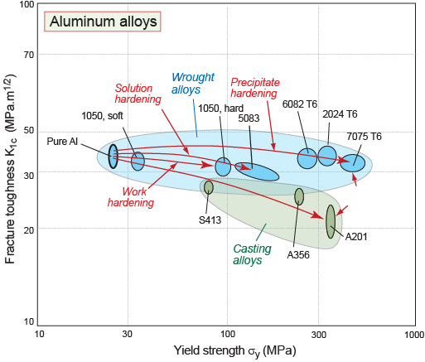
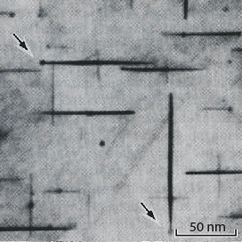
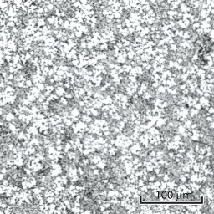
Property control: composition and microstructure
Aluminum alloys: precipitation, solution and work hardening
Al -Cu 2024
Al -Si S413
Notes:
The strength / toughness trade-off – Aluminum alloys
A common trade-off in processing for higher yield strength is the consequential evolution of fracture toughness, the resistance to crack propagation – hence charts showing this pairing are of interest.
The figure shows the composition and process trajectories for commercial Al alloys.
For wrought alloys the chart illustrates that the hardening mechanisms all increase strength with minimal impact on fracture toughness. The relative effectiveness of the different mechanisms is apparent – the strongest are the age hardened aerospace alloys.
We can then annotate the figures with typical micrographs – here a TEM image of the needle shaped precipitates in 2024 alloy (noting the nm length scale).
The figure also shows data for casting alloys – alloying + heat treatment again raises strength, but with a corresponding decrease in toughness. This can be correlated with the coarser microstructure formed on casting (2nd micrograph), and the presence of brittle second phases such as Si in casting alloys. (By zooming in, we could easily illustrate the effectiveness of chemical additions to modify the Si for greater toughness, as in Na-modified Al-Si casting alloys).

Slide 14
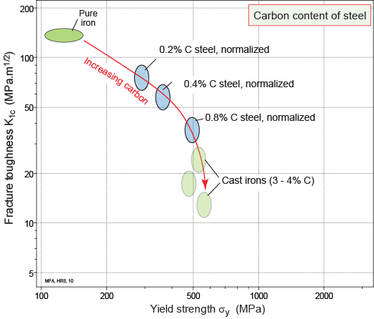
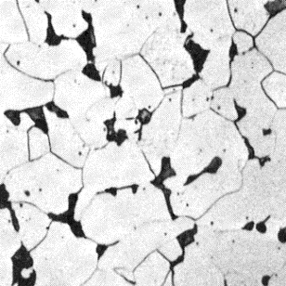
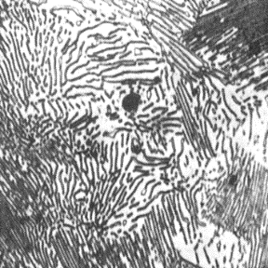
Control by composition: steels
Steels: strength, toughness and carbon content
Ferrite + pearlite
Notes:
The strength / toughness trade-off – carbon steels
Here we follow the same thought process for steels, on the same property chart. First, we examine the effect of composition alone.
First consider plain carbon steels in the normalised (slow cooled) condition. Starting with pure iron (100% ferrite), raising the carbon content steadily introduces hard iron carbide in the form of two-phase pearlite, reaching 100% pearlite at the eutectoid composition (0.8%C). Strength increase, toughness falls; the parallel micrographs illustrate why this is the case.
Progressing to cast irons (at 3-4% C), little further strengthening is achieved but toughness falls further (due to the presence of brittle graphite in the microstructure). (Cast irons too are modified by chemical additions and heat treatments – e.g. to spherodise the graphite. Zooming in would again allow this to be explored graphically).

Slide 15
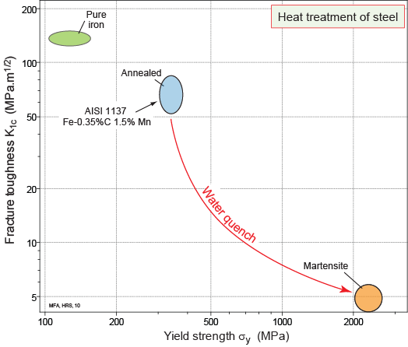
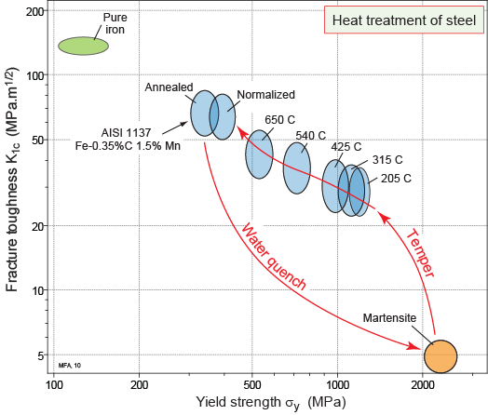
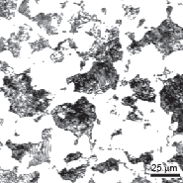
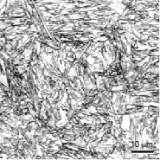
Control by microstructure: steels
Steels: Change of microstructure at constant composition
Normalised (ferrite + pearlite)
As-quenched (martensite)
Notes:
The role of heat treatment – carbon steels
Next, consider a given composition (medium carbon steel), to illustrate the quench and temper heat treatment, and consequent microstructure and properties.
Quenching leads to the brittle phase martensite (with C trapped in solid solution in a fine-scale needle-grained microstructure, as in the micrograph). This is very hard, but dangerously brittle. Tempering restores toughness while bringing the strength back to a level that is significantly above the initial normalised strength (from ferrite and pearlite, illustrated). The figure also shows that the exact combination of properties can be tuned by varying process conditions – here the temperature used to temper the steel.

Slide 16
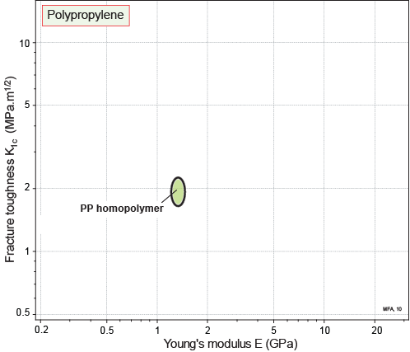
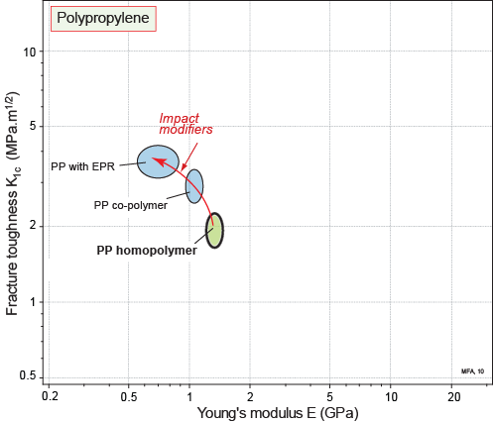
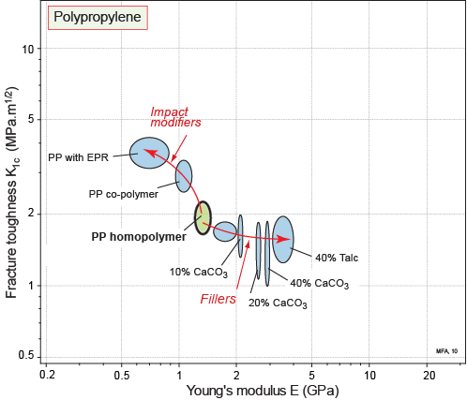
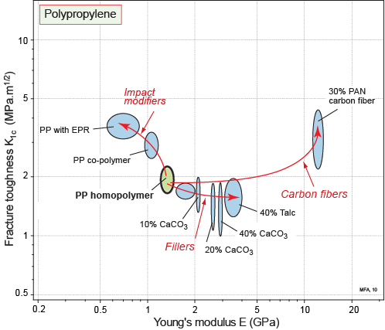
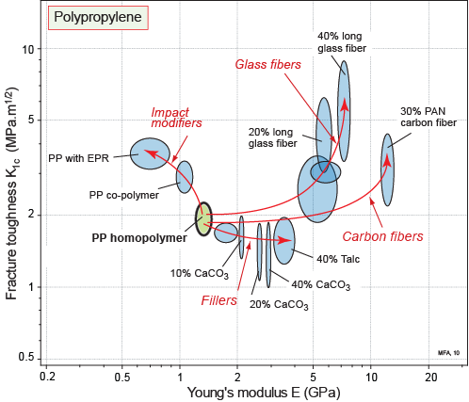
Composition and architecture: polymers
Polymers (PP): fracture toughness-modulus trajectories
Notes:
The stiffness / toughness trade-off – polymers
Now consider polymers again. Here we examine fracture toughness and modulus – since polymer design is often limited by stiffness rather than strength. The chart shows trajectories for polypropylene (PP) – exploiting composition and architecture.
First, we can toughen PP (with some loss of stiffness) by modifying composition or architecture, e.g. by making a copolymer with another monomer, or introducing fine-scale rubbery particles.
Then, architecture gives a range of composites at a more macroscopic scale, all increasing the stiffness. Adding ceramic powders causes some loss of toughness; adding glass or carbon fibres is a win-win scenario – the result is both stiffer and tougher.

Slide 17
Summary
Design-led teaching of Materials:
- design context → properties → property charts: route to material selection
- context provides motivation for exploring microstructural origins of properties
Processing for Properties:
- emphasis on those properties that can be manipulated
- core concept: “Composition + Processing → Microstructure + Properties”
Property Charts:
- visual approach: graphical illustration of “composition & process trajectories”
- widely applicable concept: metals, polymers, ceramics, foams, composites...
Notes:
Summary
Property charts provide common ground for both design-led and science-led approaches to teaching materials. Once a design context has been established, and properties defined, the charts offer great freedom to explore the physics of properties and processing, or to go on to performance analysis and material selection, or both.
Perhaps the key shift in emphasis from traditional science-led teaching is to provide the design context first – then “drilling down” into the underlying physics (the heart of conventional materials science teaching). This means that students know something about why these properties matter. Engineers automatically expect the design context, and a “light touch” approach to the science is often an appropriate level to cover in parallel with material selection and manufacturing processes.
The examples show that the core concepts of “Composition + Processing → Microstructure + Properties” illustrated via “trajectories” on charts, can lead in several directions. Here the emphasis has been on understanding which properties can be manipulated, and how. This understanding is essential for control of properties in manufacturing, e.g. appreciating the sensitivities of the outcome to the composition and process history.
The visual approach, using property charts and “trajectories”, makes the subject accessible to students, for example, showing how pairs of properties may trade-off against one another, or can both be enhanced (“win-win”). And so long as students have grasped log scales, it is then easy to visualise “factor of 2”, “factor of 10” comparisons.
The methodology is widely applicable, covering any property combination across all material classes. It guides the considered development of new materials, recognising the physical limitations of what can and can’t be manipulated, and suggesting where on the charts we might be trying to head (more on this in Unit 5).

Slide 18
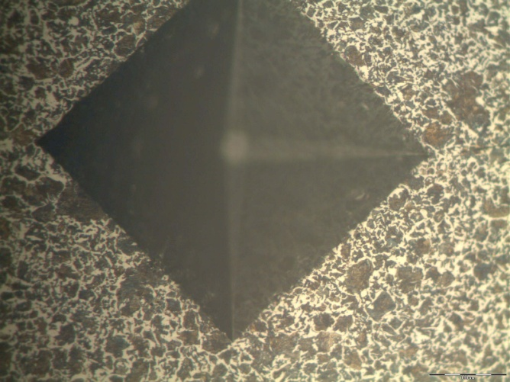
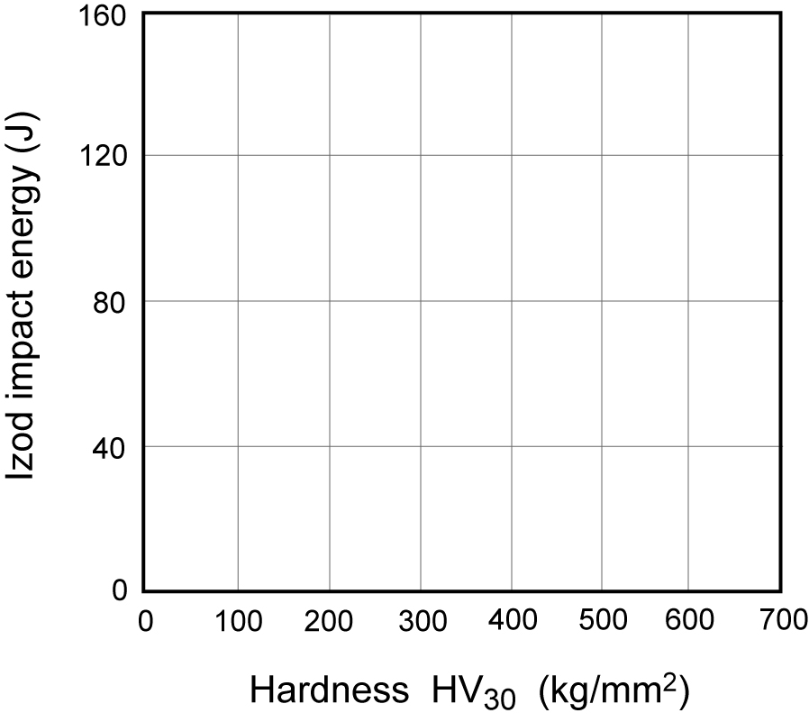
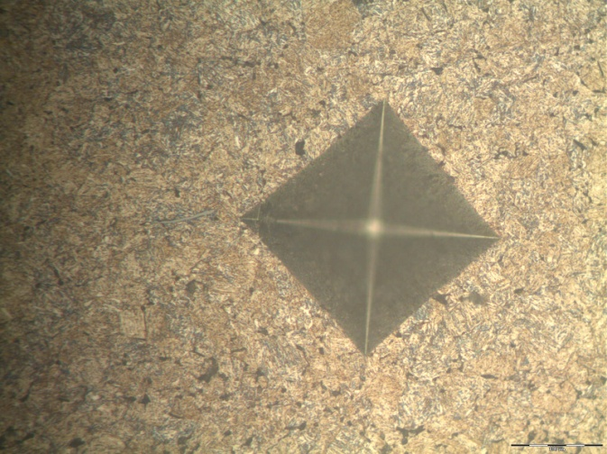
Appendix: Application in laboratory (steels)
Normalised (ferrite + pearlite)
0.2 % C NORMALISED
0.4 % C NORMALISED
100 mm
0.4 % C
Q + T
Temper
As-quenched (martensite)
Quench
0.4 % C QUENCHED
100 mm
Notes:
Strength – toughness investigation in heat treatment of steels
In a 2nd year experiment in Engineering at Cambridge University, students quench and temper two plain carbon steels, measuring the hardness (indicating yield strength) and Izod impact energy (similar to Charpy testing, as a surrogate for toughness). The results are plotted on a property chart – generating the composition and process trajectories for carbon steels by first hand experience. In the other half of the experiment, students observe the corresponding microstructures, and relate these to the Fe-C phase diagram. The charts provide an elegant link to tie it all together, emphasizing the relevance to design.
Note the synergy in using property charts for hand-plotting small datasets to interpret lab work, while the parallel lecture course utilises charts from Granta EduPack, broadening familiarity with the approach and the software. For project work developing larger datasets, students may develop their own databases using Granta Selector.

Slide 19
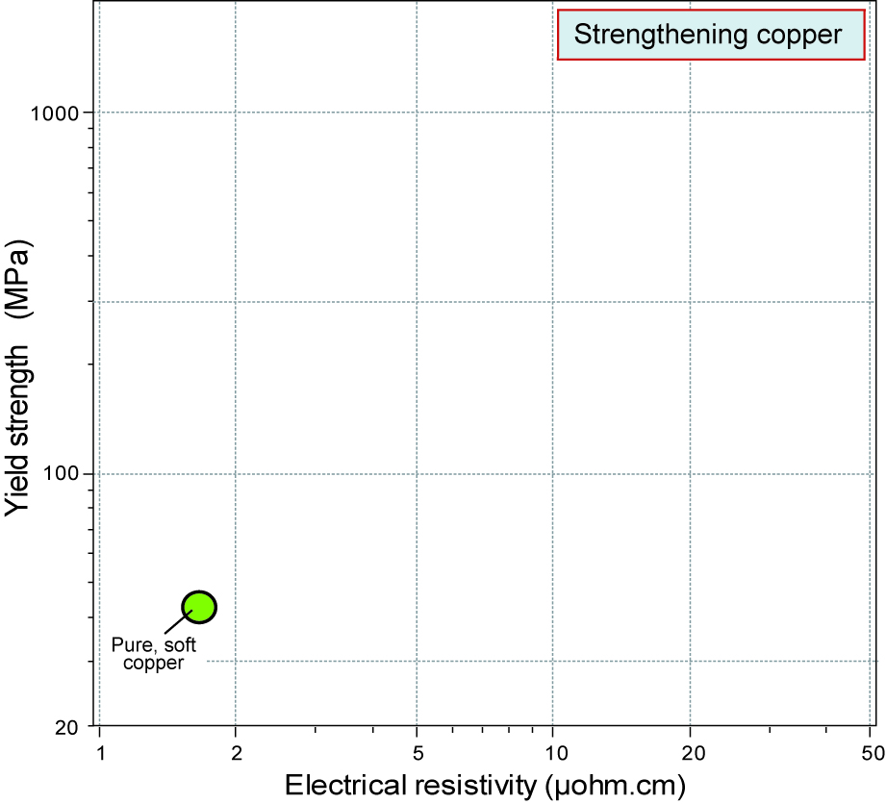
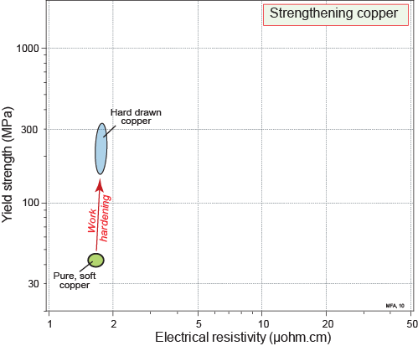
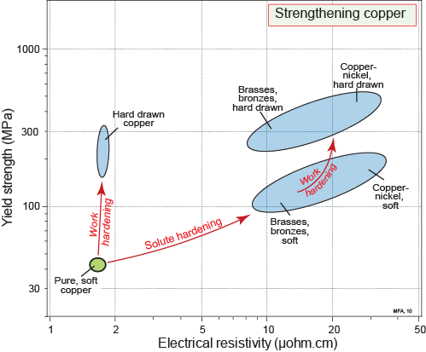
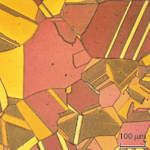
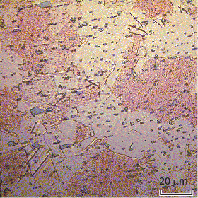
Appendix: electrical properties
Copper alloys: composition and process “trajectories”
Solid solution:
strongest effect on resistivity
Precipitation hardening:
greatest strength
70-30 Brass
Copper - beryllium
Notes:
Combinations of electrical and mechanical properties
The concept was established above for properties relevant to purely mechanical design. Here we extend it to the combination of yield strength and electrical resistivity (e.g. alloys for strong electrical conductors).
Copper alloys can be strengthened by the same three mechanisms: solute, precipitates and dislocations. But resistivity depends on how conduction electrons interact and are scattered by these obstacles. All the trajectories show increases in both properties relative to pure copper – but solute is most detrimental to resistivity. Hence conductor alloys are strengthened by work hardening or precipitation hardening. (The same is true for aluminum conductor alloys.)

Slide 20
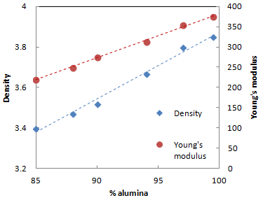
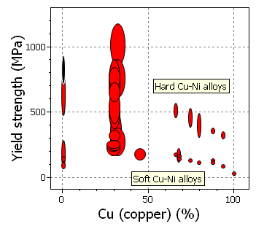
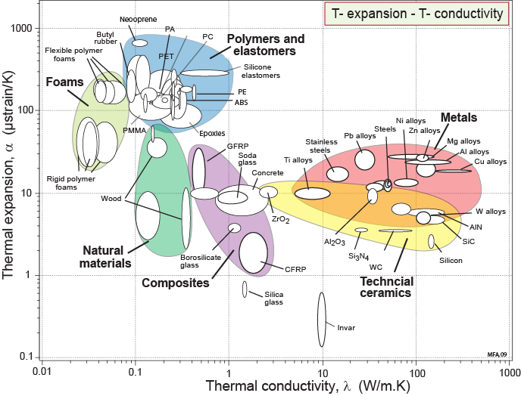
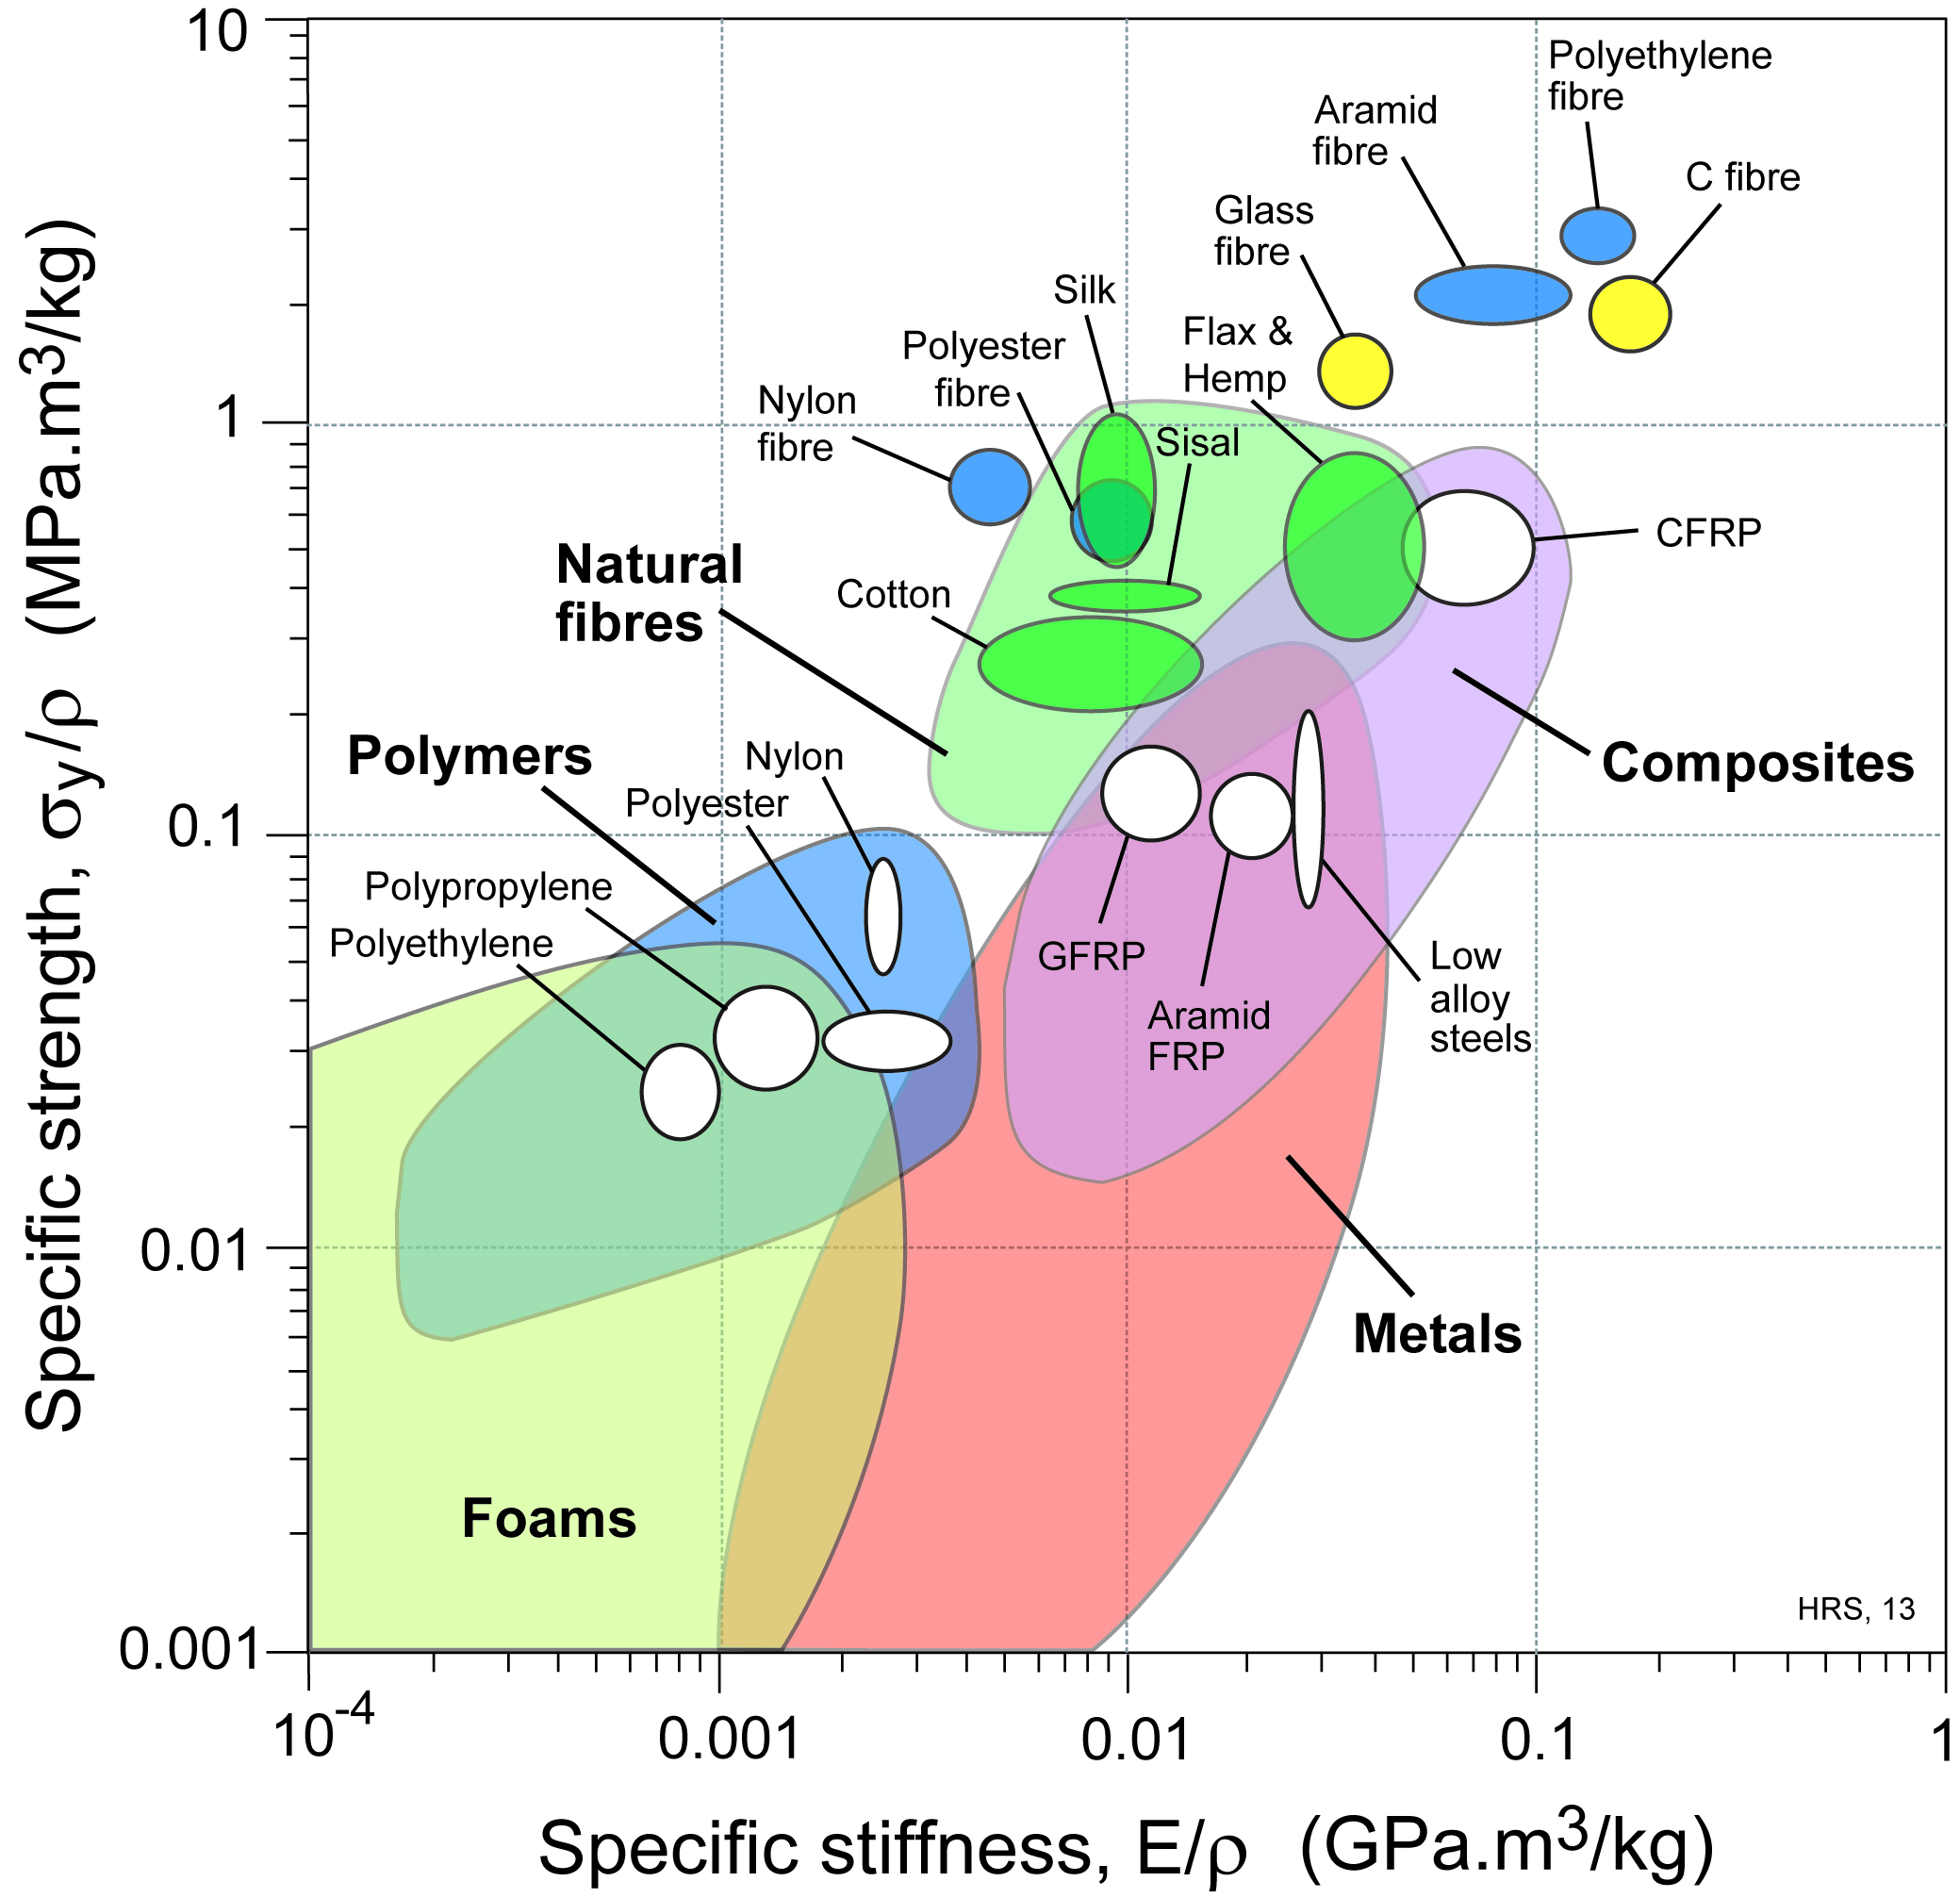


Appendix: Suggested exercises with Granta EduPack
Polymers: modulus – strength of PP: effect of fillers
Polymers: fibres vs. bulk: modulus – strength
Ceramics: modulus – strength of alumina vs. porosity
Thermal properties: expansion vs. conductivity
Cu-Ni alloys: modulus, strength, toughness, resistivity ... vs. composition
Alloy comparisons: cast vs. wrought Mg alloys? resistivity – strength, Al alloys?
Foams: predict effect of architecture – modulus and density of PP foams
Notes:
Try it yourself
A number of other examples/exercises have been developed for the Ansys Education Resources– check our website: ansys.com/education-resources

Slide 21
Lecture unit series
PowerPoint lecture units, as well as many other types of resources, can be found in the Ansys Education Resources webpage.
Finding and Displaying Information
Unit 1 | The materials of engineering
Unit 2 | Material property charts: mapping materials
Unit 3 | The Elements database: properties, relationships and resources
Material Properties
Unit 4 | Manipulating properties: composition, microstructure, architecture
Unit 5 | Designing new materials: filling the materials-property space
Unit 6 | Materials Science and Engineering
Selection
Unit 7 | Material selection: translation, screening, ranking, documentation
Unit 8 | Objectives in conflict: trade off methods and penalty functions
Unit 9 | Material and shape: materials for efficient structures
Unit 10 | Manufacturing processes and cost modeling
Unit 11 | Eco-informed material selection
Unit 12 | Eco design and the Eco Audit tool
Sustainability
What is a sustainable development? A materials perspective
Exploring Critical Materials using Ansys Granta EduPack
Special Topics
The Built Environment: materials for construction
Structural sections: shape in action
Materials in industrial design: Why do consumers buy products?
The Design database for Products
The Medical Devices database
The Battery Designer tool
Advanced Teaching and Research
Advanced databases: a lightning tour
The Aerospace edition
The Polymer edition
The Synthesizer tool: hybrids and other models
Materials for Bioengineering
www.ansys.com/education-resources
Notes:
Lecture Units Series
This is a list of the Lecture Units available for teaching with the Ansys Granta EduPack. These PowerPoint presentations and more information can be found on the Ansys Education Resources webpage:
www.ansys.com/education-resources.

