Slide 1
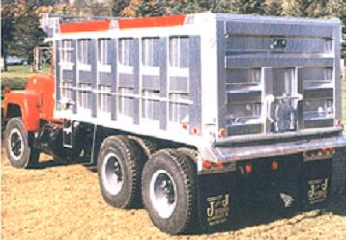






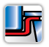
Advanced Databases
Cellular structures
Composites
Mike Ashby
Department of Engineering,
University of Cambridge
Sandwich structures
Multi-layers
Part cost estimator
Battery Designer
Notes:
The PowerPoint Lecture Units For 2023
The Lecture Units developed for teaching in connection with Ansys Granta EduPack are listed at the end of this presentation.

Slide 2
Learning objectives for this lecture unit
Intended Learning Outcomes
Knowledge and Understanding | Knowledge about the Advanced Databases
Skills and Abilities | Ability to find advanced material properties and use them in a structured way alongside advanced tools
Values and Attitudes | Appreciation of the complexity of advanced industrial applications
Resources
White Papers: White Papers describing databases available via the Ansys Education Resources webpage
Software: Ansys Granta EduPack
A number of Advanced Industrial Case Studies available via the Ansys Education Resources webpage
Notes:
Learning Objectives
These Intended Learning Outcomes are based on a taxonomy of knowledge and understanding as the basis, skills and abilities as necessary for the practical use of knowledge and understanding, followed by acquired values and attitudes enabling assessments and responsible use of these abilities.
Combined with a suitable assessment, they should be helpful in the context of accreditations or for the CDIO Syllabus.
The Texts listed are from books authored or co-authored by Mike Ashby but other texts are also referred to in the Science Notes.

Slide 3
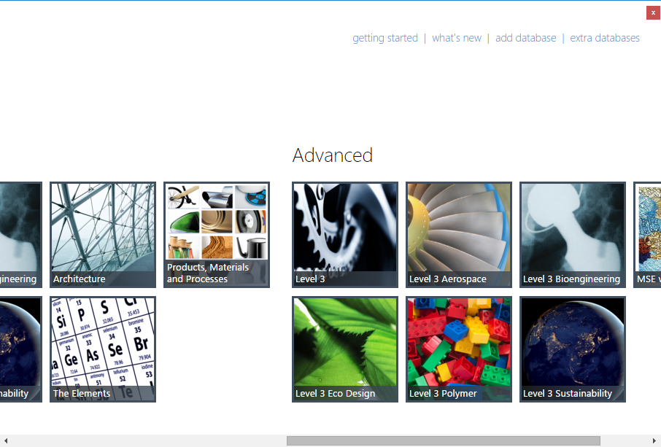
Outline of the lecture unit
Available databases and tools
The advanced level
Database overview and subsets
External and temperature dependent data
Sustainability
Advanced Granta EduPack tools and capabilities
Advanced Industrial Case Studies
Notes:
Outline
This Unit provides an overview of the advanced teaching and design databases, along with the advanced tools, available in Granta EduPack:
Level 3 Engineering
Bioengineering
Sustainability
Eco Design
Polymer
Aerospace

Slide 4


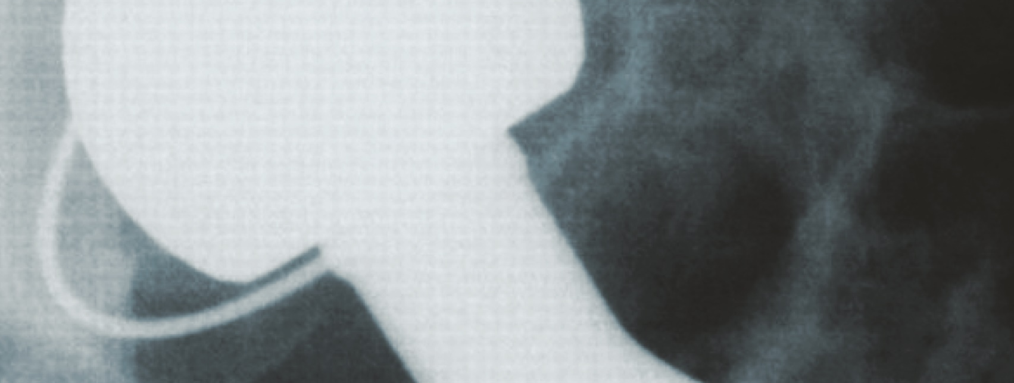



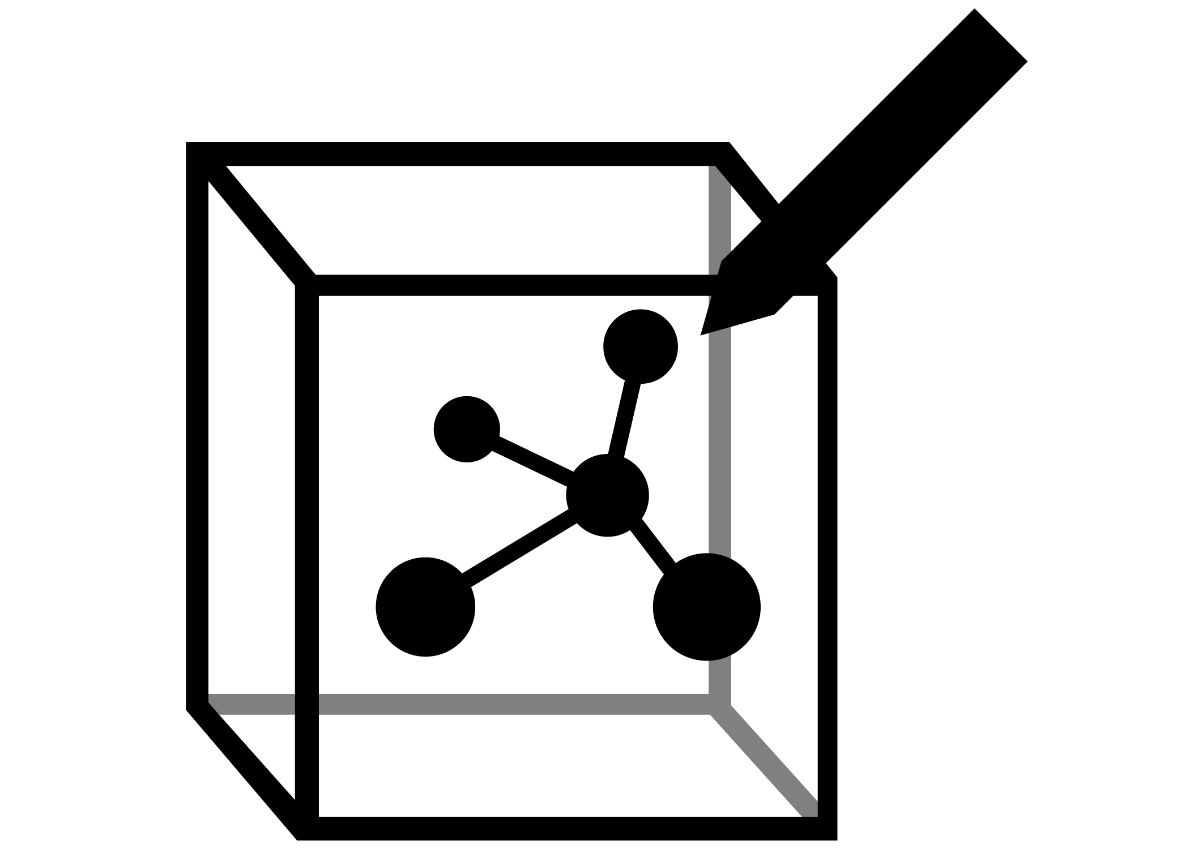





Advanced databases and tools
Standard
Eco Audit
Advanced
Level 3 Standard Database
Extra data in:
Bioengineering
Polymer
Aerospace
Eco Design
Sustainability
Tools Available:
Eco Audit
Enhanced Eco Audit
Synthesizer
Engineering Solver
Find Similar
Comparison Tables
Bioengineering
Eco Audit
Solver
Comparison Table
Synthesizer
Find Similar
Polymer
Eco Audit
Solver
Comparison Table
Synthesizer
Find Similar
Aerospace
Eco Audit
Solver
Comparison Table
Synthesizer
Find Similar
Eco Design
Eco Audit
Solver
Comparison Table
Synthesizer
Find Similar
Sustainable
Development
Eco Audit
Solver
Comparison Table
Synthesizer
Find Similar
Notes:
Databases and Tools
The databases that are available in your version of Granta EduPack depends on your Edition. In the AllEditions version, you have access to all advanced databases. In specialized editions, you have access to some of them. The Advanced Tools, the Enhanced Eco Audit and the Synthesizer tool are included, as shown in this slide.

Slide 5


Granta EduPack level structure
Level 1
1st year students:
Engineering, Materials Science, Design
69 materials, 74 processes
Introductory Courses
Level 2
Undergraduate students
of Engineering and
Materials Science and Design.
100 materials, 116 processes
Simple user
interface
Intermediate courses, Assignments etc
Level 3
Senior, masters and research students.
4000+ materials, 240+ processes
Advanced and applied courses
Project-based work
Notes:
The Level structure
Level 3 contains advanced materials records and data, suitable for senior students and projects.

Slide 6

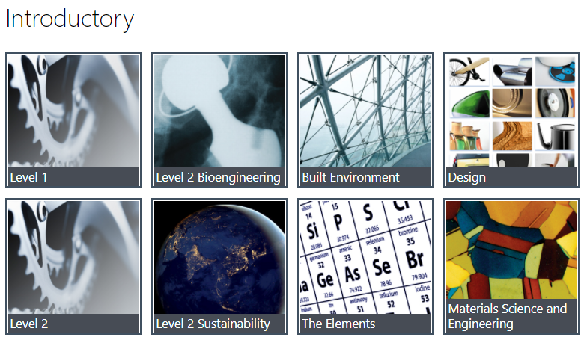
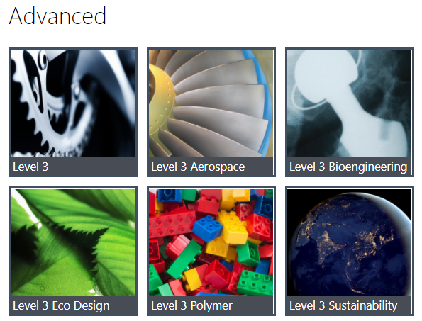
Granta EduPack 2024R1
Databases
What Databases do you have?
Notes:
The opening screen
This shows the 2023 release of the EduPack with an opening screen that displays the available databases. On the left are the Introductory databases. Level 1 General Engineering is intended for a very introductory course on materials. It contains records for 69 common structural materials and 74 processes. Level 2 General engineering has records for 100 materials and 116 processes with much more extensive data for each, including technical notes, design guidelines, environmental and economic notes. This is suitable to introduce the principles of material selection for undergraduates. There are 4 specialized unique databases classified as introductory: Architecture, Materials Science and Engineering, and Design for products. All versions of the software also has The Elements database covering the entire Periodic Table.
On the right are the more advanced databases. Level 3 General Engineering has 4167 materials (with records for specific grades in specific states of heat treatment) and 249 processes.
It allows real design problems to be tackled. Additionally, there are specialized databases for Bioengineering Architecture, Polymers, Aerospace materials, Energy-related materials and for the teaching of Eco Design and Sustainability. Bioengineering and Sustainability have additional Level 2 versions that are less overwhelming to new Students.
All three levels provide supporting information through the EduPack Home tab.

Slide 7



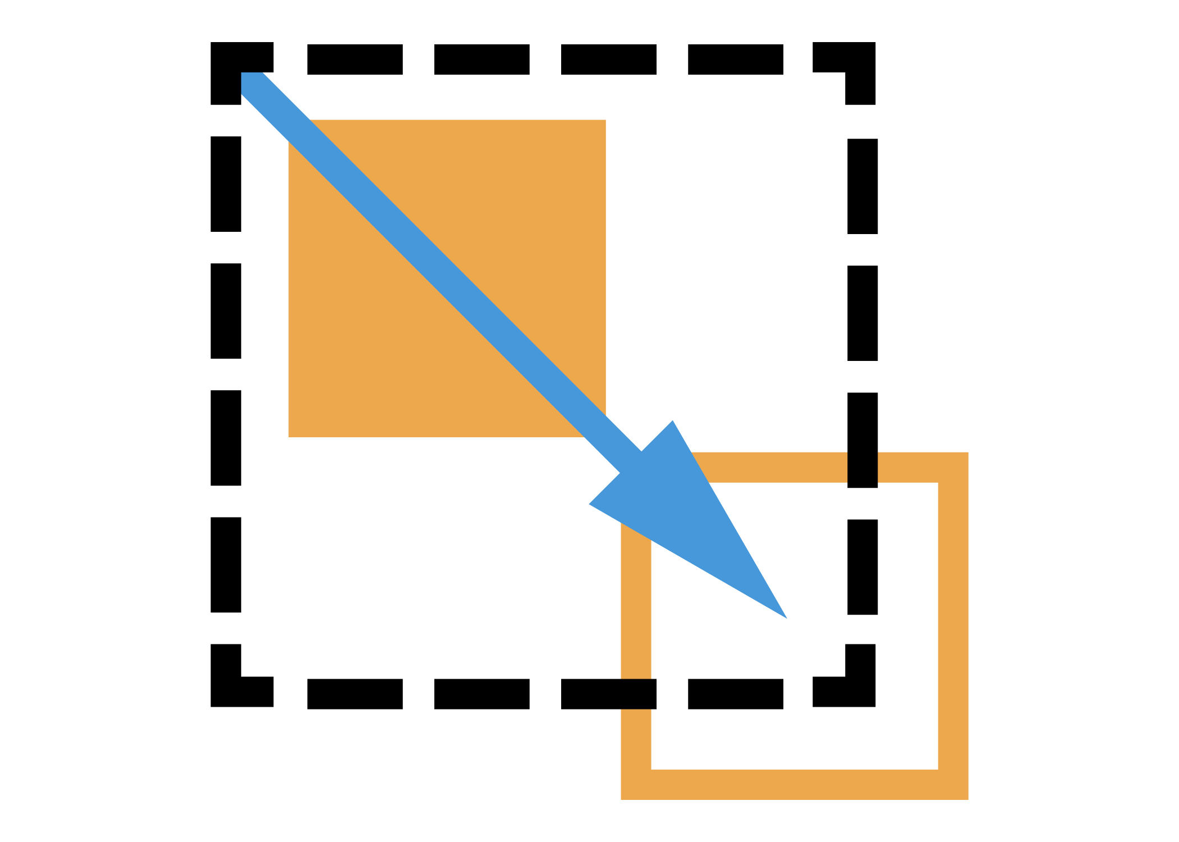


Level 3 Standard database
Data:
Material Universe
  More than 4,200 Materials and 240 Process records
  More than 60 engineering properties for each
Around 100 records for automotive alloys
  Aluminum alloys (2008.2036, 5182, 6111)
  Magnesium alloys (AE44, AM60, AS41)
  High-strength steels (Dual phase/HSLA/Mn-B)
  Automotive composites (Polyester and Polyamide matrix)
Standard Level 3 EduPackTools:
Reliable data
Charting tools
Materials selection tools
Teaching Resources
Eco Audit Tool
Notes:
The Standard Level 3 Engineering database
This database is aimed at higher-year University teaching, project work and real design projects. It contains a comprehensive set of mechanical, thermal, optical, electrical, magnetic and environmental properties for over 4200 engineering materials. The materials and the content of the records were chosen by the Ansys Academic Development team in collaboration with our users to enable realistic selection studies and environmental audits for project-based teaching.
Each material is linked to records for processes that are used to shape, join or finish it. The process records include a simple cost model that allows cost-comparisons between alternative processes. You can create your own records, allowing the materials they describe to be compared with those already in the database.

Slide 8
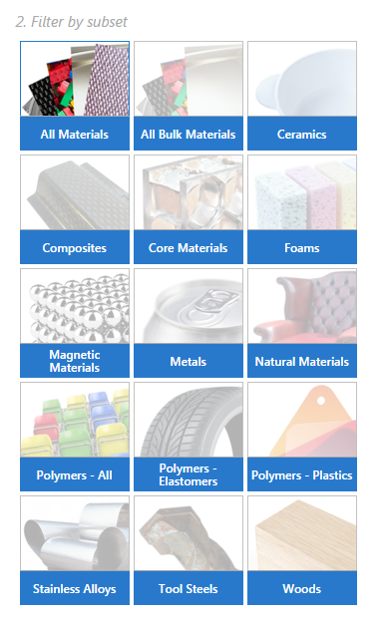
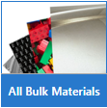
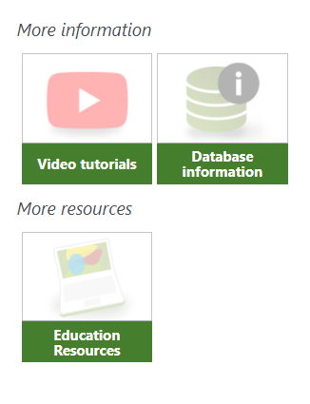

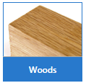
Subsets
  All major material classes including: fibers, particulates, foams and biomaterials
  Engineering materials – suitable for most design and build projects.
  Magnetic materials with remanence, saturation induction, coercive force etc.
  500+ Hardwoods, softwoods, tropical, palms, particleboard, fiber board, and plywood
Notes:
Material subsets
You can view different slices of the database using the subsets.
All materials (default subset) – 4243 records: This record subset contains all the major material classes as well as materials that are not commonly used by engineers: fibers, particulates, less common woods and some other natural materials (e.g. biomaterials such as bone).
All bulk materials – 3461 records: This record subset contains all those which are commonly used by engineers. In practice, this means that the major material classes are included in the record subset but the following are excluded: fibers, particulates, less common woods and some other natural (e.g. biomaterials such as bone).
Many of the attributes in the MaterialUniverse table are relevant for all classes of materials. These are the so-called "generic" attributes. They are properties like the density, strength, stiffness, thermal expansion coefficient and so on, which can be measured for all classes of (room temperature) solids and which play a role in the mechanical, thermal or electrical performance of the material. These attributes can be viewed in Granta EduPack using the All Bulk Materials attribute group.
For systematic selection from the whole "kingdom" of materials, it is usual to start by considering all classes of materials using the All Bulk Materials attribute group. Once a specific class or sub-class of materials has been identified as the best choice, it is possible to select a different group so as to consider other attributes which may be important for those materials. Such attributes, for example "water absorption" for polymers or "cells per unit volume" for foams are not included in the All Bulk Materials attribute group. The subset Materials data for simulation contain 743 records.
Magnetic Materials – 202 records: This subset allows easy identification of the magnetic materials in the MaterialUniverse and the relevant properties e.g. remanent and saturation inductions, coercive force, and maximum permeability, that characterize them as such.
Tool Steels – 82 records: It is difficult to correlate the physical and mechanical properties of tool steels to their suitability to processing and their in-service performance. Therefore a set of properties have been developed to enable the comparison of tool steels.
Stainless Alloys – 359 records (stainless steels and nickel alloys): The layout contains relevant properties such as: Formability (cold, hot), Machinability, Weldability (MIG, Plasma, sub arc, TIG), Brazeability, Pitting and crevice corrosion, PREn - pitting resistance equivalent number, Stress corrosion cracking, and Intergranular (weldline) corrosion and Carbon equivalency.
Woods – 503 records: The main classes of materials classed as wood include hardwoods, softwoods, tropical, palms, cork, bamboo, particleboard, fiberboard, and plywood. Note that in Granta Edupack, woods are classified by density. This is because many of the properties of wood are strongly correlated to their density. For this reason, of the same type, for example oaks, of different densities, will appear on 2 or 3 different branches of the tree. For historical reasons, woods are characterized by using tests which differ from those which are standard for other classes of engineering materials.
The relevant generic and wood specific attributes define and explain the attributes in the MaterialUniverse table relevant to wood, for which a bibliography is provided. It also catalogues the ways where attributes were estimated, where this was necessary. Wherever possible, real data were sought — estimates were used when nothing else was available. Reliable numeric data are generally available for density, flexural modulus, compressive strength, modulus of rupture and some thermal properties. These were used as the basis for estimating missing attributes such as Young's modulus, tensile strength, etc.
The properties of woods depend on the moisture content (MC, symbol u). The MC is the fraction of the density of the wood, expressed in percent, which is attributable to the physisorbed water it contains. An MC of 12% is typical of wood stored, or used, in an average European interior. The data stored in the database refers to an MC of 12% as the 'standard state'. Where necessary, expressions allowing correction to other MCs are given.
In the case of wood-based composites, moduli and strengths are reported in the two in-plane directions. For plywoods, 'parallel' (or longitudinal) and 'perpendicular' (or transverse) mean parallel and perpendicular to the grain direction in the outer plies. For particleboard and fiberboard, 'parallel' and 'perpendicular' indicate the direction of higher and lower particle and fiber alignment respectively.

Slide 9
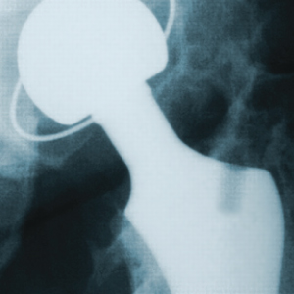
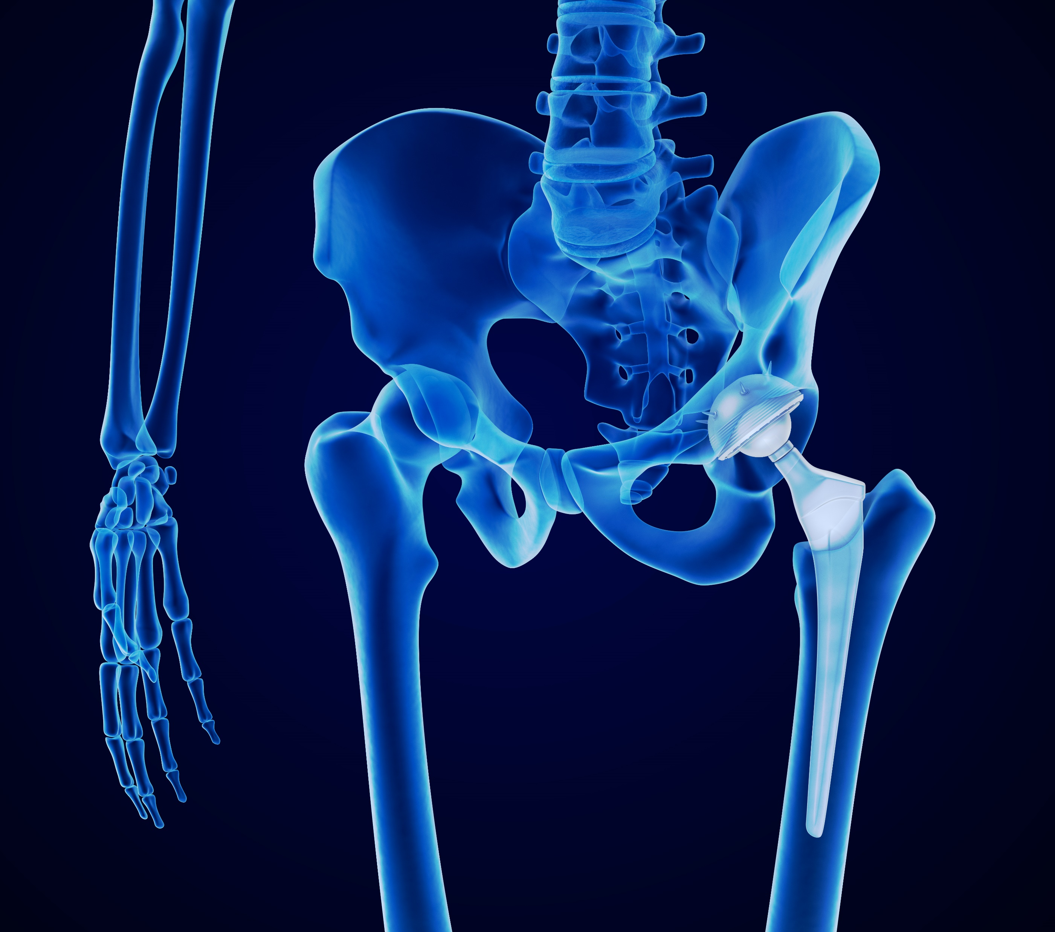
Level 3 Bioengineering database
Data:
Additional biological materials and data (4200+ materials and 240+ processes total)
Data for Medical grades, Medical trade-names, and Sterilizability
Link to ASM Medical Materials online data
  Biomedical response data with medical device application information (Orthopaedic, Cardiovascular, Neurological)
Bio-related subsets
  Biological, Natural and Biological materials, Bio-derived, Bio-polymers, Bio-medical, Bioceramics
Information on Medical devices, including over 100 FDA examples linked to relevant materials
  Also available in Level 2
Tools:
Standard Level 3 Tools
ASM Medical Materials
Enhanced
Eco Audit
Comparison
Table
Synthesizer
Tool
Engineering
Solver
Find
Similar
Notes:
The Level 3 Bioengineering databases
In the advanced database for Bioengineering Level 3, we have compiled extra properties and materials to the standard Level 3 database as shown in the slide. This database is now part of the package. A simplified Level 2 database is available.
The Bioengineering database includes all the updated information contained in the Bioengineering Level 2 database. It has additional bio-attributes, included to enable projects on the design of medical devices design projects.

Slide 10
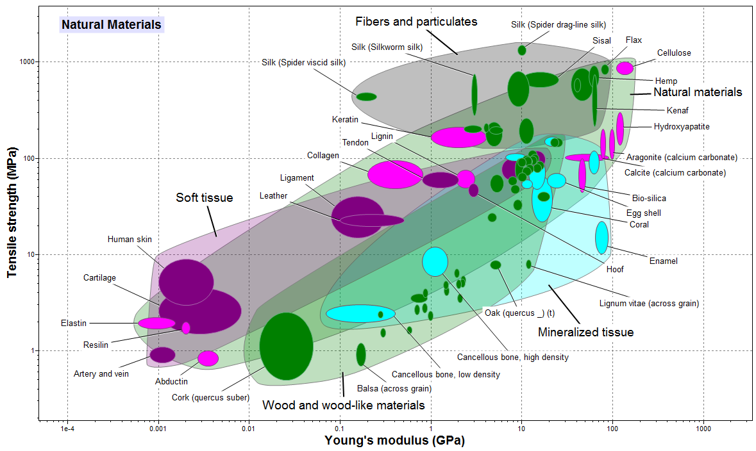
Example of materials in Bioengineering
Notes:
Bioengineering data
Here is an example of a chart made with the Level 2 Bioengineering database. Biological materials can be compared with the set of engineering materials at the same level.

Slide 11
Level 3 Polymer database
Data:
MaterialUniverse – 970+ polymer records
  Includes ChemRes data for resistance to chemical environments.
Global Polymers Plastics
  105,000+ datasheets for commercial polymer grades from suppliers Meeting ASTM or ISO standards.
Tools:
Standard Level 3 Tools
Enhanced
Eco Audit
Synthesizer
Tool
Comparison
Table
Find
Similar
Engineering
Solver
Notes:
The Granta EduPack Polymer database
The optional ChemRes module adds around an additional 190 attributes to the Polymer records in the MaterialUniverse table. These attributes detail the relative resistance of each polymer to various chemical environments.
The chemical resistance data in this module is reproduced under license from RAPRA Technology Ltd, Shawbury. It was accumulated by RAPRA from a wide variety of sources over many years of research. It is presented in the form of a compilation of value judgements based, wherever possible, on quantitative data available in the public domain. The value judgements of the effects of the environments on the polymers in the Granta ChemRes module use the system given by RAPRA:
The Global Polymers Plastics module is a database of around 105,000 datasheets for specific plastic resin grades from around 870 suppliers worldwide. The original datasheets come from participating resin vendors, are collated and provided under license.
The database contains around 69 000 ASTM datasheets and nearly 48 000 ISO datasheets.
Using Global Polymers Plastics Data
Applications of Plastics data in Granta EduPack include the following:
Property Look Up – What are the properties of Grade E2 from supplier 'Cool Polymers, Inc'.
Selection – As a second stage in the selection process. Having identified suitable resin/filler combinations using the MaterialUniverse, find specific grades in Global Polymers Plastics.
Sourcing – Find a supplier, alternative suppliers, or substitute materials.

Slide 12
Using the Polymer modules
MaterialUniverse
  Designed for primary, broad materials selection. Enables generic candidates (resin and filler type) to be easily identified.
Global Polymers Plastics
  Once the resin and filler type are known these can be used to find specific commercial grades and possible vendors.
STAGE 1
STAGE 2
Identify
Resin/Filler
Options
Identify
Commercial
Grades
Design Requirements
Contact Suppliers
Granta MaterialUniverse
RAPRA ChemRes
Global Polymers Plastics
Notes:
So how can we use this database?
The MaterialUniverse data table is designed for primary materials selection exercises. Use the Global Polymers Plastics data-tables for finding specific grades and for selection of possible vendors.
The strength of the MaterialUniverse database is for materials selection at the resin-filler level. Only one generic grade exists for each common resin-filler combination. Every material can be compared with every other material because there are no holes in the data – the datasheets are complete – and all the data are reported on the same scale.
The strength of Global Polymers Plastics is the breadth of coverage – Over 870 suppliers list materials in Global Polymers Plastics. Global Polymers Plastics is excellent for North American usage, where ASTM standards pre-dominate. Comparability between Global Polymers Plastics grades is relatively poor, however. The Global Polymers Plastics datasheets are not complete, meaning that a rigorous approach to selection is not possible.

Slide 13

Level 3 Aerospace database
Data:
Materials Data Tables (Material Universe)
  Additional ‘Aerospace Materials’ subset with 950+ records with many showing temperature dependent mechanical properties from the MMPDS database
MMPDS – Metals (formerly MIL-HDBK-5)
2500+ records of statistically-derived design data for aerospace alloys, temperature dependent properties, fatigue curves, and corrosion rankings.
MIL-HDBK-17 – Composites
950+ records of test data for polymer matrix, metal matrix, and ceramic matrix composites.
Tools:
Standard Level 3 Tools
Enhanced
Eco Audit
Synthesizer
Tool
Comparison
Table
Find
Similar
Engineering
Solver
Notes:
Additional data-tables
There are several independent datatables in the Aerospace edition
MMPDS 'Metallic Materials Properties Development and Standardization’
The records contain statistically based design data, corresponding to the tabular data in the Handbook, and graphical data, i.e. x-y data plots, corresponding to the figures in the Handbook.
The tree structure of the database is based on that in the handbook itself.
The tree branches in the following way:
Alloy – Temper/Condition – Form – Dimension – Statistical Basis
MIL-HDBK-17
Data from the US Department of Defence Military Handbook, Mil-HDBK-17 "Composite Materials Handbook" has been compiled into a Granta EduPack database. This comprises of two data tables; MIL-HDBK-17 Handbook Data has 984 records containing test data from the MIL-HDBK-17 document.
This also has MIL-HDBK-17 Summarized Data table which has 91 records, some of which contain graphical data, e.g. stress-strain and fatigue charts.

Slide 14
Granta EduPack Aerospace database structure
The
database
PMP-HDBK
Shape
data-table
References
data-table
MMPDS
Materials
data-table
Processes
data-table
Links
Suppliers
data-table
Structural Sections
data-table
MIL-HDBK-17
Aerospace
Database
Specific Data
Notes:
Granta EduPack Aerospace Database structure
The structure of the database is very similar to the others of EduPack Level 3, although the wealth of data is sometimes overwhelming.
It relies on the proven MaterialUniverse, ProcessUniverse, Shape and Structural sections data-tables linked together, plus the MMPDS and MILL-HDBK-17 data-tables connected to the Material

Slide 15
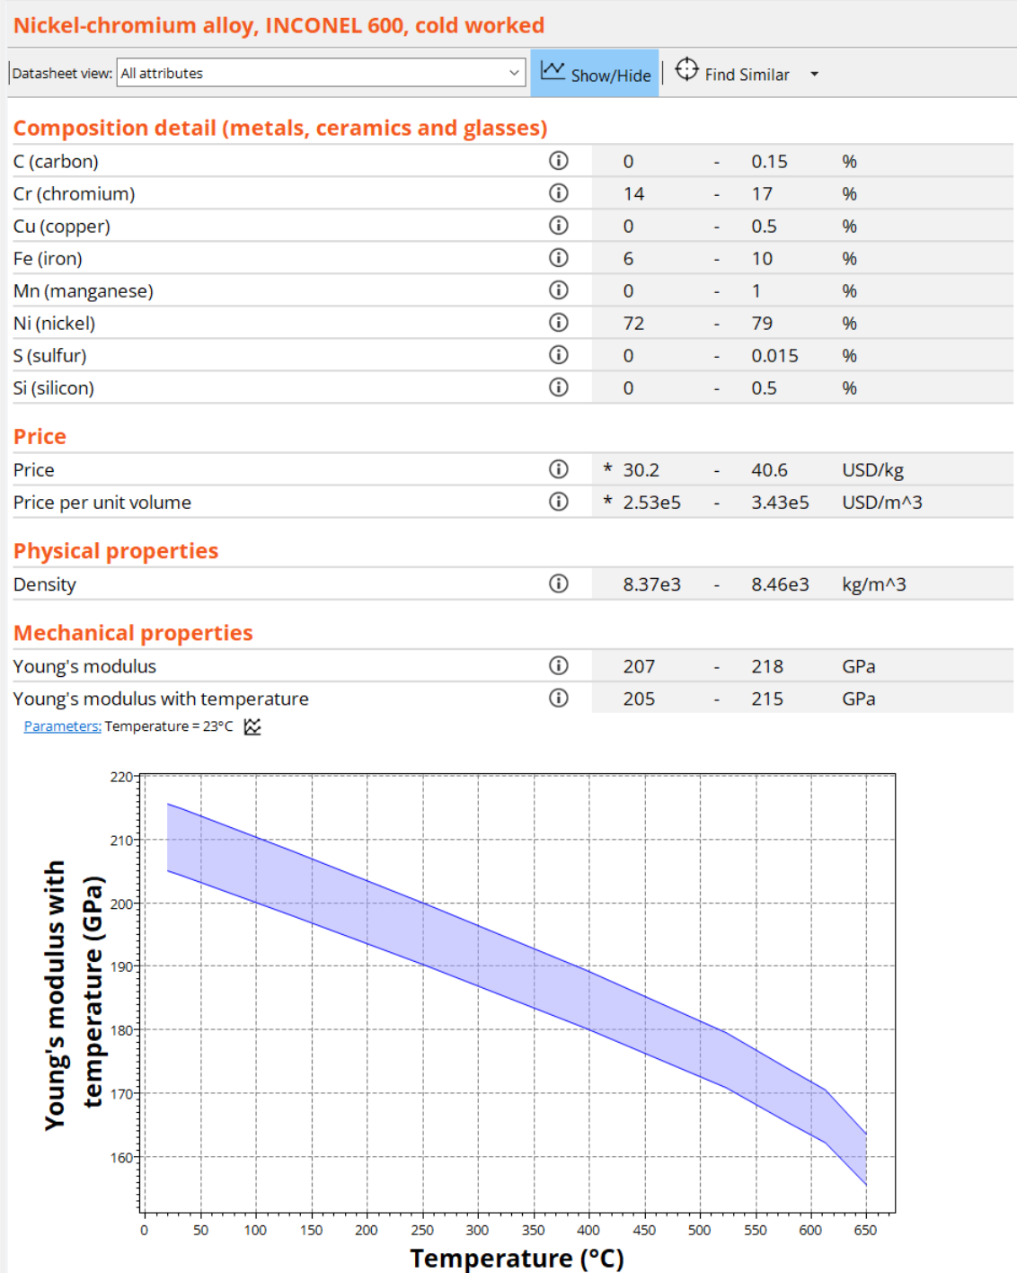
Materials Universe – Aerospace subset
Each material in the Aerospace subset links to the MMPDS (metals) or MIL-HDBK-17 (composites) tables.
Each record has all the attributes of the 'All bulk materials' subset, as well as additional temperature dependant functional data.
It allows materials comparisons and selection on a database with no holes.
Notes:
Aerospace subset
Each material in this subset can either be found in MMPDS or MIL-HDBK-17. Each record within this subset has all the attributes of the 'All bulk materials' attribute group, as well as additional temperature dependant functional data attributes.
You can set the temperature at which you would like to view the temperature related data. Selections will use data at the temperature you set to measure the material against any criteria you set for the temperature dependant properties. Any graphs created with the temperature related data will be correct for the temperature you have set in the parameters dialog box.

Slide 16
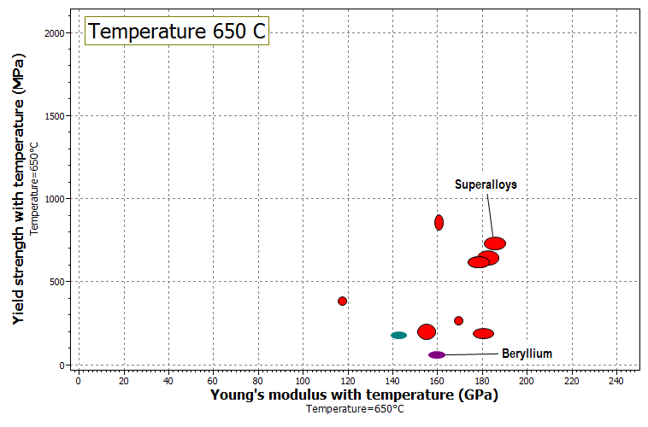
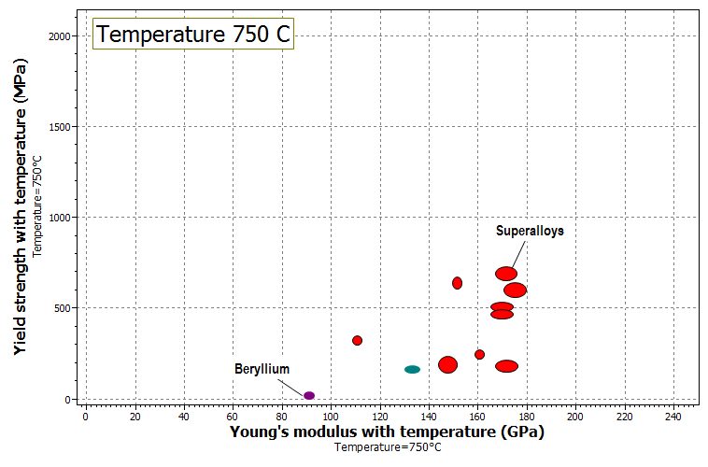
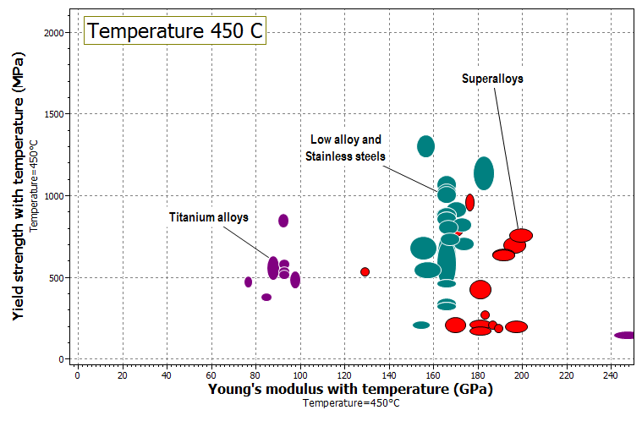
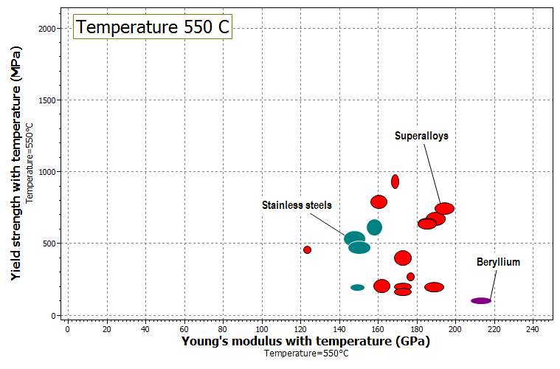
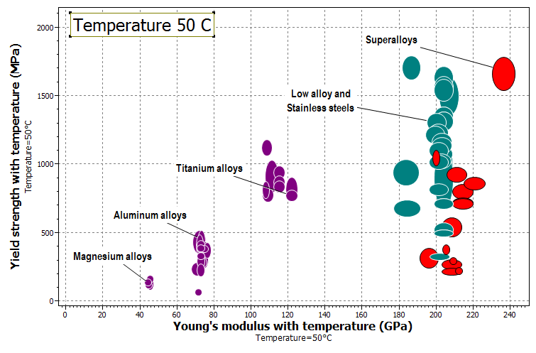
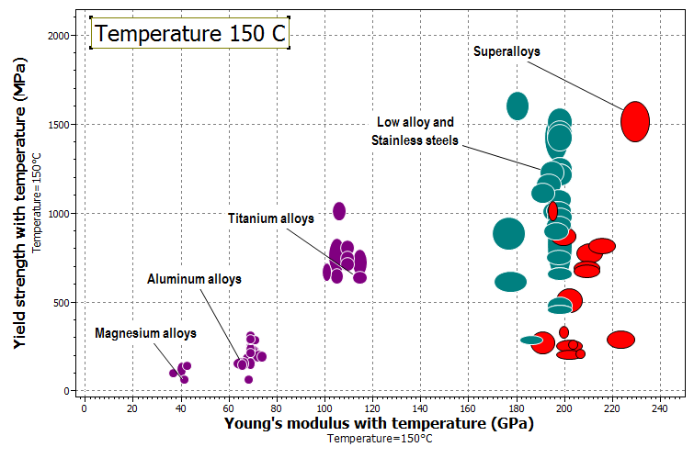
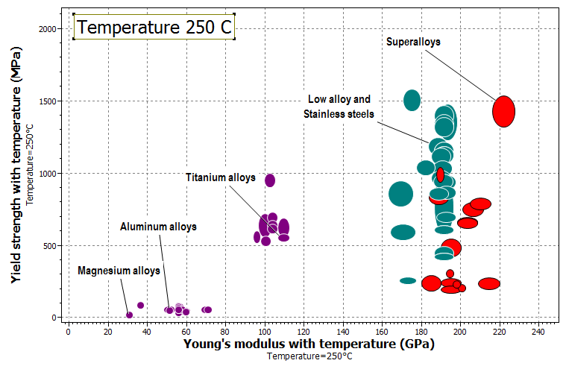
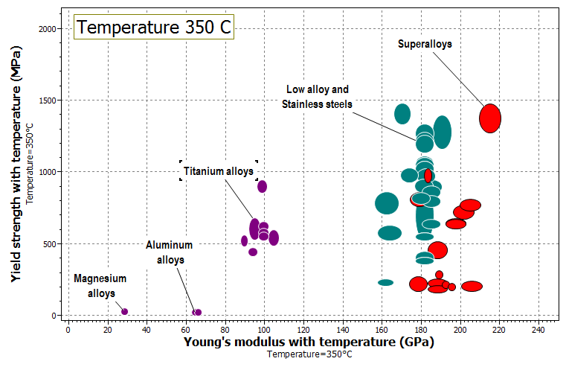
Temperature dependence
Notes:
Temperature dependent properties
The temperature dependence of properties can be illustrated with animated charts.

Slide 17

Level 3 Eco design database
Data:
Eco Design Level 3 Database – 4200+ materials and 240+ Processes.
Useful attributes for Eco Design
  Eco Properties – Energy use, Water usage, CO_{2,} Traceable CO₂ and Embodied Energy (where available)
  Geoeconomic data – Criticality, Abundance, reserves etc.
  Hazard data – REACH, SIN List, RoHS, Food Contact
Tools:
Standard Level 3 Tools
Enhanced
Eco Audit
Synthesizer
Tool
Comparison
Table
Find
Similar
Engineering
Solver
Notes:
The Eco Design edition
The Eco Design database contains additional Eco-data and information on hazardous substances and restricted materials. Increased information on e.g. water usage facilitates the assessment of the Eco-impact a product could have throughout its lifecycle. This helps students select materials that satisfy the many trade-offs involved in Eco aware design.

Slide 18
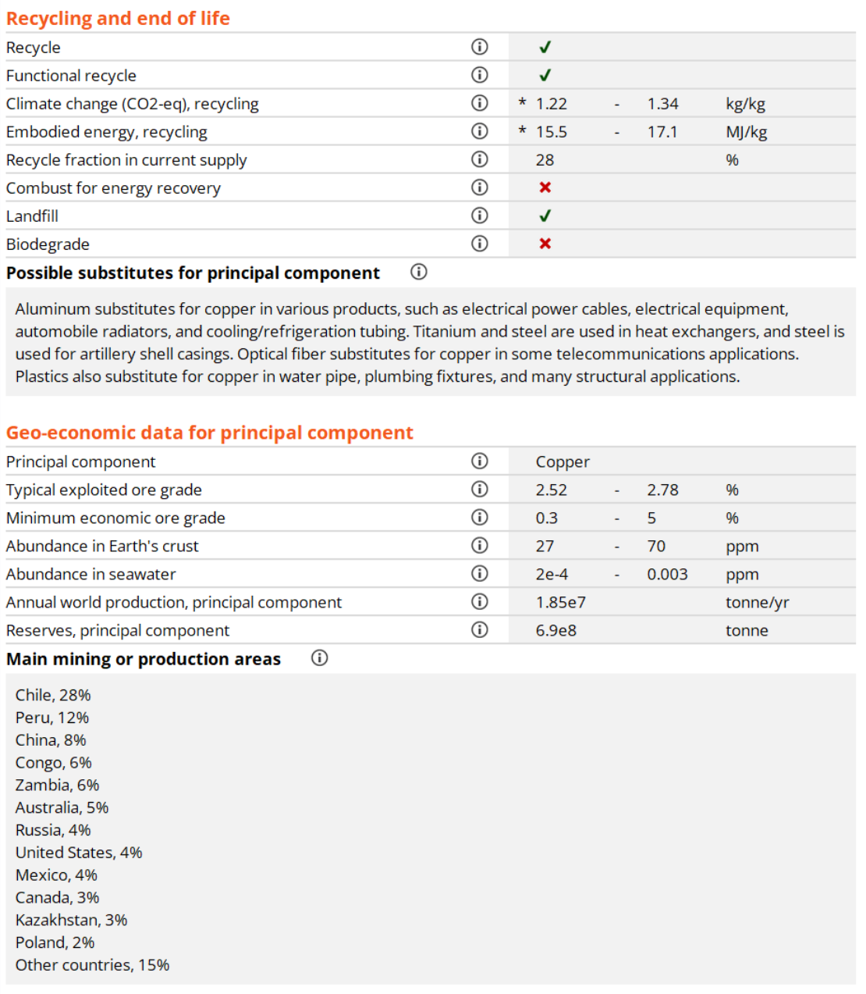
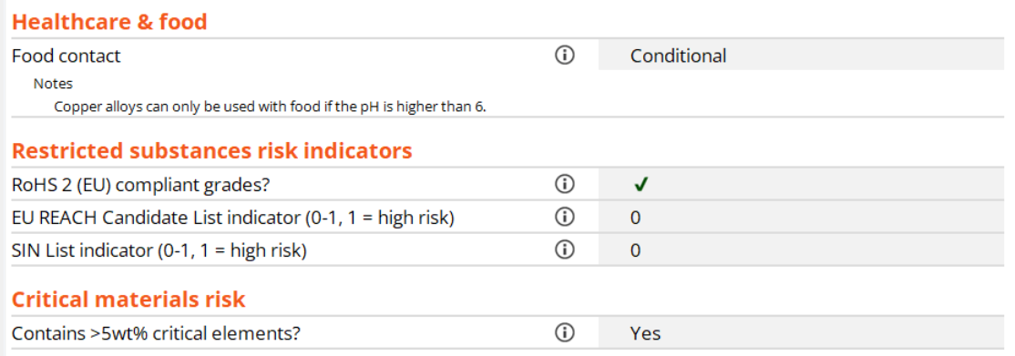
Examples of additional data
Notes:
Examples of additional data
Many properties useful for Eco Design has been added to this database, which still includes all engineering materials of Level 3.

Slide 19

Level 3 Sustainability database
Data:
Nations of the world - attribute per country.
Legislation and regulation - representative legal framework around technological decisions
Power Systems-Storage, Power Systems-Generation, and Battery Cells datatables
  Also available at Level 2
Tools:
Standard Level 3 Tools
Enhanced
Eco Audit
Synthesizer
Tool
Comparison
Table
Find
Similar
Engineering
Solver
Notes:
The Sustainability databases
The Sustainable Development edition includes two databases and a number of linked data-tables.
Level 2 is suitable for introducing the concepts of Sustainable Development, and to provide intermediate-level materials data. The economic, regulatory, and political data supports the analysis of stakeholder perspectives on technological issues.
Level 3 provides a comprehensive database for advanced teaching and projects in Sustainable Development. As well as the full Engineering database for materials selection, it provides supporting data for an analysis of different stakeholder perspectives on technological issues.

Slide 20








Sustainability database
Power
Sources
Energy
Storage
Elements
Materials
Processes
Level 2 Sustainability
100 Materials
Teach the concepts
Nations
Regulation
Level 3 Sustainability
4243 Materials
Advanced Projects
Analysis of Materials Systems
Notes:
Database structure
The Sustainability database consists of several linked data-tables. In addition to the MaterialUniverse and ProcessUniverse, there are data-tables to facilitate analysis of Societal issues (Legislation, Nations of the World, Energy production and storage). A data-table on the Elements of the full periodic table is directly linked to materials datasheets and contain the same Geo-economic and critical materials information as the Elements database.

Slide 21
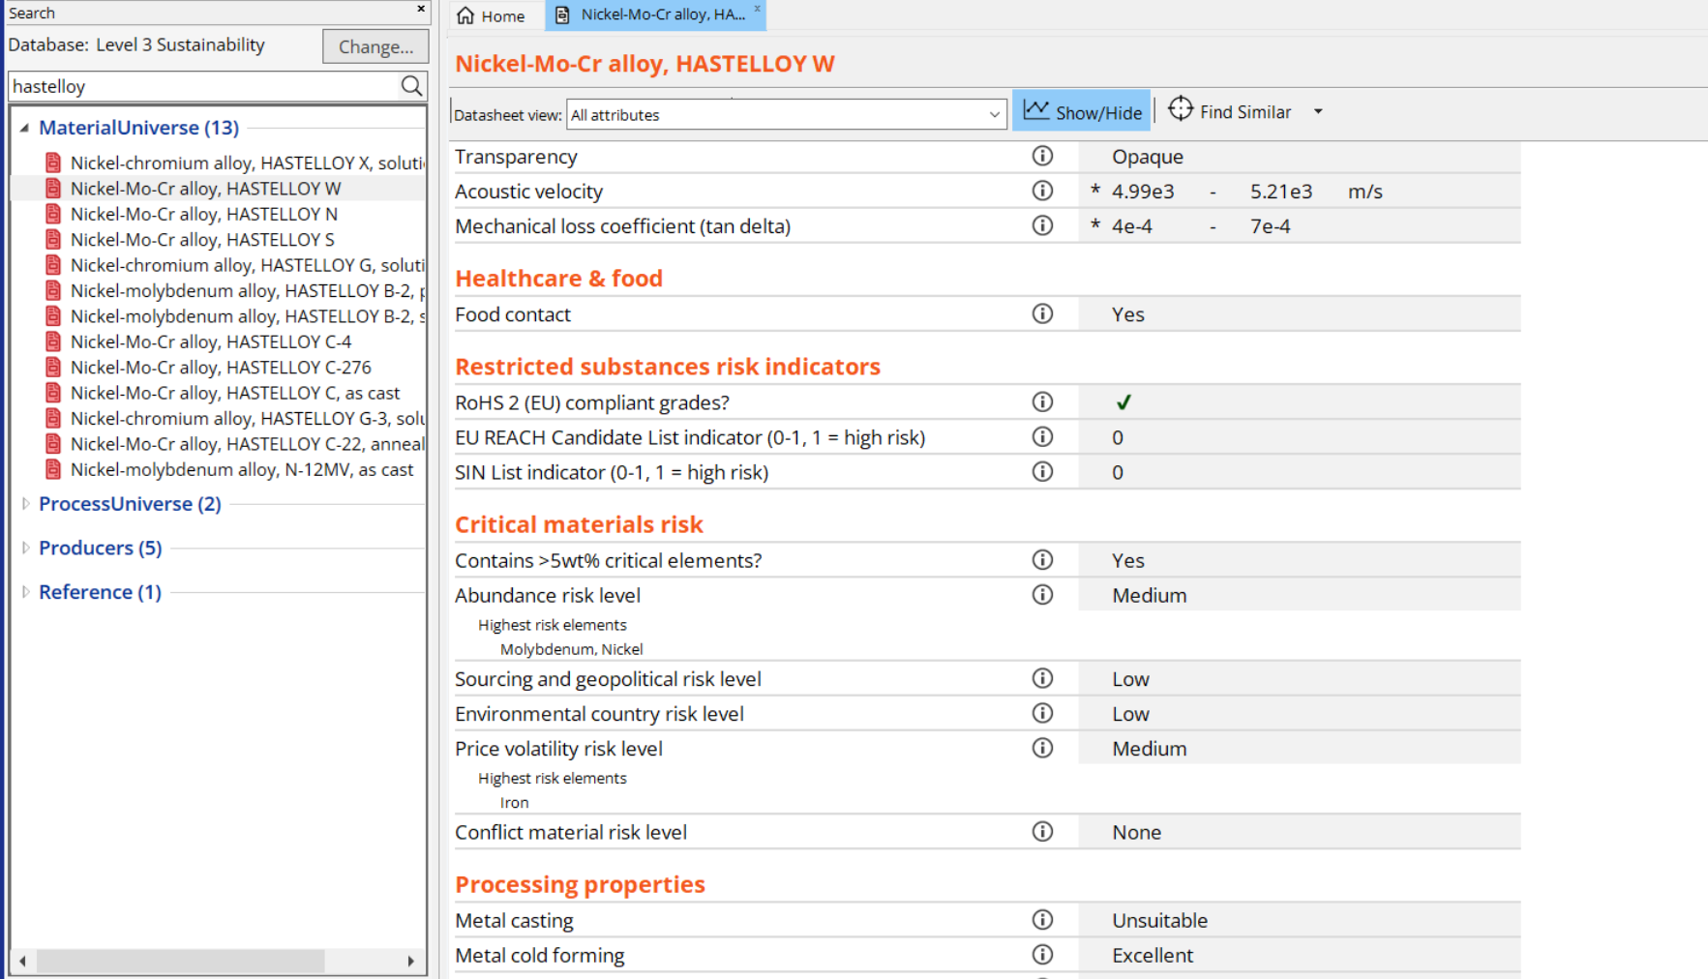
Eco properties and supply risk
Ni: 58-69% Mo: 23-26% Fe: 4-7%
It is proposed to replace stainless steel pipework with Hastelloy W
Questions:
Eco-profile that I can trust?
Supply-chain security?
Notes:
Workflow example
A practical example of how the Sustainability database can be used is the proposed substitution of a stainless steel pipework with Hastelloy W. Hastelloy W can be found by Search. The composition reveals that it contains significant amounts of Ni and Mo. These datasheets can easily be found via the links at the bottom of the Hastelloy datasheet.

Slide 22
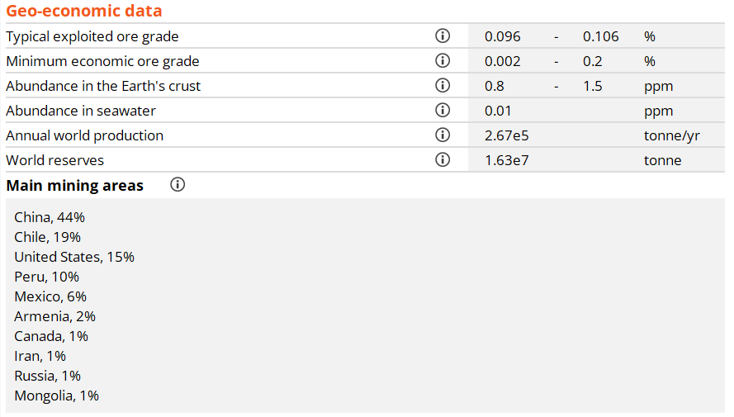

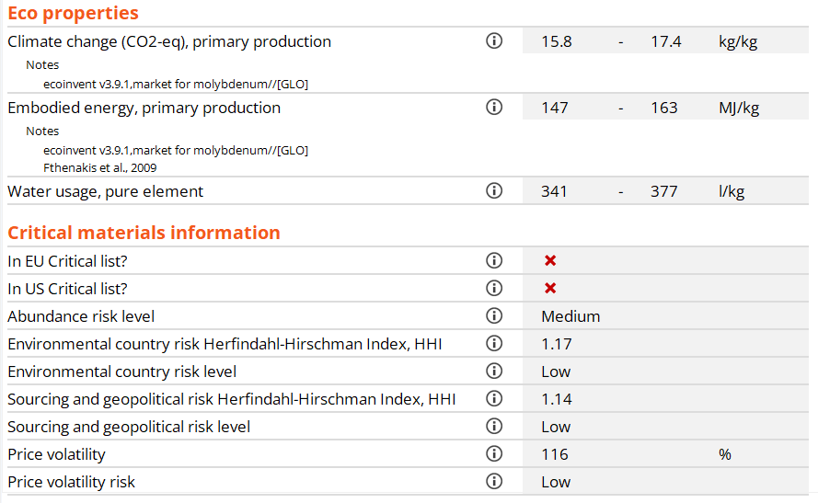
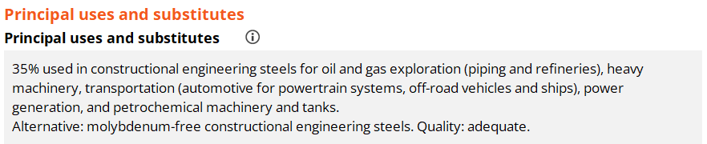
The Elements database
Geo-economic information
Traceable
eco-data
Possible
substitutes
Notes:
Example (continued)
The Eco profile, Criticality and Geo-economics can be investigated and, in the case of Mo, it is found to be on the EU critical materials list, which is negative for the Supply-chain risk. Some recommended alternatives are given at the bottom of the datasheet

Slide 23
Advanced databases and tools
Standard
Eco Audit
Advanced
Level 3 Standard Database
Extra data in:
Bioengineering
Polymer
Aerospace
Eco Design
Sustainability
Tools Available:
Eco Audit
Enhanced Eco Audit
Synthesizer
Engineering Solver
Find Similar
Comparison Tables
Bioengineering
Eco Audit
Solver
Comparison Table
Synthesizer
Find Similar
Polymer
Eco Audit
Solver
Comparison Table
Synthesizer
Find Similar
Aerospace
Eco Audit
Solver
Comparison Table
Synthesizer
Find Similar
Eco Design
Eco Audit
Solver
Comparison Table
Synthesizer
Find Similar
Sustainable
Development
Eco Audit
Solver
Comparison Table
Synthesizer
Find Similar
Notes:
Databases and Tools
The databases that are available in your version of Granta EduPack depends on your Edition. In the AllEditions version, you have access to all advanced databases. In specialized editions, you have access to some of them. The Advanced Tools, the Enhanced Eco Audit and the Synthesizer tool are included, as shown in this slide.

Slide 24
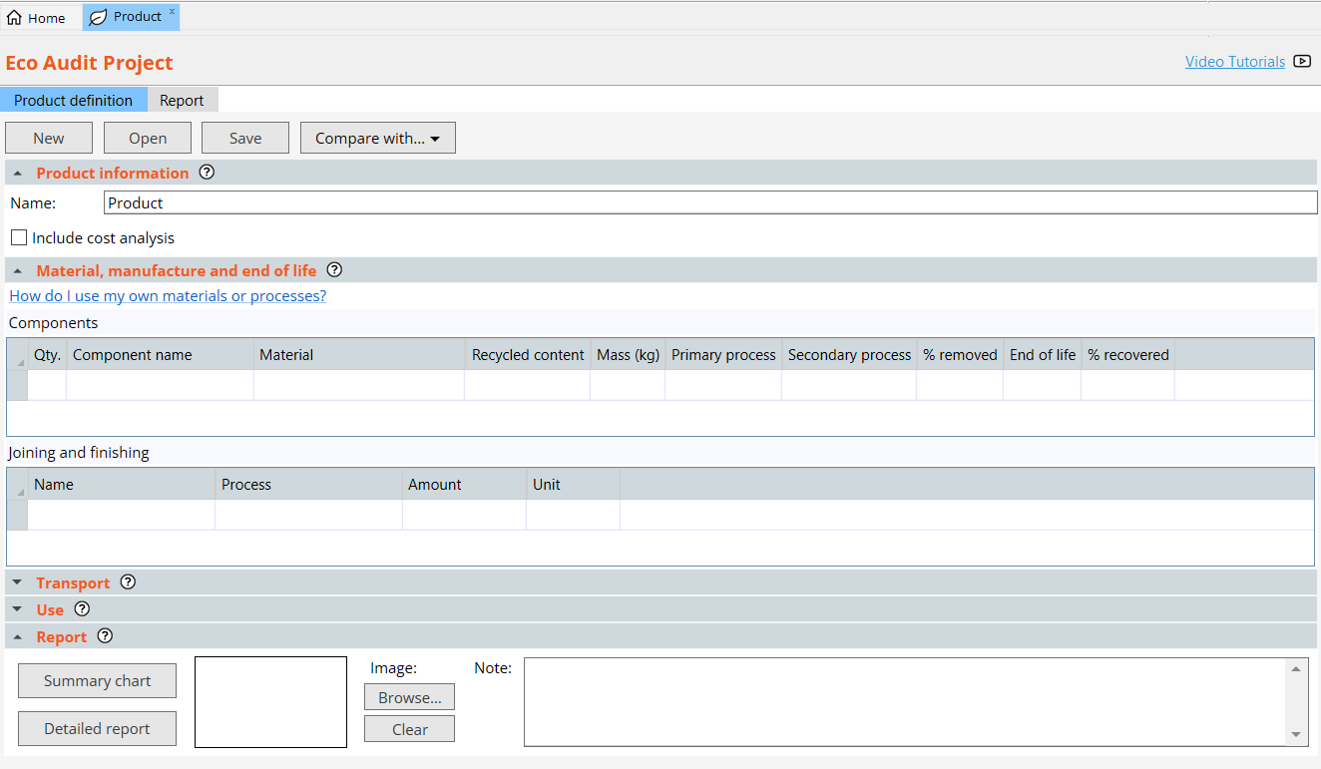
Enhanced Eco Audit
Ability to include cost analysis during audit
Can use custom records for both materials and processes
More elements to consider during manufacturing, such as secondary processes and % material recovered
Can consider the impact of additional joining and finishing steps
Notes:
The enhanced Eco Audit tool has increased functionality from the basic eco audit, as highlighted here. Key changes include cost analysis and ability to explore impact of increased processing steps.

Slide 25
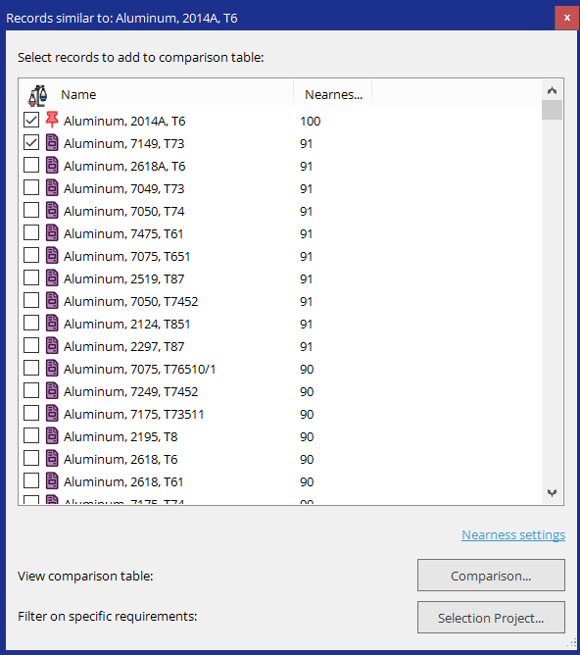
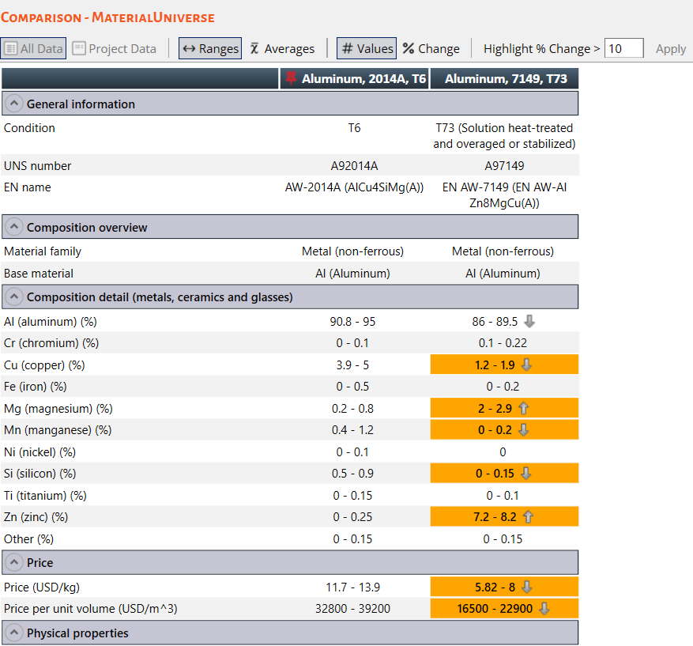
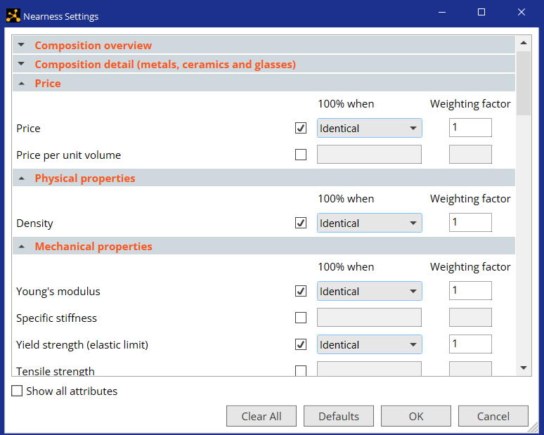
Find Similar Tool
Reference
Differences >10% highlighted in orange
Ranking
0-100%
Add to comparison table
Creates selection project
Filters data
Notes:
The Find Similar Tool allows for exploration of materials compared to some reference material (i.e. a material some product that is being redesigned was made of previously)
By adjusting the nearness settings, you can explore the materials available in the Advanced databases based on design requirements and how closely they match the reference material

Slide 26
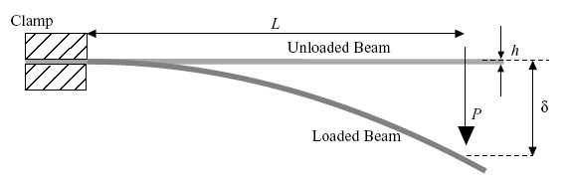
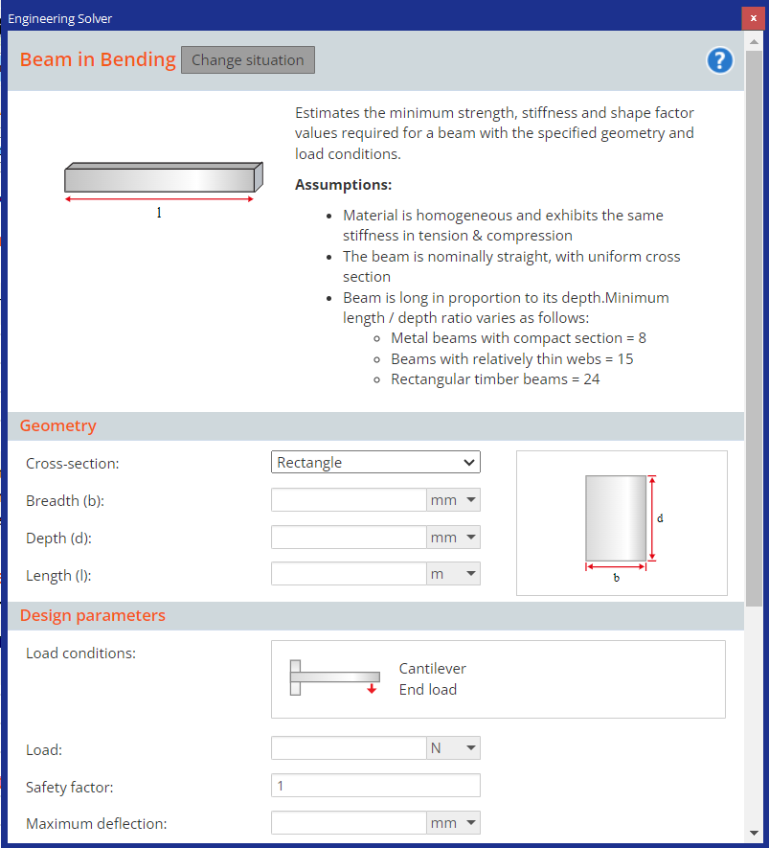
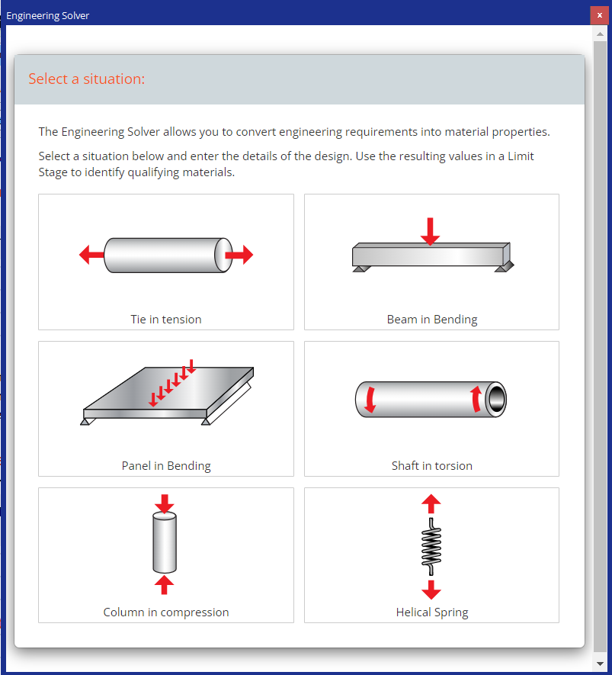



The Engineering Solver (1)
Basic equations from:
‘Roark’s formulas of stress and strain’
Engineering / Design
Converts engineering ‘requirements’ into material properties
$$L$$
$$F$$
$$δ$$
Materials?
Min Strength
Min Stiffness
b
h
Cross-section
Notes:
The engineering solver uses analytic models (with equations from Roark’s “Formulas of Stress and Strain”) to help explore the loading conditions of various designs
This can be used to aid materials selection by considering the main loading criteria of a part, the geometry, and other design parameters to determine the minimum properties needed

Slide 27
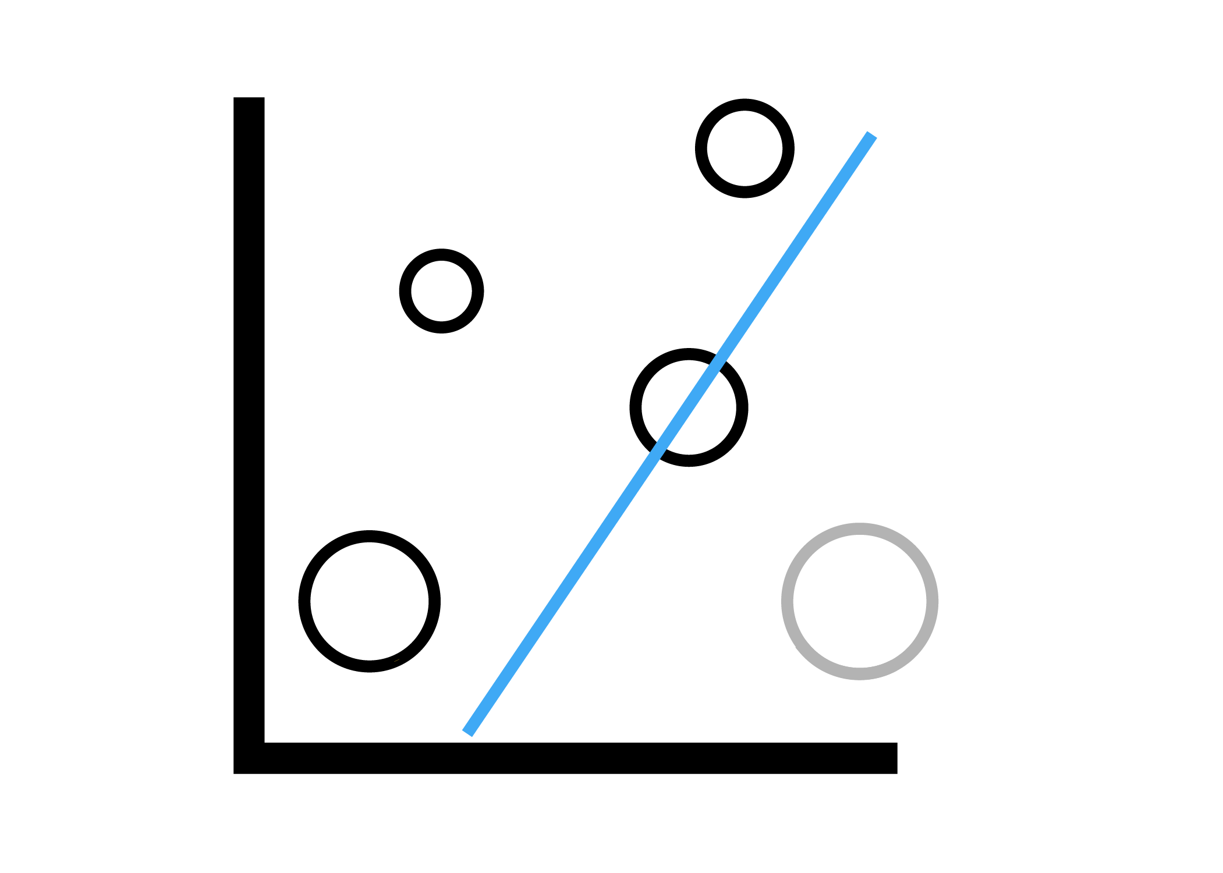
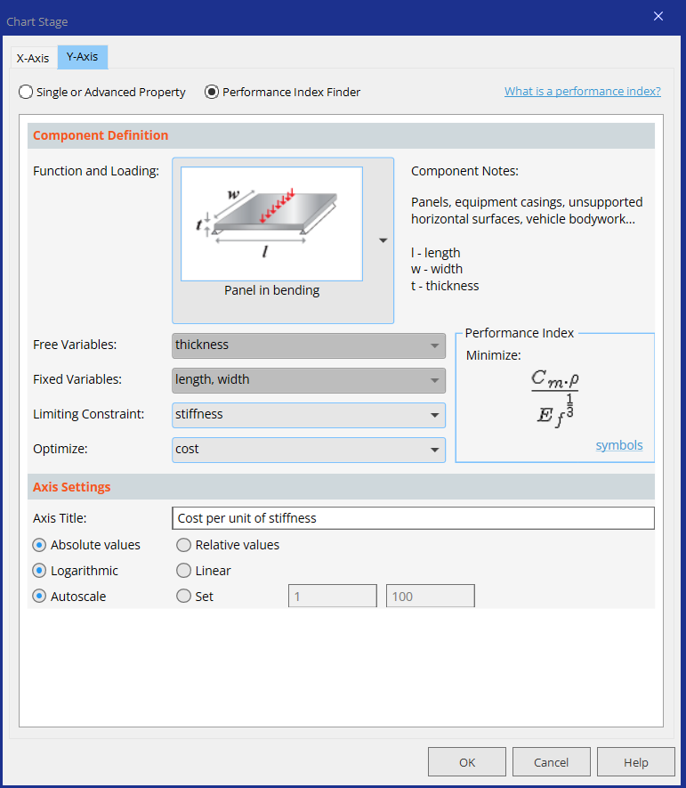
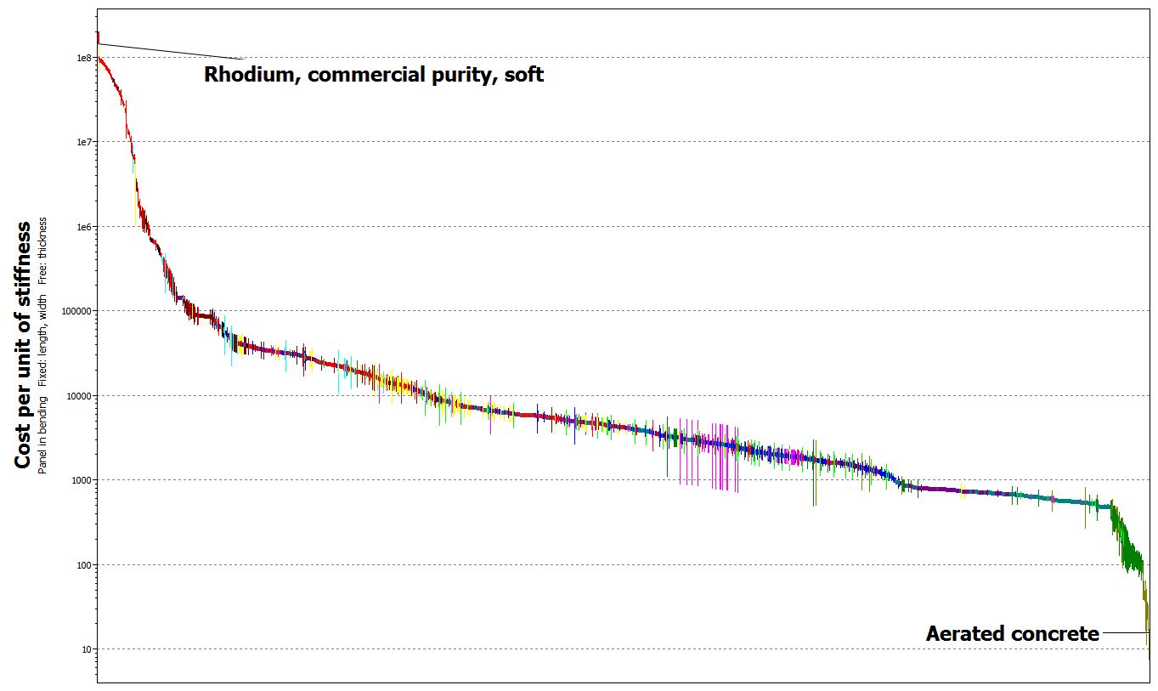
Performance Index finder
To plot a performance index, click here and choose the model that best fits your function and loading.
Chart/Index
Then choose the Limiting constraint and the property you want to optimise - the ‘performance index’ is automatically generated and plotted.
Notes:
The Performance Index finder is embedded in the Chart function of Granta EduPack in the Advanced databases. It allows for selection from various functions and loading conditions to aid in selection.

Slide 28

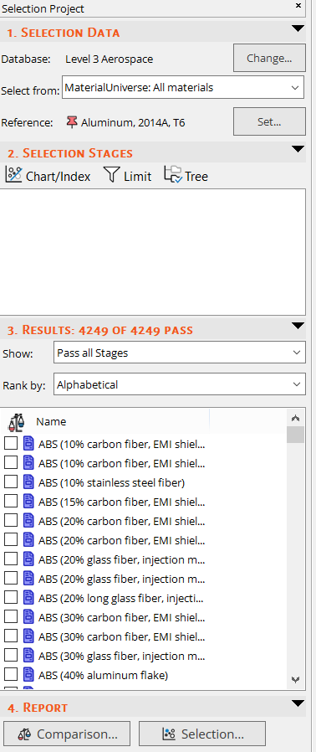


Reference Materials
Set reference material here for use in Comparison Tables and easier identification in charts via the “Highlight Reference Record” button
Favorite records are also easier to identify on charts via the “Highlight Favorite Record” button
Notes:
Reference materials can be useful during selection, especially when doing a redesign. By setting the reference material, it can be highlighted within charts

Slide 29
Comparison Table
  Compare all properties
  Highlight differences in performance
  Identify ‘Gotchas’
Notes:
Reference materials are also useful for comparison tables, which automatically highlight differences between the reference and other selected materials

Slide 30
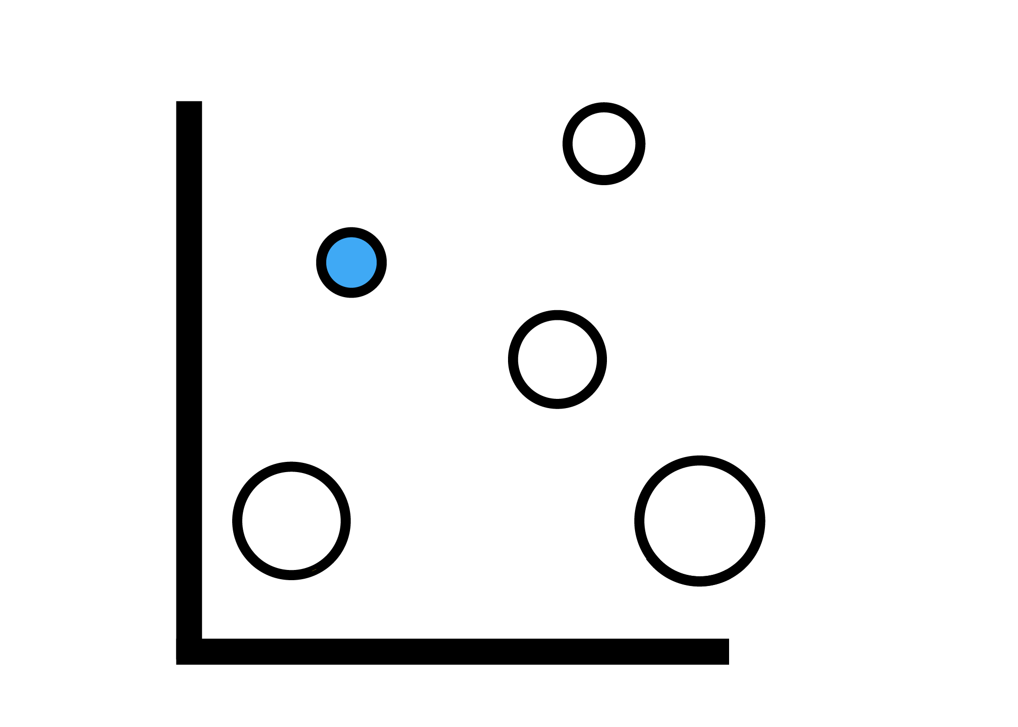
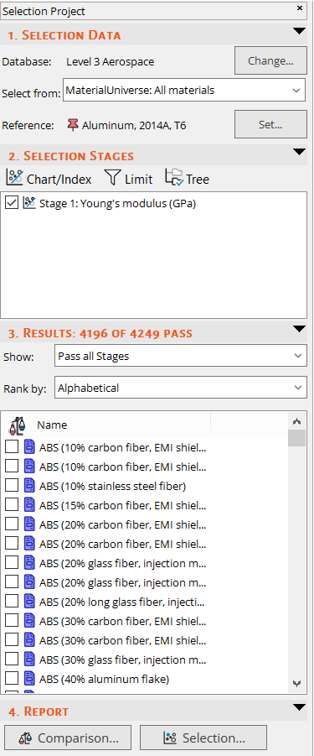
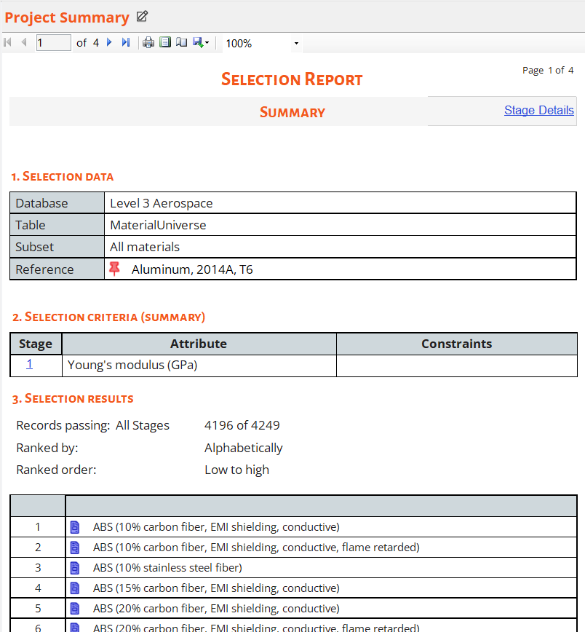
Reporting tool
To create a report automatically, click Selection.
You can print and export the report as a PDF or into Word.
Notes:
The Reporting tool at the bottom of the Selection Project page gives a print out of detailed information gathered by using reference materials and other selection strategies. This can be quite useful in advance courses, like capstone design.

Slide 31

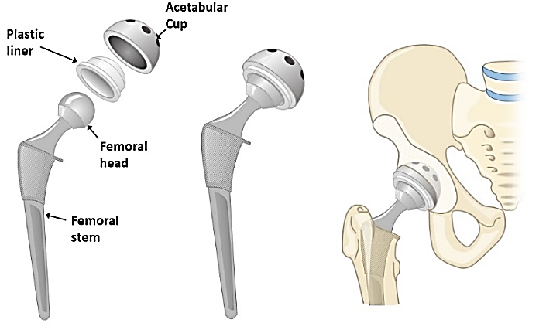


Advanced case studies at Ansys Education Resources Webpage
www.ansys.com/education-resources
Notes:
Advanced Industrial Case Studies
There are a number of short papers describing Advanced Industrial Case Studies, which can inspire students as demonstrations, assignments or small projects. The areas include Bioengineering, Aerospace, Automotive and Mechanical Engineering.

Slide 32
Lecture unit series
These PowerPoint lecture units, as well as many other types of resources,
can be found in the Ansys Education Resources webpage.
Finding and Displaying Information
Unit 1 | The materials of engineering
Unit 2 | Material property charts: mapping materials
Unit 3 | The Elements database: properties, relationships and resources
Material Properties
Unit 4 | Manipulating properties: composition, microstructure, architecture
Unit 5 | Designing new materials: filling the materials-property space
Unit 6 | Materials Science and Engineering
Selection
Unit 7 | Material selection: translation, screening, ranking, documentation
Unit 8 | Objectives in conflict: trade off methods and penalty functions
Unit 9 | Material and shape: materials for efficient structures
Unit 10 | Manufacturing processes and cost modeling
Unit 11 | Eco-informed material selection
Unit 12 | Eco design and the Eco Audit tool
Sustainability
What is a sustainable development? A materials perspective
Exploring Critical Materials using Ansys Granta EduPack
Special Topics
The Built Environment
Structural sections: shape in action
Materials in industrial design: Why do consumers buy products?
The Design database for Products
The Battery Designer tool
Bioengineering and Medical Devices
Advanced Teaching and Research
Advanced databases
The Aerospace database
The Polymer database
The Synthesizer tool: hybrids and other models
www.ansys.com/education-resources
Notes:
Lecture Units Series
This is a list of the Lecture Units available for teaching with the Ansys Granta EduPack. These PowerPoint presentations and more information can be found on the Ansys Education Resources webpage:
www.ansys.com/education-resources.

