Slide 1
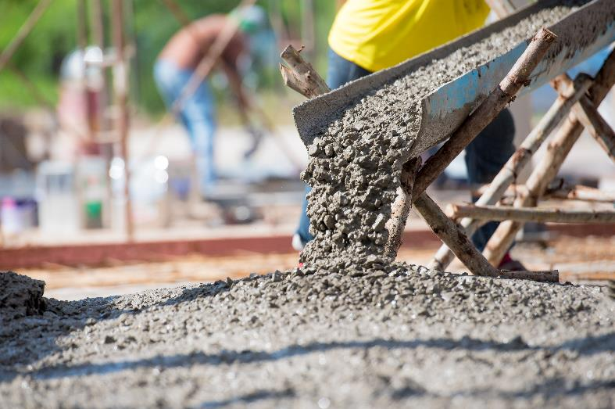
Sustainability Case Study
Built Environment: Low carbon concrete
Mike Ashby¹ and Tatiana Vakhitova²
¹Department of Engineering, University of Cambridge
²Ansys Education Division
AdobeStock_123745217
Originally created 2016

Slide 2
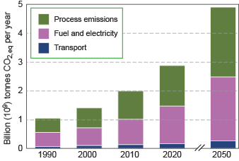
Low carbon concrete: Background
Concrete is cement-bonded aggregate, usually Portland Cement (PC) made by calcining lime (CaCO₃)
It is the second most consumed product on earth after water
Carbon emissions arise from fossil fuel combustion and from the calcining reaction
(CaCO₃ → CaO + CO₂)
At present making 1 tonne of cement releases around 1 tonne of CO_{2eq}
Globally 5% of all greenhouse gas emissions are from making cement; expected emissions of 5 billion tonnes/year by 2050
EU committed to reducing carbon emission to 20% of 1990 level by 2050
Can the cement industry achieve this?

Slide 3
Step 1: Objective, scale and functional unit
Objective: reduce green-house gas emissions from making concrete
Size scale: a reduction of 80% relative to 1990 levels
Time scale: by 2050
Functional unit: 1 tonne of C25 concrete (one part cement 6 parts aggregate)
Facts needed
What options for carbon reduction?
What economic, environmental and social consequences might they have

Slide 4
Step 2: Stakeholders and concerns
Stakeholders
Stakeholder diagram
Government and Health authorities
– short term: cement dust
– long term: meeting carbon reduction obligations
Cement makers
– carbon taxes, corporate sustainability reporting
– alternative chemistries
– carbon capture and storage (CCS)
Construction industry
– cost and availability of cement
– setting time
– safety
Environmentalists
– climate change
Little Influence / Power Great
Health
and
safety
Government
Cement
makers
Building
industry
Green
lobby
Little Interest Great

Slide 5
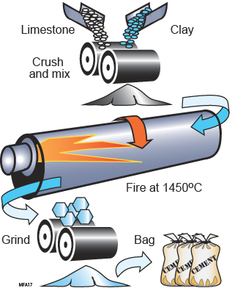
Step 3: Fact-finding – making cement
Portland cement is made from limestone (CaCO₃), clays (hydrated aluminum silicates) and marls (mixed clay-limestone minerals) fired at 1450ºC and ground to cement powder.
Carbon release: 1 tonne CO_{2,eq} per tonne of cement
Options for reducing emissions from cement production:
The use of biomass for heating
Replacing some of the PC with pulverised fly ash (PFA) or ground granulated blast furnace slag (GGBS)
Carbon capture and storage (CCS)
Develop new cement formulations with lower energy and carbon footprint such as reactive MgO cement.

Slide 6
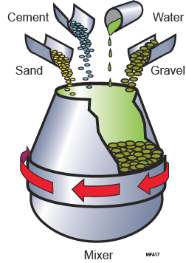
Step 3: Fact-finding – making concrete
Concrete is a mixture of sand, gravel (aggregate) and cement.
Strength depends on the cement / aggregate ratio. The mix designation C25 means that the concrete will attain a cube-compression strength of 25 MPa after 28 days.
the mix for C25 is 1 part cement, 2 parts sand and 4 parts gravel.

Slide 7
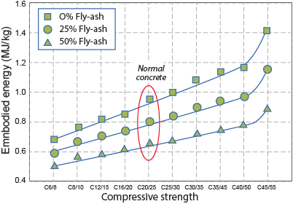
Step 3: Fact-finding – fly ash cement and CCS
Fly ash
Coal-fired power stations burn pulverized coal at about 1400 C.
Fly ash is the fine alumino-silicate particulate carried in the flue gases.
Collected by filtration with little additional demand for energy or emissions of carbon.
Embodied energy, concrete
Replacing up to half the Portland cement in concrete reduces embodied energy and carbon footprint by up to 30%.
Carbon footprint, concrete
Carbon capture and storage (CCS)
Current cost of CCS is about € 75 per tonne CO₂
Cement costs € 75 per tonne
CCS almost double price of cement
Data from the Eco-audit tool, Granta EduPack, Level 3 Sustainability

Slide 8
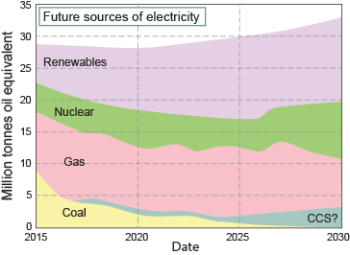
Step 4: Impact on the Three Capitals (overview)
Natural capital
Fly ash and blast furnace slag additions reduce the carbon footprint and price of cement with no loss of strength.
Both are diminishing resources. Stockpiles are sufficient for 20 year supply.
Fly ash additions a good short-term step for reducing carbon emissions..
Carbon capture and storage (CCS) a possible long-term solution
Social capital
Concrete is a material that brings many benefits to society (bridges, tunnels, roads)
Manufactured capital
Economics of fly ash addition are attractive
Large cost penalty of CCS unattractive to all
Health hazards: locally, cement dust; globally, contribution to climate change

Slide 9
Step 4: Impact on the Three Capitals (overview)
Natural capital
✓ Replacing Portland cement with fly ash reduces carbon emission.
✓ CCS reduces it further but with a considerable cost penalty.
Manufacture capital
✓ Fly ash additions give environmental gains with cost reduction
× Fly ash increases setting times
× CCS will increase cost significantly
Human and social capital
× Cement dust is a health hazard
✓ Construction with concrete brings great social benefits.

Slide 10
Step 5: Reflection
Short term – 4 years
Fly ash additions a good short term step but not a long-term solution
Long term – 30 years
Carbon capture and storage
Alternative materials – MgO based cements?
Alternative strategies
Reuse rather than rebuilding of concrete-based structures

